Slide 2
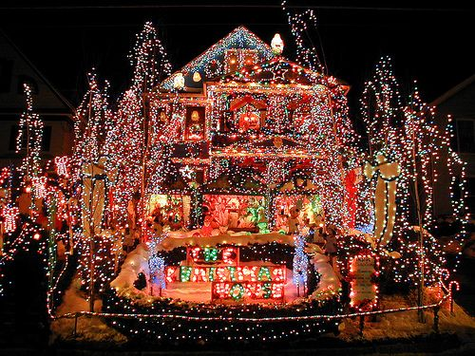

Slide 3
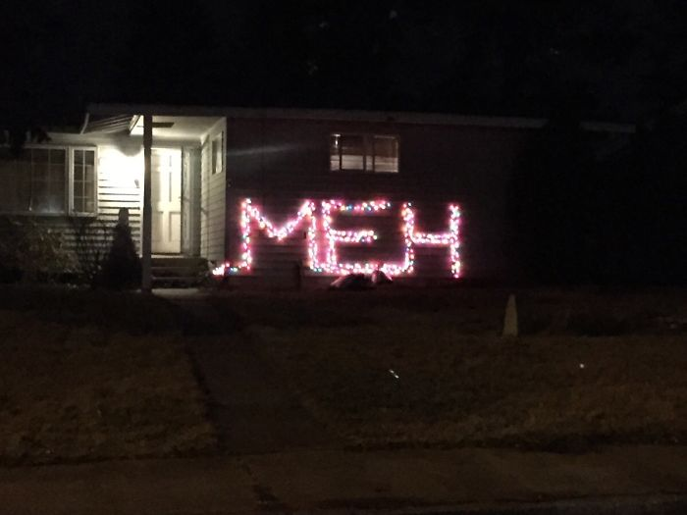

Slide 4
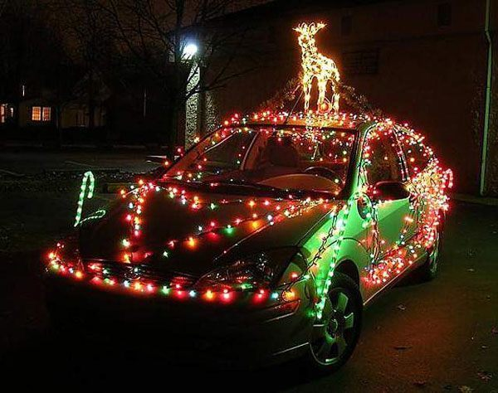

Slide 5
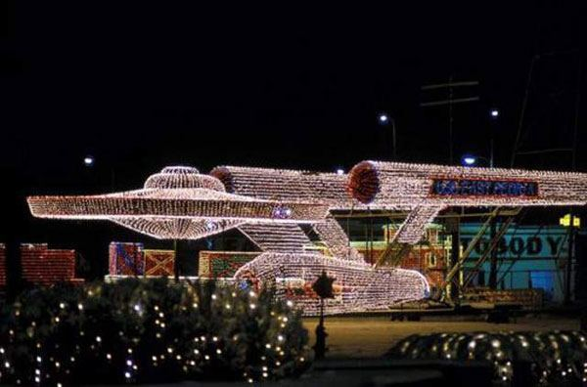

Slide 6
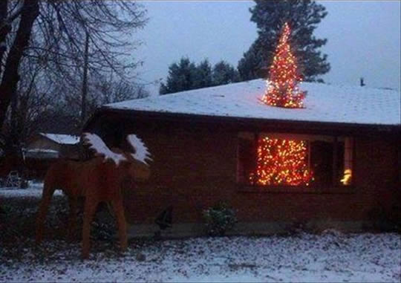

Slide 7
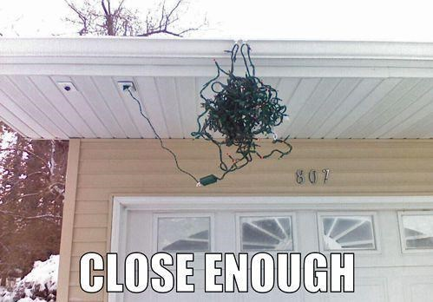

Slide 9
The term is over: the holidays have begun. The dream is ended: this is the morning…for them it was only the beginning of the real story.

Slide 10
All their life in this world and all their adventures in Narnia had only been the cover and the title page:

Slide 11
Now at last they were beginning Chapter One of the Great Story which no one on earth has read: which goes on for ever: in which every chapter is better than the one before.

Slide 13
This is what Isaiah son of Amoz saw concerning Judah and Jerusalem:
In the last days
the mountain of the Lord’s temple will be established
as the highest of the mountains;

Slide 14
it will be exalted above the hills,
and all nations will stream to it.

Slide 15
Many peoples will come and say,
“Come, let us go up to the mountain of the Lord,
to the temple of the God of Jacob.
He will teach us his ways,
so that we may walk in his paths.”

Slide 16
The law will go out from Zion,
the word of the Lord from Jerusalem.
He will judge between the nations
and will settle disputes for many peoples.

Slide 17
They will beat their swords into ploughshares
and their spears into pruning hooks.
Nation will not take up sword against nation,
nor will they train for war anymore.

Slide 18
Come, descendants of Jacob,
let us walk in the light of the Lord.
Isaiah 1:1-5

Slide 20
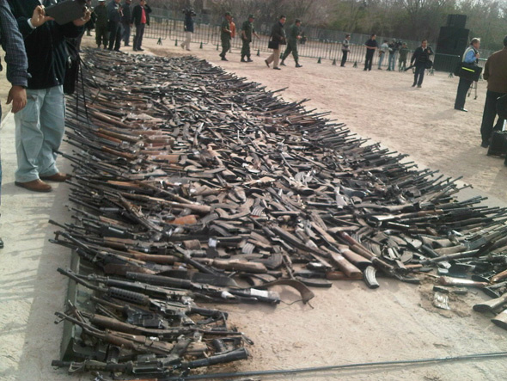

Slide 21


Slide 22
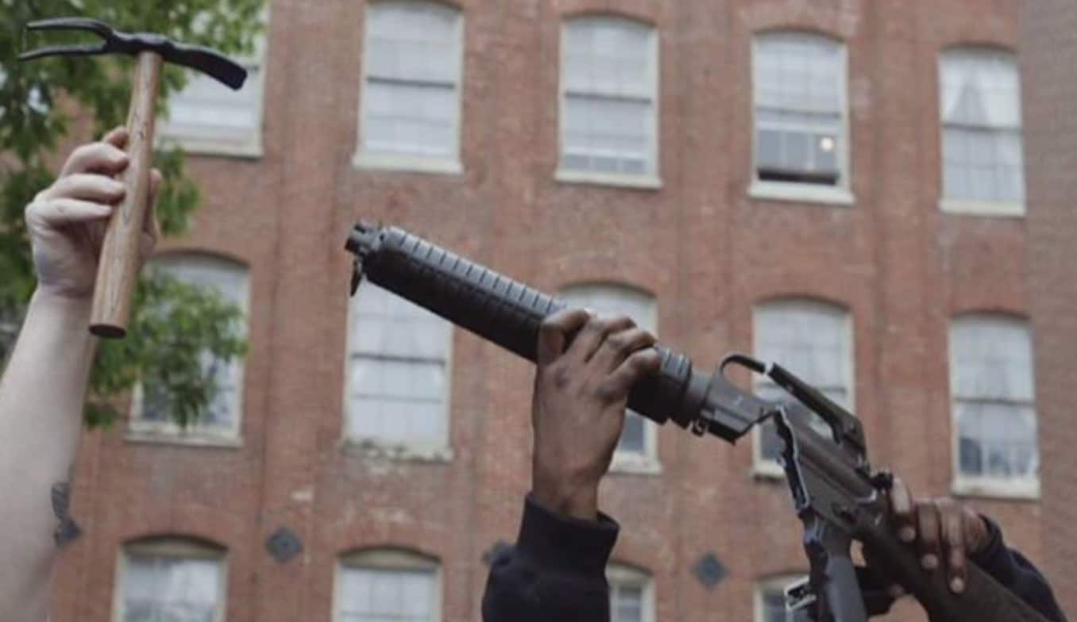

Slide 23
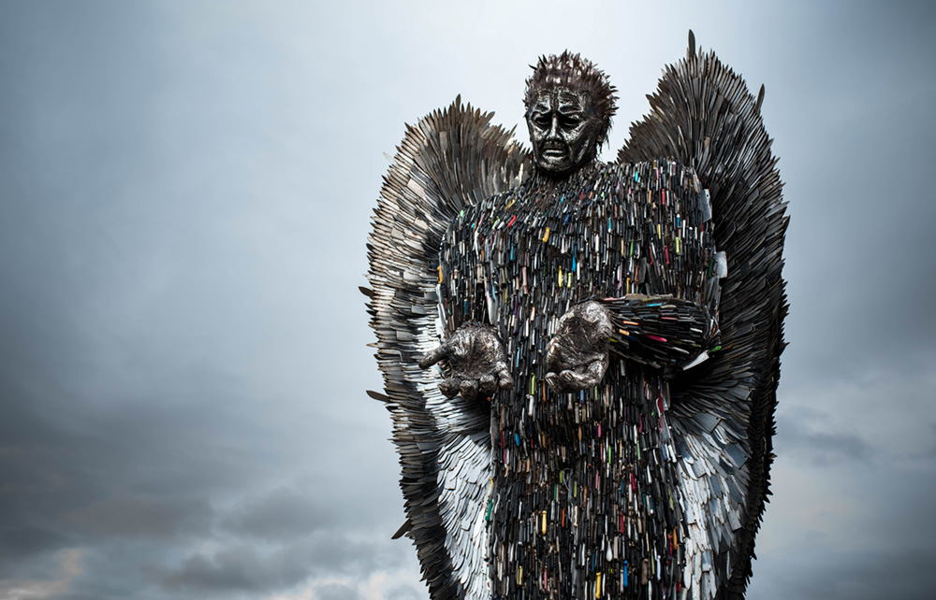

Slide 25
Nations will bring to Jerusalem their desire and hunger, need and hurt, greed and grievance,

Slide 26
and submit them to the authority of the One who is able to make peace, bridge division, and resolve conflict.
Anathea Portier-Young

Slide 28
The vision concerning Judah and Jerusalem that Isaiah son of Amoz saw. Isaiah 1:1

Slide 29
This is what Isaiah son of Amoz saw concerning Judah and Jerusalem. Isaiah 2:1

Slide 31
We are therefore Christ’s ambassadors, as though God were making his appeal through us. We implore you on Christ’s behalf: Be reconciled to God. 2 Corinthians 5:20

Slide 33
A day when glory outshines shadow, when joy extinguishes sorrow, when peace silences violence, when rebellion cedes to obedience- when faith becomes sight. Michael J Chan

