Slide 1
Built to worship

Slide 2
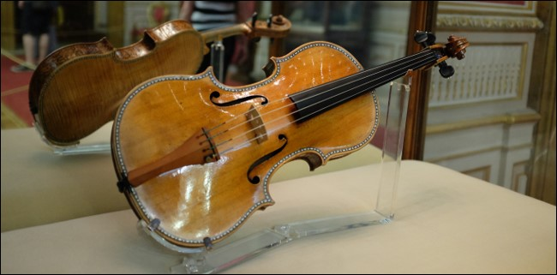

Slide 4
Adam and Eve joined in the song of the stars and the streams and the wind in the trees, the wonderful song of love to the One who made them. Their hearts were filled with happiness.

Slide 5
And nothing ever made them sad or lonely or sick or afraid.
God looked at everything He had made. ‘Perfect!’ He said. And it was.

Slide 7
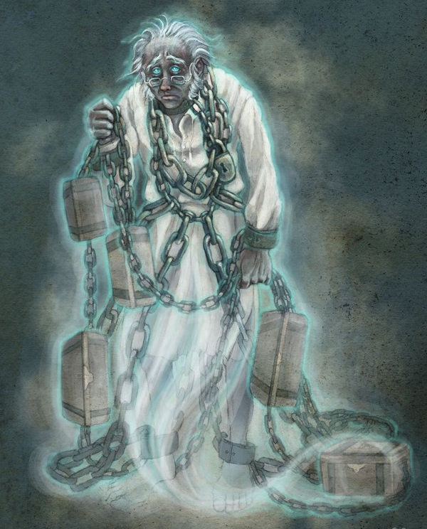

Slide 9
Now the serpent was more crafty than any of the wild animals the Lord God had made. He said to the woman, “Did God really say, ‘You must not eat from any tree in the garden’?”

Slide 10
The woman said to the serpent, “We may eat fruit from the trees in the garden, but God did say, ‘You must not eat fruit from the tree that is in the middle of the garden, and you must not touch it, or you will die.’”

Slide 11
“You will not certainly die,” the serpent said to the woman. “For God knows that when you eat from it your eyes will be opened, and you will be like God, knowing good and evil.”

Slide 12
When the woman saw that the fruit of the tree was good for food and pleasing to the eye, and also desirable for gaining wisdom, she took some and ate it. She also gave some to her husband, who was with her, and he ate it.

Slide 13
Then the eyes of both of them were opened, and they realized they were naked; so they sewed fig leaves together and made coverings for themselves.

Slide 14
Then the man and his wife heard the sound of the Lord God as he was walking in the garden in the cool of the day, and they hid from the Lord God among the trees of the garden.

Slide 15
But the Lord God called to the man, “Where are you?”
Genesis 1:3-9

Slide 16
Then I saw “a new heaven and a new earth,” for the first heaven and the first earth had passed away, and there was no longer any sea.

Slide 17
I saw the Holy City, the new Jerusalem, coming down out of heaven from God, prepared as a bride beautifully dressed for her husband.

Slide 18
And I heard a loud voice from the throne saying, “Look! God’s dwelling place is now among the people, and he will dwell with them. They will be his people, and God himself will be with them and be their God.

Slide 19
‘He will wipe every tear from their eyes. There will be no more death’ or mourning or crying or pain, for the old order of things has passed away.”

Slide 20
He who was seated on the throne said, “I am making everything new!” Then he said, “Write this down, for these words are trustworthy and true.”

Slide 21
He said to me: “It is done. I am the Alpha and the Omega, the Beginning and the End.
Revelation 21:1-6

Slide 23
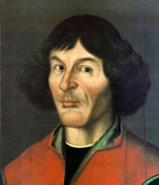

Slide 25
If the Son sets you free, you will be free indeed. John 8:36

Slide 27
God’s dwelling place is now among the people, and He will dwell with them. They will be His people, and God Himself will be with them and be their God.
Revelation 21:3

Slide 28
Built to worship

