Slide 2
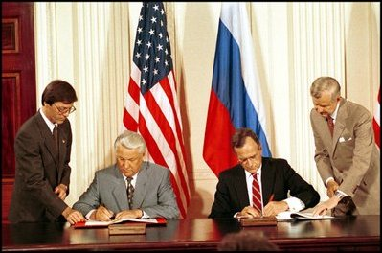

Slide 4
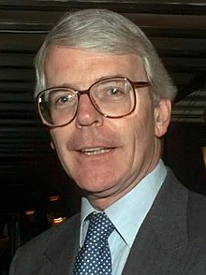

Slide 5
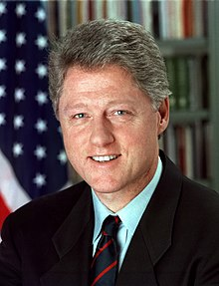

Slide 6
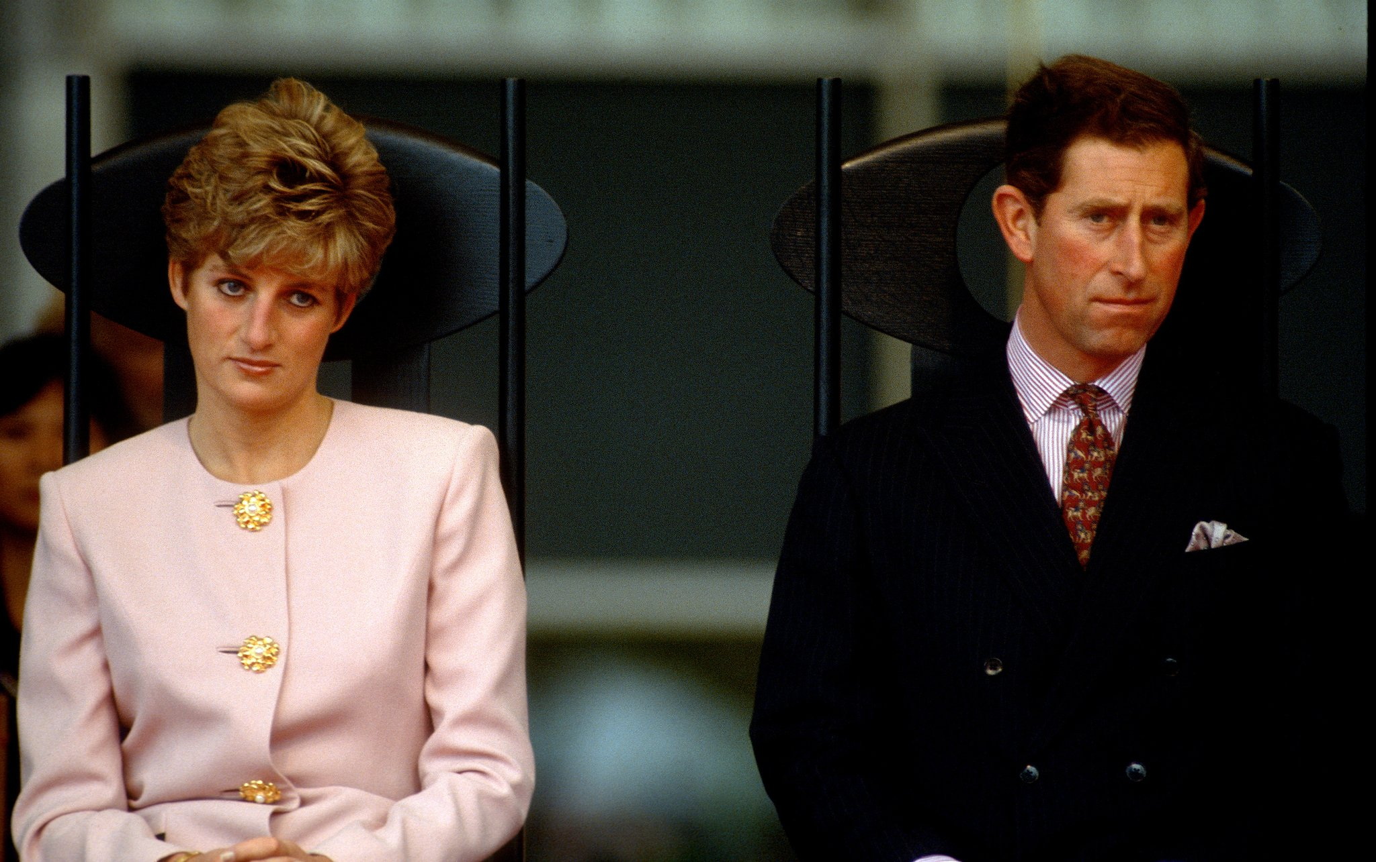

Slide 7
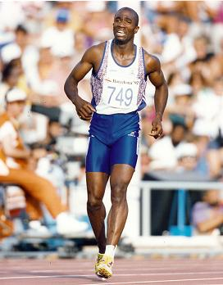

Slide 8
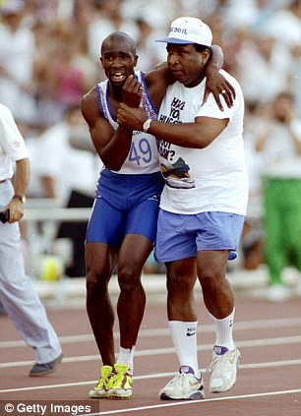

Slide 10
The virgin will conceive and give birth to a son and they will call Him ‘Immanuel’ (which means ‘God with us.’)

Slide 11
Where two or three gather in my name, there am I with them.

Slide 13
Then the eleven disciples went to Galilee, to the mountain where Jesus had told them to go. When they saw him, they worshiped him; but some doubted.

Slide 14
Then Jesus came to them and said, “All authority in heaven and on earth has been given to me. Therefore go and make disciples of all nations,

Slide 15
baptising them in the name of the Father and of the Son and of the Holy Spirit, and teaching them to obey everything I have commanded you.

Slide 16
And surely I am with you always, to the very end of the age.”
Matthew 28:16-20

Slide 18
Oh the depths of the riches of the wisdom and knowledge of God! How unsearchable His judgments, and His paths beyond tracing out!

Slide 19
Who has known the mind of the Lord? Or who has been His counselor? Who has ever given to God that God should repay them?

Slide 20
For from Him and through Him and for Him are all things. To Him be the glory forever! Amen.
Romans 11:33-36

Slide 22
I am with you day-in day-out until the close of the age.

Slide 24
Man shall not live on bread along, but on every word that comes from the mouth of God.
Matthew 4:4

Slide 26
The primary way to define sin is not just the doing of bad things, but the making of good things into ultimate things.
Tim Keller

Slide 28
The Spirit and the Bride say ‘Come!’ Revelation 22:17

