Slide 1
Built to worship

Slide 2
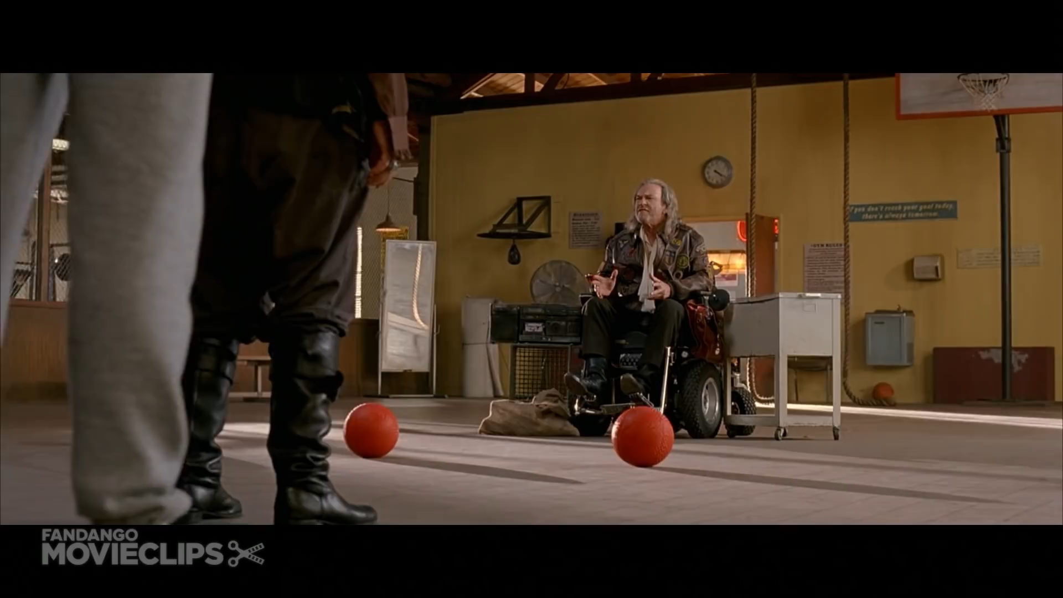

Slide 4
Disappointment with God is one of the unmentionables in the Christian community. There are some things you don’t say out loud.

Slide 5
It’s like family problems that some folks prefer to sweep under the rug.
Rick Thomas

Slide 7
The Lord is compassionate and gracious,
slow to anger, abounding in love.

Slide 8
He will not always accuse,
nor will he harbour his anger forever;

Slide 9
he does not treat us as our sins deserve
or repay us according to our iniquities.

Slide 10
For as high as the heavens are above the earth,
so great is his love for those who fear him;

Slide 11
as far as the east is from the west,
so far has he removed our transgressions from us.

Slide 12
As a father has compassion on his children,
so the Lord has compassion on those who fear him;

Slide 13
for he knows how we are formed,
he remembers that we are dust.
Psalm 103:8-14

Slide 15
Disappointment is not a sin. If anything, it is a sign that we were made for a perfect world. Laura Rieck

Slide 17
We know that in all things God works for the good of those who love him, who have been called according to his purpose. Romans 8:28

Slide 19
You can say anything to God. Throw at him your grief, your anger, your doubt, your bitterness, your betrayal, your disappointment- he can absorb them all.

Slide 20
As often as not, spiritual giants of the Bible are shown contending with God. They prefer to go away limping, like Jacob, rather than to shut God out.
Philip Yancey

Slide 22
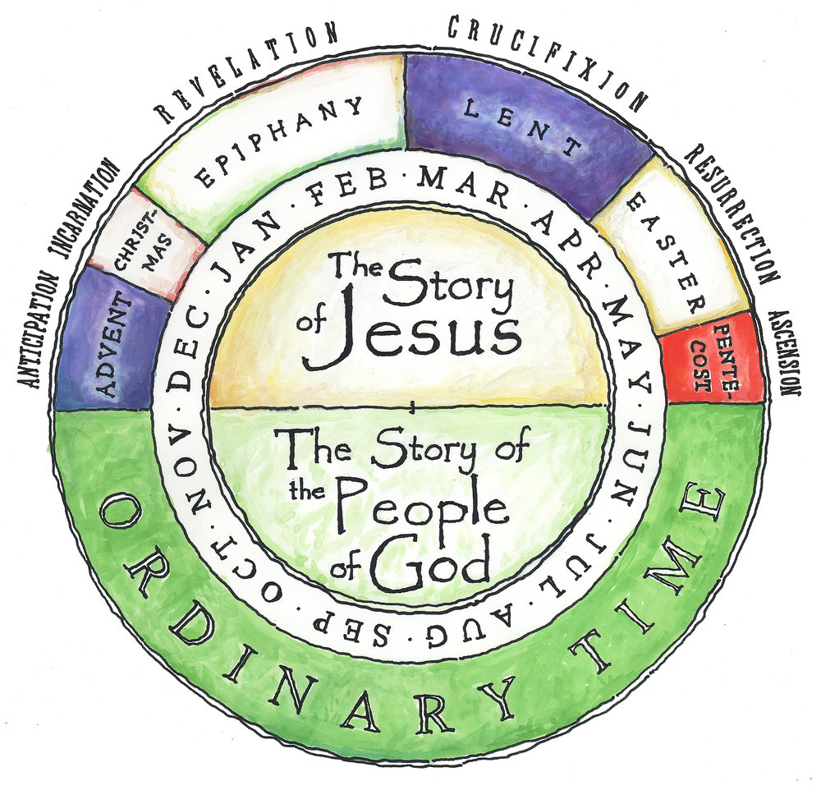

Slide 24
I’m learning that feeling the disappointment and choosing to trust God’s goodness don’t have to be contradictions.

Slide 25
Both are possible, and both come to me as invitations from God and opportunities to draw closer to Him.

Slide 26
Those truths raise in me something that feels like hope. Lisa Rieck

Slide 28
Weeping may stay for the night,
But rejoicing comes in the morning.
Psalm 30:5

Slide 29
Built to worship

