Slide 1
Built to worship

Slide 2
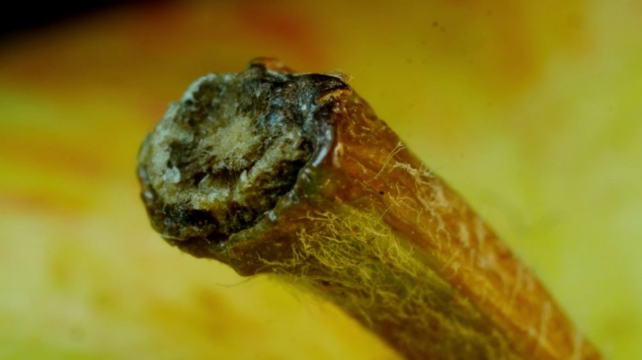

Slide 3
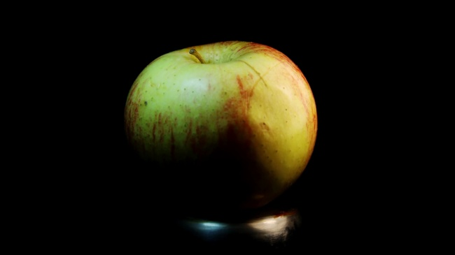

Slide 4
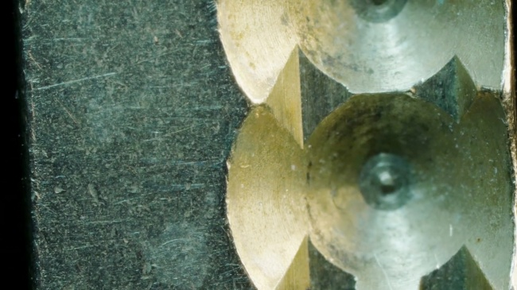

Slide 5
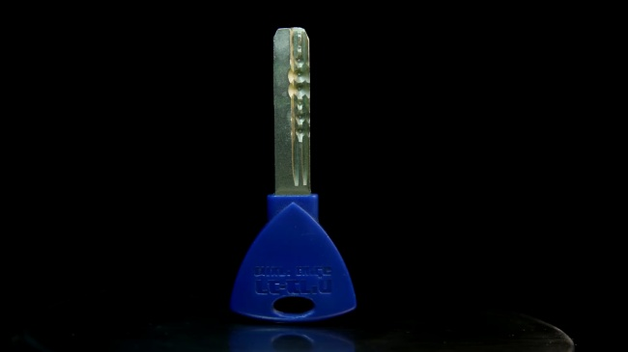

Slide 6
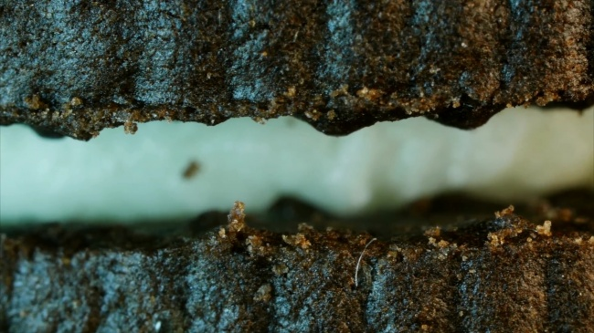

Slide 7
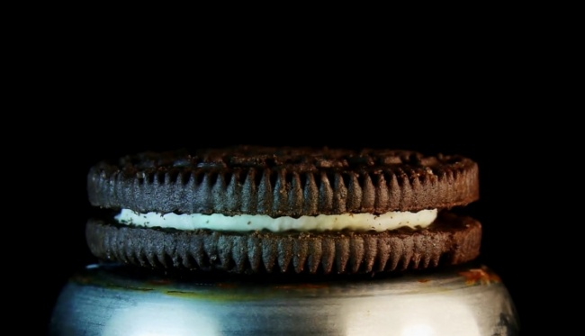

Slide 8
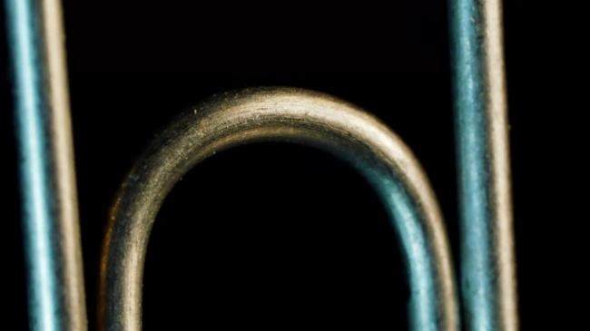

Slide 9
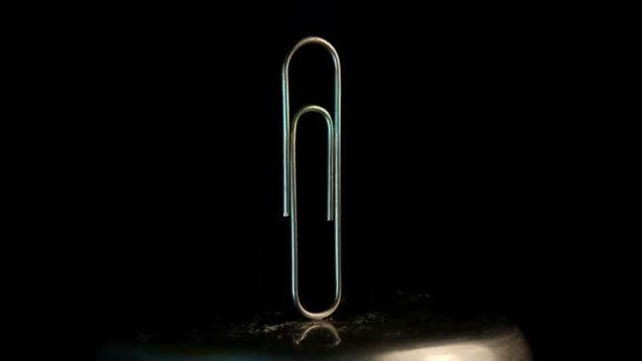

Slide 10
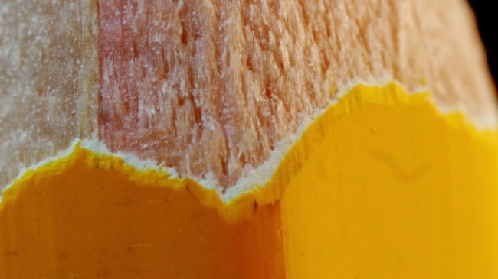

Slide 11


Slide 12
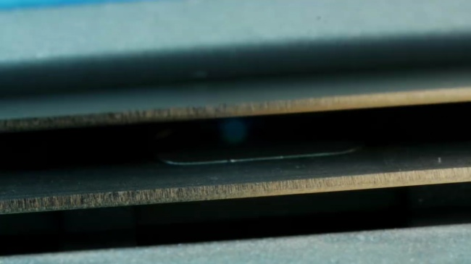

Slide 13
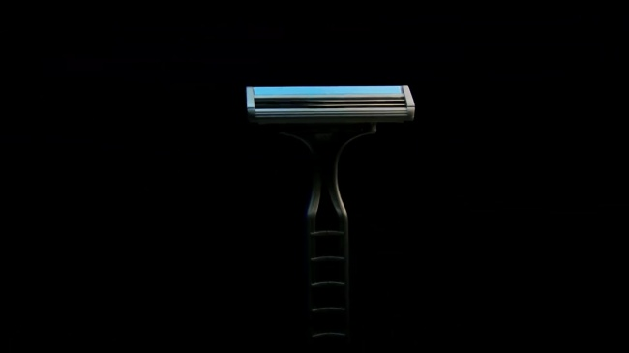

Slide 14
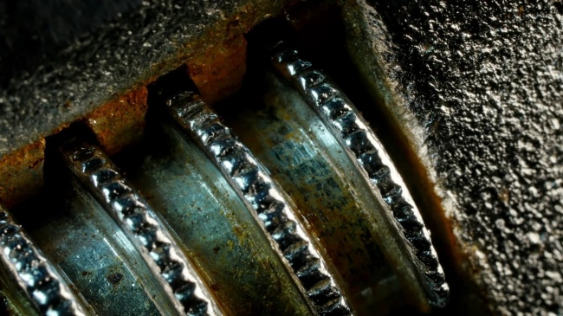

Slide 15
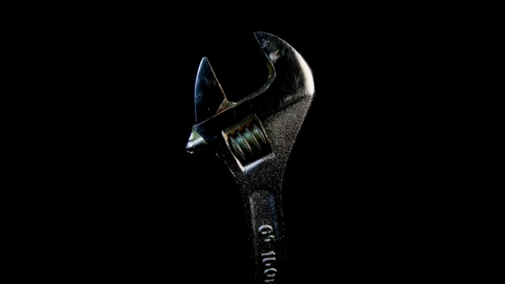

Slide 16
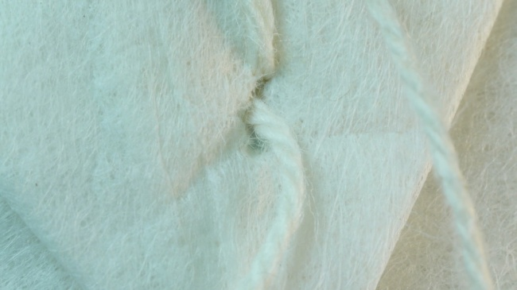

Slide 17
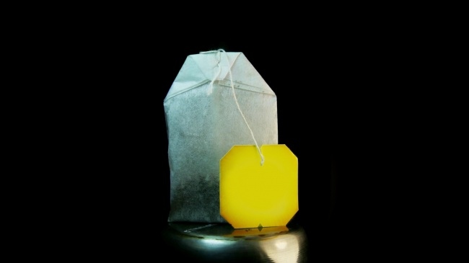

Slide 18
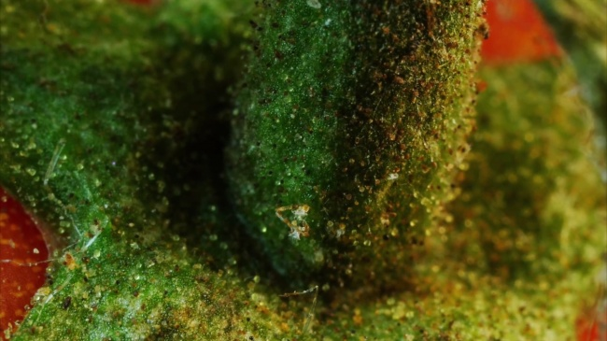

Slide 19
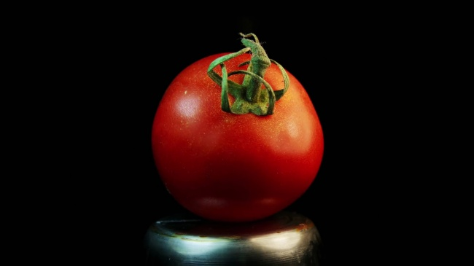

Slide 20
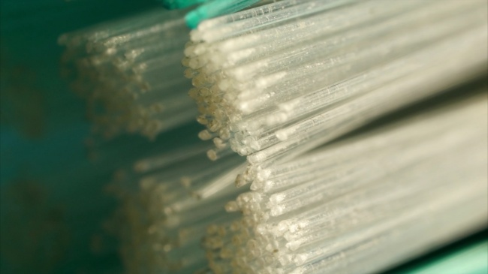

Slide 21
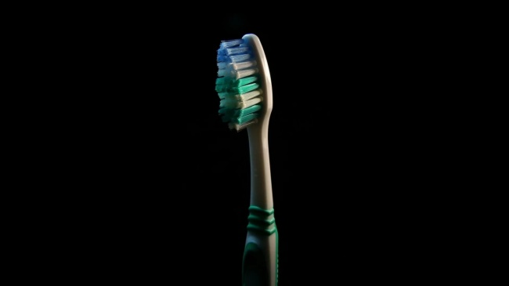

Slide 23
The writer will not let the readers’ imaginations remain impoverished with a Christ who is too small.
CR Koester

Slide 25
In the past God spoke to our ancestors through the prophets at many times and in various ways, but in these last days he has spoken to us by his Son,

Slide 26
whom he appointed heir of all things, and through whom also he made the universe.

Slide 27
The Son is the radiance of God’s glory and the exact representation of his being, sustaining all things by his powerful word.

Slide 28
After he had provided purification for sins, he sat down at the right hand of the Majesty in heaven.

Slide 29
So he became as much superior to the angels as the name he has inherited is superior to theirs. Hebrews 1:1-4

Slide 31
Built to worship

