Slide 1
Built to worship

Slide 2


Slide 3
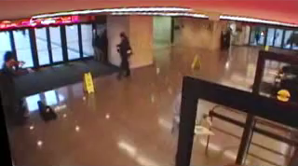

Slide 5
To worship that which is not God is to fall in love with death.
NT Wright

Slide 7
The wrath of God is being revealed from heaven against all the godlessness and wickedness of people, who suppress the truth by their wickedness,

Slide 8
since what may be known about God is plain to them, because God has made it plain to them.

Slide 9
For since the creation of the world God’s invisible qualities—his eternal power and divine nature—have been clearly seen, being understood from what has been made, so that people are without excuse.

Slide 10
For although they knew God, they neither glorified him as God nor gave thanks to him, but their thinking became futile and their foolish hearts were darkened.

Slide 11
Although they claimed to be wise, they became fools and exchanged the glory of the immortal God for images made to look like a mortal human being and birds and animals and reptiles.

Slide 12
Therefore God gave them over in the sinful desires of their hearts to sexual impurity for the degrading of their bodies with one another.

Slide 13
They exchanged the truth about God for a lie, and worshiped and served created things rather than the Creator—who is forever praised. Amen.
Romans 1:18-25

Slide 15
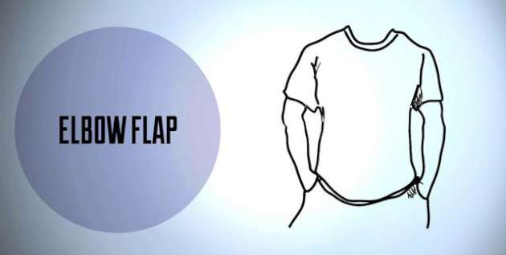

Slide 16
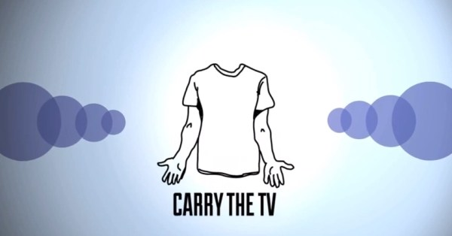

Slide 17
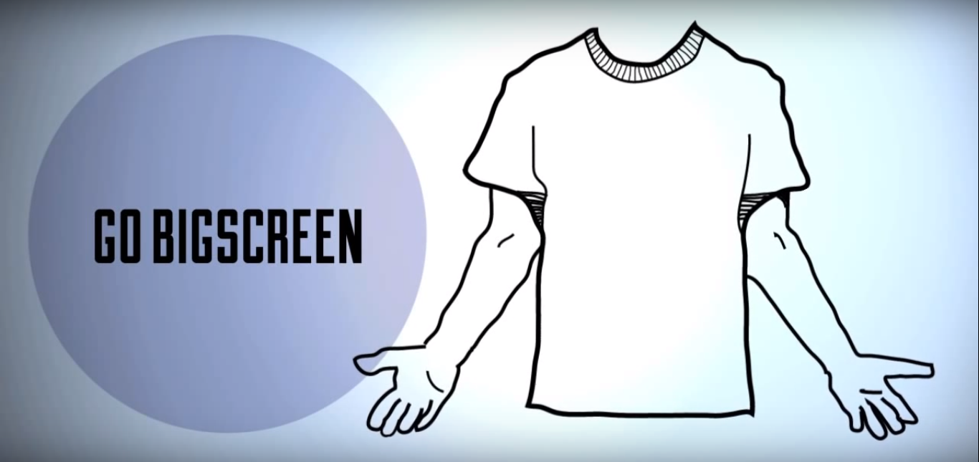

Slide 18
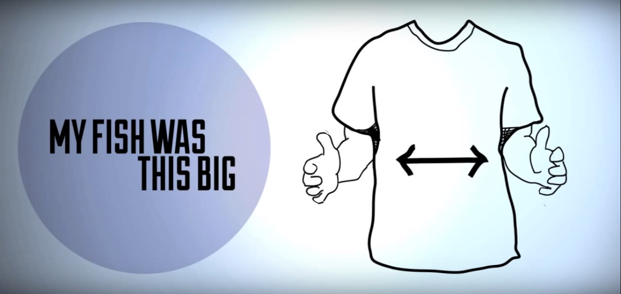

Slide 19
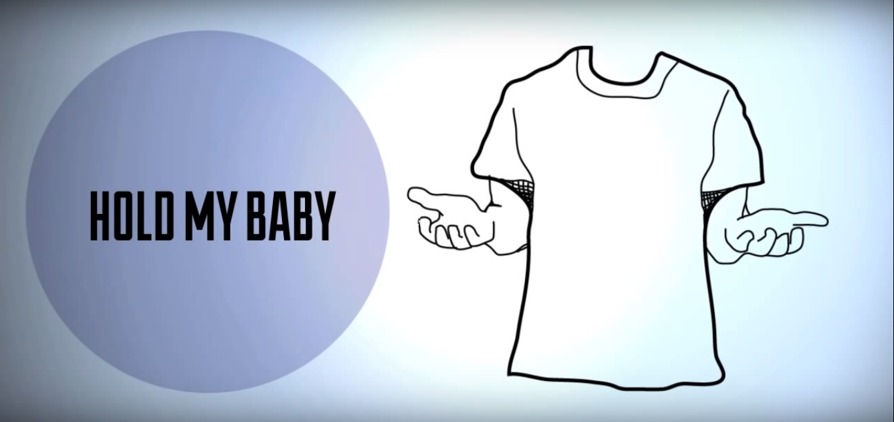

Slide 20
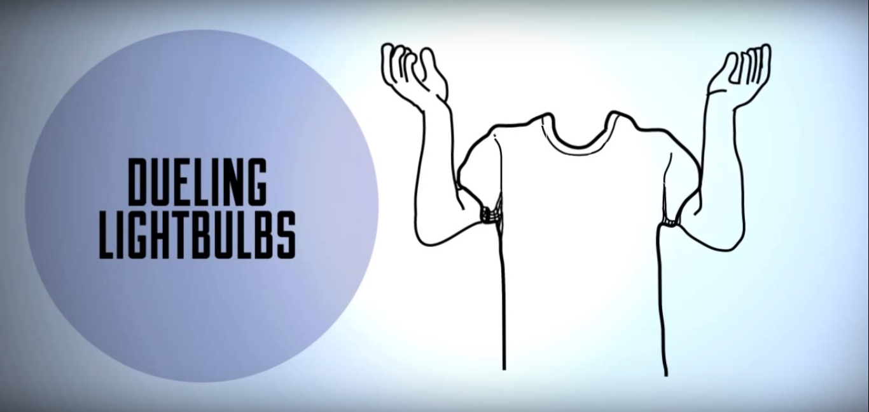

Slide 21
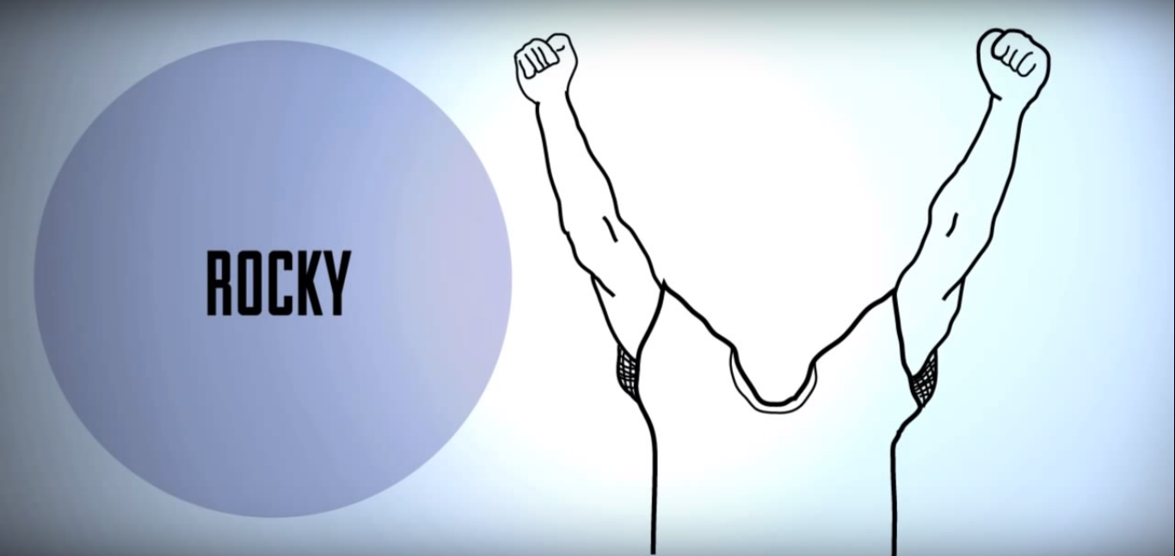

Slide 22
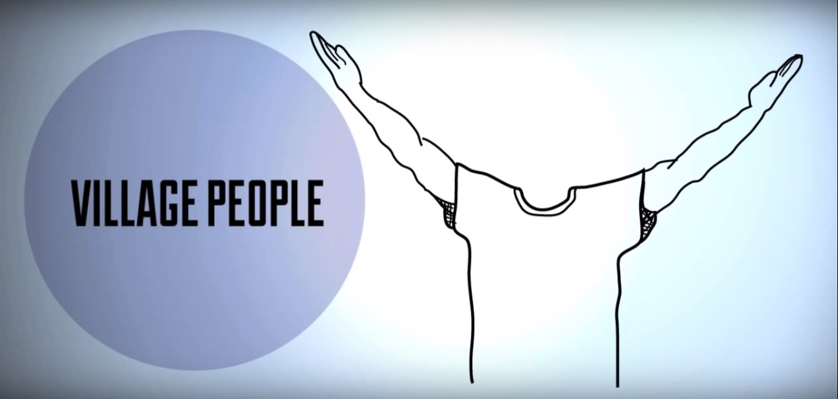

Slide 24
For since the creation of the world God’s invisible qualities—his eternal power and divine nature—have been clearly seen, being understood from what has been made.
Romans 1:20

Slide 26
The heavens proclaim the glory of God.
The skies display his craftsmanship.
Day after day they continue to speak;
night after night they make him known.

Slide 27
They speak without a sound or word;
their voice is never heard.
Yet their message has gone throughout the earth,
and their words to all the world.
Psalm 19:1-4

Slide 29
Creation exists as an invitation to dialogue with God. WM Greathouse

Slide 31
When God looks at sin, what He sees is what a violin maker would see if the player were to use his lovely creation as a tennis racquet. NT Wright

Slide 33
Hate opposes love; wrath is the form love takes with those who oppose it. Hate is unjust; wrath is just. Hate seeks to destroy; wrath forgives. BH Throckmorton, Jr

