Slide 1
Let me tell you a story…

Slide 2
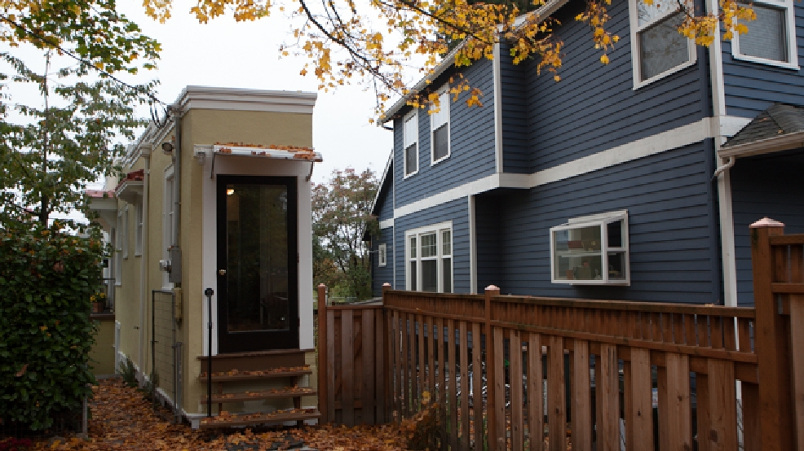

Slide 3
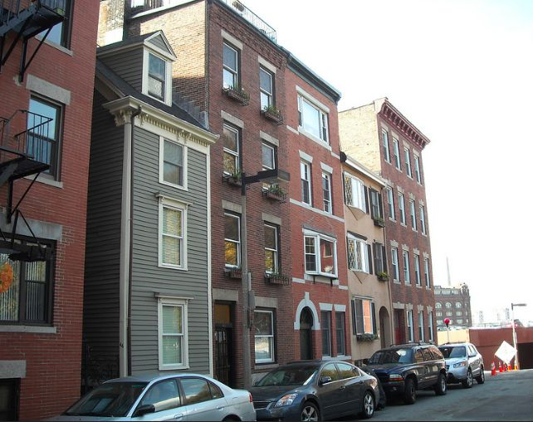

Slide 5
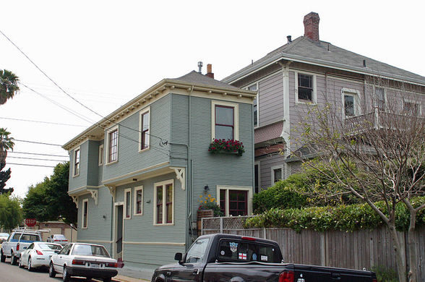

Slide 7
“Not everyone who says to me, ‘Lord, Lord,’ will enter the kingdom of heaven, but only the one who does the will of my Father who is in heaven.

Slide 8
Many will say to me on that day, ‘Lord, Lord, did we not prophesy in your name and in your name drive out demons and in your name perform many miracles?’

Slide 9
Then I will tell them plainly, ‘I never knew you. Away from me, you evildoers!’

Slide 10
“Therefore everyone who hears these words of mine and puts them into practice is like a wise man who built his house on the rock.

Slide 11
The rain came down, the streams rose, and the winds blew and beat against that house; yet it did not fall, because it had its foundation on the rock.

Slide 12
But everyone who hears these words of mine and does not put them into practice is like a foolish man who built his house on sand.

Slide 13
The rain came down, the streams rose, and the winds blew and beat against that house, and it fell with a great crash.”
Matthew 7:21-28

Slide 15
Among its marvels is the greatest and most complete conceivable eucatastrophe.

Slide 16
The Birth of Christ is the eucatastrophe of Man's history. The Resurrection is the eucatastrophe of the story of the Incarnation. JRR Tolkien

Slide 18
I have come to regard with some suspicion those who claim that the Bible never troubles them.

Slide 19
I can only assume this means they haven't actually read it. Rachel Held Evans

Slide 21
Love the Lord your God with all your heart and with all your soul and with all your mind and with all your strength.
Mark 12:30

Slide 23
Don’t fool yourself into thinking that you are a listener when you are anything but, letting the Word go in one ear and out the other. Act on what you hear!

Slide 24
Those who hear and don’t act are like those who glance in the mirror, walk away,

Slide 25
and two minutes later have no idea who they are, what they look like. James 1:22-24

Slide 27
Whoever looks intently into the perfect law that gives freedom, and continues in it-

Slide 28
not forgetting what they have heard, but doing it- they will be blessed in what they do. James 1:25

