Slide 2
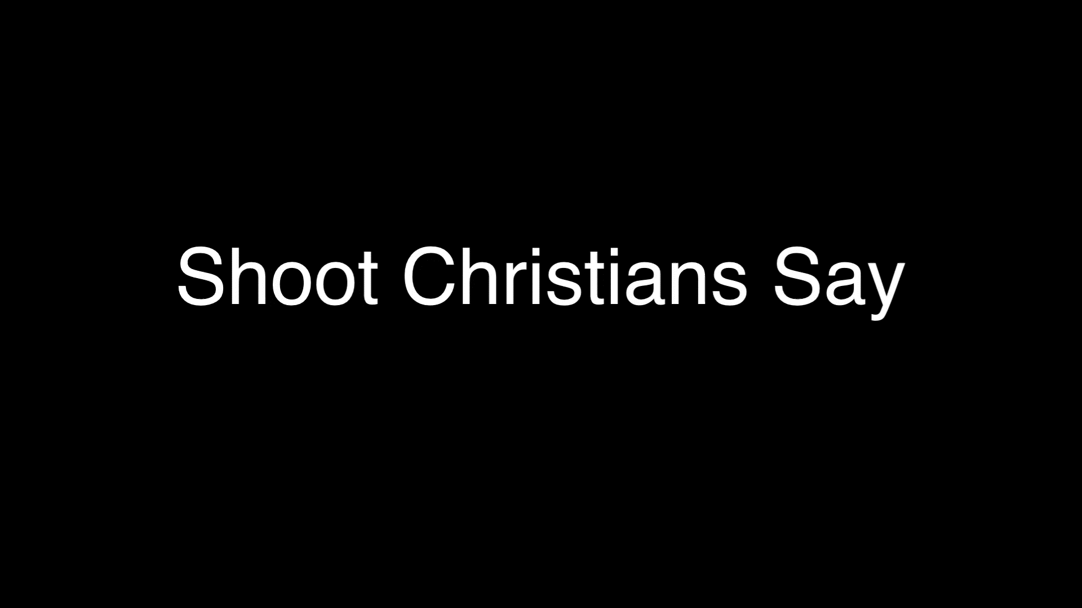

Slide 4
I always thank my God as I remember you in my prayers, because I hear about your love for all his holy people and your faith in the Lord Jesus.

Slide 5
I pray that your partnership with us in the faith may be effective in deepening your understanding of every good thing we share for the sake of Christ.

Slide 6
Your love has given me great joy and encouragement, because you, brother, have refreshed the hearts of the Lord’s people.

Slide 7
Therefore, although in Christ I could be bold and order you to do what you ought to do, yet I prefer to appeal to you on the basis of love.

Slide 8
It is as none other than Paul—an old man and now also a prisoner of Christ Jesus- that I appeal to you for my son Onesimus, who became my son while I was in chains.

Slide 9
Formerly he was useless to you, but now he has become useful both to you and to me. I am sending him—who is my very heart—back to you.

Slide 10
I would have liked to keep him with me so that he could take your place in helping me while I am in chains for the gospel.

Slide 11
But I did not want to do anything without your consent, so that any favour you do would not seem forced but would be voluntary.

Slide 12
Perhaps the reason he was separated from you for a little while was that you might have him back forever- no longer as a slave, but better than a slave, as a dear brother.

Slide 13
He is very dear to me but even dearer to you, both as a fellow man and as a brother in the Lord. So if you consider me a partner, welcome him as you would welcome me.

Slide 14
If he has done you any wrong or owes you anything, charge it to me. I, Paul, am writing this with my own hand. I will pay it back—not to mention that you owe me your very self.

Slide 15
I do wish, brother, that I may have some benefit from you in the Lord; refresh my heart in Christ.

Slide 16
Confident of your obedience, I write to you, knowing that you will do even more than I ask.
Philemon 4-21

Slide 18
Not to mention that you owe me your very self.
Philemon 19

Slide 20
O perfect redemption, the purchase of blood,
To every believer the promise of God;

Slide 21
The vilest offender who truly believes,
That moment from Jesus a pardon receives.

Slide 23
Have mercy on me, O God,
according to your unfailing love;
according to your great compassion
blot out my transgressions.

Slide 24
Wash away all my iniquity
and cleanse me from my sin.
Psalm 51:1-2

