Slide 1
Built to worship

Slide 2
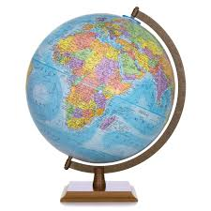
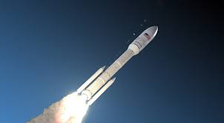
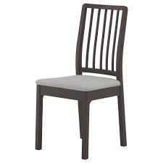
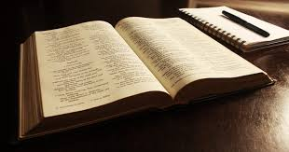
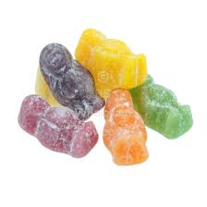
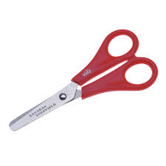
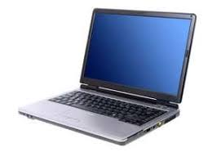
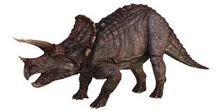
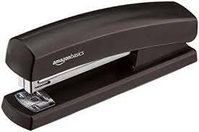
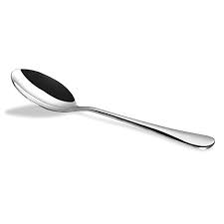
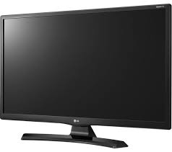
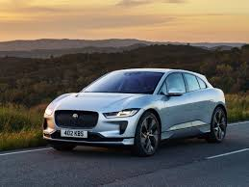
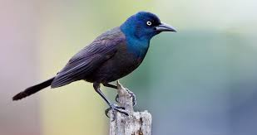
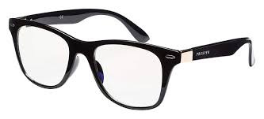

Slide 4
The song of a full heart.
WT Purkiser

Slide 5
Scarcely any other part of the Old Testament lets us perceive the truth ‘God is love’ so intimately as Psalm 103.
Heinrich Herkenne

Slide 7
Praise the Lord, my soul;
all my inmost being, praise his holy name.
Praise the Lord, my soul,
and forget not all his benefits—

Slide 8
who forgives all your sins
and heals all your diseases,
who redeems your life from the pit
and crowns you with love and compassion,

Slide 9
who satisfies your desires with good things
so that your youth is renewed like the eagle’s.
The Lord works righteousness
and justice for all the oppressed.

Slide 10
He made known his ways to Moses,
his deeds to the people of Israel:
The Lord is compassionate and gracious,
slow to anger, abounding in love.

Slide 11
He will not always accuse,
nor will he harbour his anger forever;
he does not treat us as our sins deserve
or repay us according to our iniquities.

Slide 12
For as high as the heavens are above the earth,
so great is his love for those who fear him;
as far as the east is from the west,
so far has he removed our transgressions from us.

Slide 13
As a father has compassion on his children,
so the Lord has compassion on those who fear him;
for he knows how we are formed,
he remembers that we are dust.

Slide 14
The life of mortals is like grass,
they flourish like a flower of the field;
the wind blows over it and it is gone,
and its place remembers it no more.

Slide 15
But from everlasting to everlasting
the Lord’s love is with those who fear him,
and his righteousness with their children’s children—
with those who keep his covenant
and remember to obey his precepts.

Slide 16
The Lord has established his throne in heaven,
and his kingdom rules over all.

Slide 17
Praise the Lord, you his angels,
you mighty ones who do his bidding,
who obey his word.
Praise the Lord, all his heavenly hosts,
you his servants who do his will.

Slide 18
Praise the Lord, all his works
everywhere in his dominion.
Praise the Lord, my soul.
Psalm 103

Slide 20
Be careful that you do not forget the LORD, who brought you out of Egypt, out of the land of slavery…

Slide 21
…watch yourselves closely so that you do not forget the things your eyes have seen or let them fade from your heart…

Slide 22
Be careful not to forget the covenant of the LORD your God that He made with you…
Deuteronomy 6:12, 4:9, 23

Slide 24
O my soul, bless God.
From head to toe, I’ll bless his holy name!
O my soul, bless God,
don’t forget a single blessing!

Slide 25
He forgives your sins—every one.
He heals your diseases—every one.
He redeems you from hell—saves your life!

Slide 26
He crowns you with love and mercy—a paradise crown.
He wraps you in goodness—beauty eternal.
He renews your youth—you’re always young in his presence.
Psalm 103:1-5

Slide 28
Yet you are enthroned as the Holy One;
you are the one Israel praises.
In you our ancestors put their trust;

Slide 29
they trusted and you delivered them.
To you they cried out and were saved;
in you they trusted and were not put to shame.
Psalm 22:3-5

Slide 31
Your sicknesses shall all be healed, doubt it not. They are great, you will say; but the Physician is greater.
Augustine

Slide 33
He knit us together- Psalm 139:13
He has known us- Jeremiah 1:5
He works all things for our good- Romans 8:28
He has numbered the hairs on our head- Luke 12:7

Slide 34
He supplies our need- Philippians 4:19
He loved us when we were unlovable- 1 John 4:10
He moved into our neighbourhood- John 1:14
While we were yet sinners, Christ died for us- Romans 5:8

Slide 35
He triumphed over every foe- Colossians 2:15
He will be with us- Matthew 28:20
He carved our name on His hand- Isaiah 49:16
He has given us the Advocate- John 14:26

Slide 36
He will resource us- 1 Corinthians 12:7
He has sanctified us- 1 Corinthians 1:2
He is coming soon- Revelation 22:7

