Slide 1
Community
Bible
Experience

Slide 2
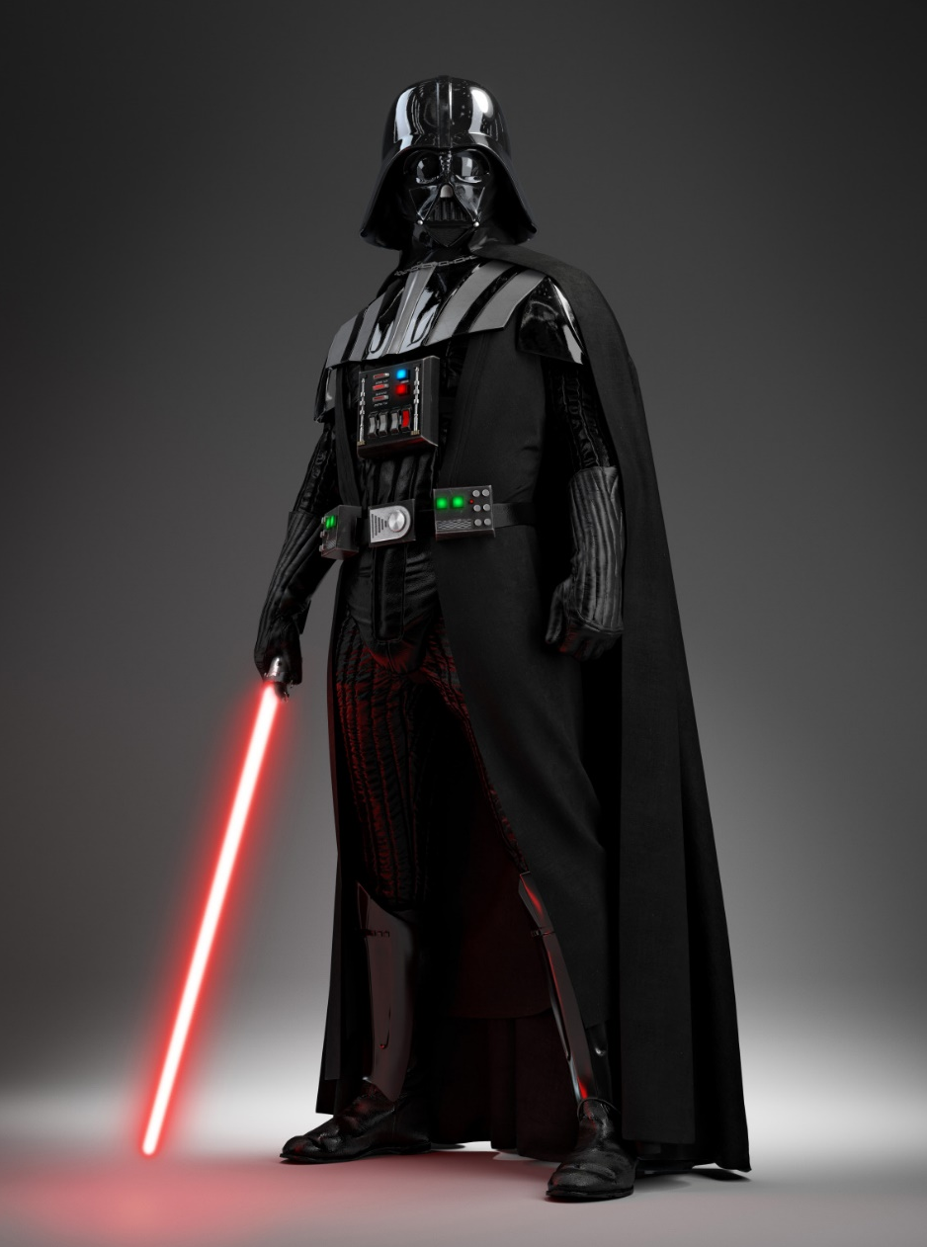

Slide 4
Meanwhile, Saul was still breathing out murderous threats against the Lord’s disciples.

Slide 5
Meanwhile, Saul was still breathing out murderous threats against the Lord’s disciples.

Slide 6
He went to the high priest and asked him for letters to the synagogues in Damascus, so that if he found any there who belonged to the Way, whether men or women, he might take them as prisoners
to Jerusalem.

Slide 7
As he neared Damascus on his journey, suddenly a light from heaven flashed around him. He fell to the ground and heard a voice say to him, “Saul, Saul, why do you persecute me?”

Slide 8
“Who are you, Lord?” Saul asked. “I am Jesus, whom you are persecuting,” he replied. “Now get up and go into the city, and you will be told what you must do.”

Slide 9
The men traveling with Saul stood there speechless; they heard the sound but did not see anyone. Saul got up from the ground, but when he opened his eyes he could see nothing.

Slide 10
So they led him by the hand into Damascus. For three days he was blind, and did not eat or drink anything. In Damascus there was a disciple named Ananias. The Lord called to him in a vision, “Ananias!”

Slide 11
“Yes, Lord,” he answered. The Lord told him, “Go to the house of Judas on Straight Street and ask for a man from Tarsus named Saul, for he is praying.

Slide 12
In a vision he has seen a man named Ananias come and place his hands on him to restore his sight.”

Slide 13
“Lord,” Ananias answered, “I have heard many reports about this man and all the harm he has done to your holy people in Jerusalem.

Slide 14
And he has come here with authority from the chief priests to arrest all who call on your name.” But the Lord said to Ananias, “Go!

Slide 15
This man is my chosen instrument to proclaim my name to the Gentiles and their kings and to the people of Israel. I will show him how much he must suffer for my name.”

Slide 16
Then Ananias went to the house and entered it. Placing his hands on Saul, he said,

Slide 17
“Brother Saul, the Lord—Jesus, who appeared to you on the road as you were coming here—has sent me so that you may see again and be filled with the Holy Spirit.”

Slide 18
Immediately, something like scales fell from Saul’s eyes, and he could see again. He got up and was baptised, and after taking some food, he regained his strength. Acts 9:1-19

Slide 20
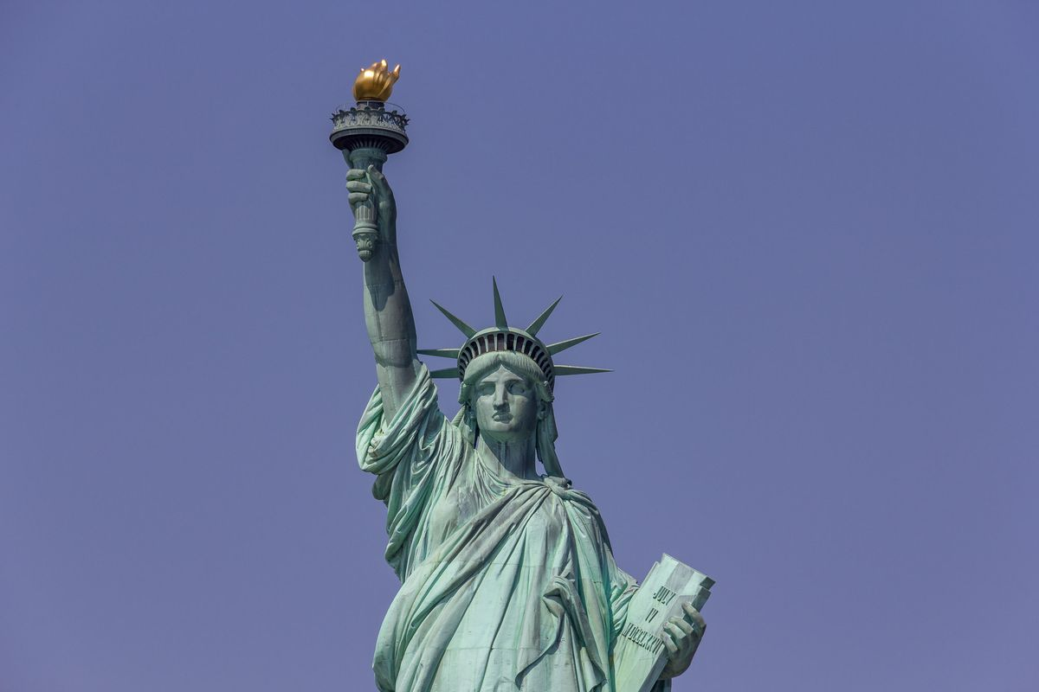

Slide 22
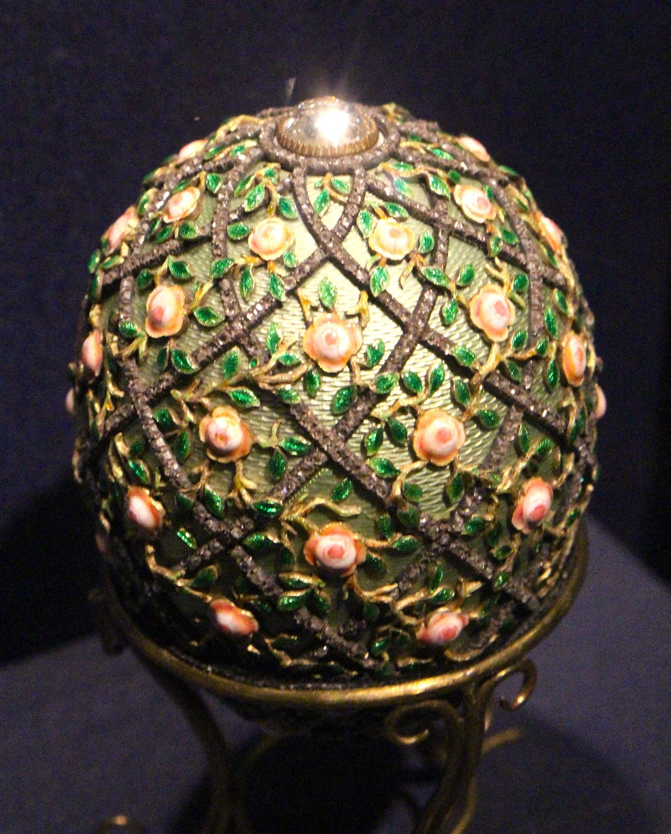

Slide 23
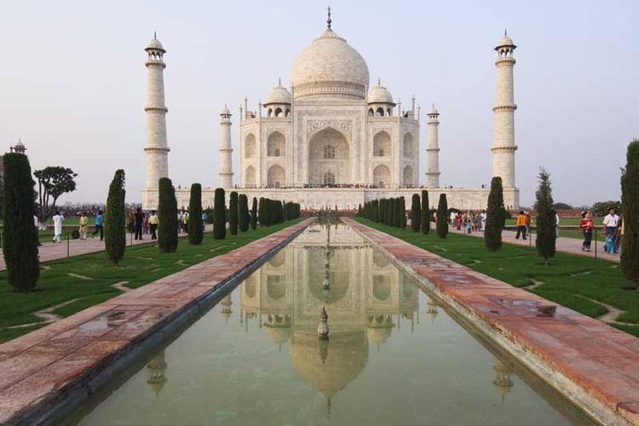

Slide 24
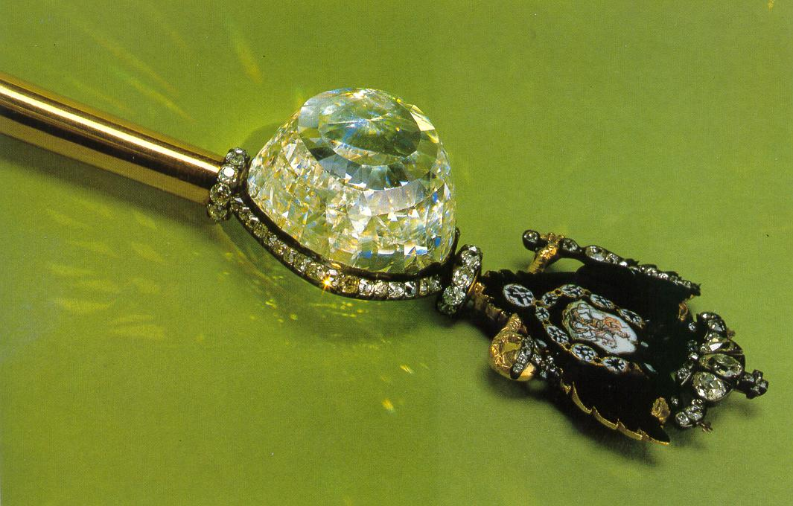

Slide 26
Whatever were gains to me I now consider loss for the sake of Christ.

Slide 27
What is more, I consider everything a loss because of the surpassing worth of knowing Christ Jesus my Lord, for whose sake I have lost all things.

Slide 28
I consider them garbage, that I may gain Christ and be found in him, not having a righteousness of my own that comes from the law,

Slide 29
but that which is through faith in Christ—the righteousness that comes from God on the basis of faith.

Slide 30
I want to know Christ—yes, to know the power of his resurrection and participation in his sufferings,

Slide 31
becoming like him in his death, and so, somehow, attaining to the resurrection from the dead.
Philippians 3:7-11

Slide 33
Her many sins have been forgiven- as her great love has shown.
Luke 7:47

