Slide 2
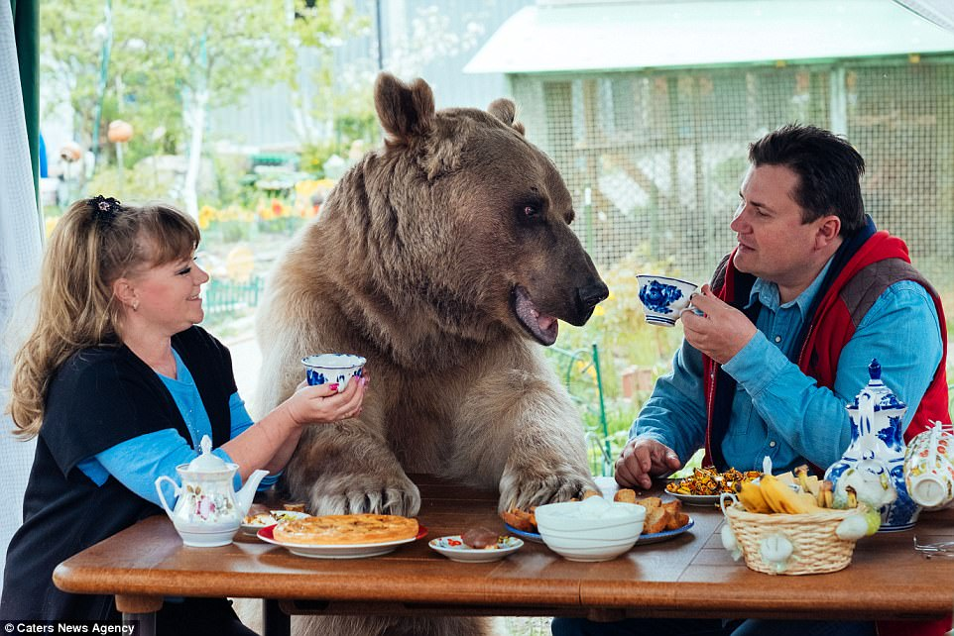

Slide 3
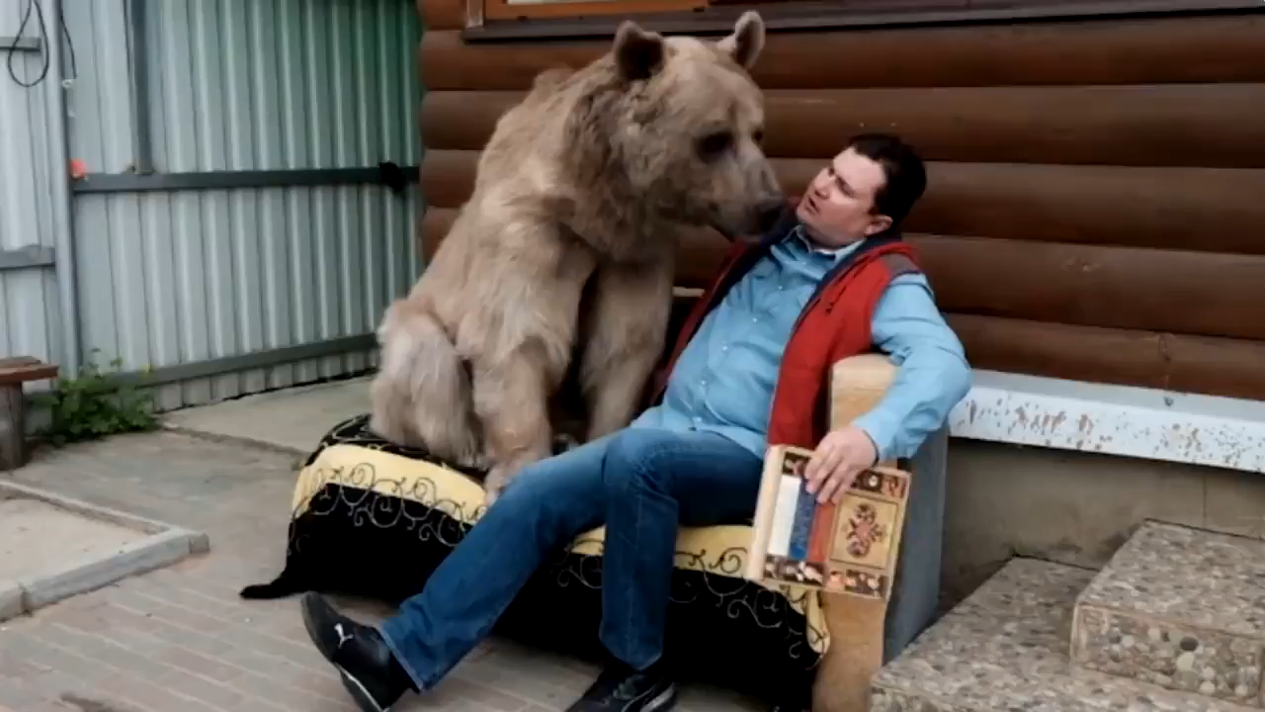

Slide 5
A shoot will come up from the stump of Jesse;
from his roots a Branch will bear fruit.
The Spirit of the Lord will rest on him—

Slide 6
the Spirit of wisdom and of understanding,
the Spirit of counsel and of might,
the Spirit of the knowledge and fear of the Lord—
and he will delight in the fear of the Lord.

Slide 7
He will not judge by what he sees with his eyes,
or decide by what he hears with his ears;
but with righteousness he will judge the needy,
with justice he will give decisions for the poor of the earth.

Slide 8
He will strike the earth with the rod of his mouth;
with the breath of his lips he will slay the wicked.
Righteousness will be his belt
and faithfulness the sash around his waist.

Slide 9
The wolf will live with the lamb,
the leopard will lie down with the goat,
the calf and the lion and the yearling together;
and a little child will lead them.

Slide 10
The cow will feed with the bear,
their young will lie down together,
and the lion will eat straw like the ox.

Slide 11
The infant will play near the cobra’s den,
and the young child will put its hand into the viper’s nest.

Slide 12
They will neither harm nor destroy
on all my holy mountain,
for the earth will be filled with the knowledge of the Lord
as the waters cover the sea.

Slide 13
In that day the Root of Jesse will stand as a banner for the peoples; the nations will rally to him, and his resting place will be glorious.
Isaiah 11:1-10

Slide 15
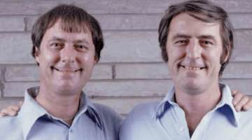

Slide 16
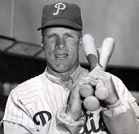

Slide 17
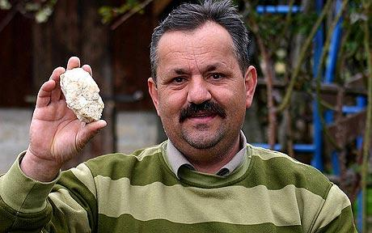

Slide 19
The webbing together of God, humans, and all creation in justice, fulfilment, and delight is what the Hebrew prophets call shalom.

Slide 20
We call it peace but it means far more than mere peace of mind or a cease-fire between enemies.

Slide 21
In the Bible, shalom means universal flourishing, wholeness and delight…

Slide 22
a state of affairs that inspires joyful wonder as its Creator and Saviour opens doors and welcomes the creatures in whom He delights.

Slide 23
Shalom, in other words, is the way things ought to be.
Cornelius Plantinga

Slide 25
The Light of Israel will become a fire,
their Holy One a flame;
in a single day it will burn and consume
his thorns and his briers.

Slide 26
The splendour of his forests and fertile fields
it will completely destroy,
as when a sick person wastes away.

Slide 27
And the remaining trees of his forests will be so few
that a child could write them down.
Isaiah 9:17-19

Slide 29
See, the Lord, the Lord Almighty,
will lop off the boughs with great power.

Slide 30
The lofty trees will be felled,
the tall ones will be brought low.
He will cut down the forest thickets with an axe.
Isaiah 9:33-34

Slide 32
Who trusted God was love indeed
And love Creation's final law-
Tho' Nature, red in tooth and claw
With ravine, shriek'd against his creed.
Alfred Lord Tennyson

Slide 34
To us a child is born,
to us a son is given,
and the government will be on his shoulders.

Slide 35
And he will be called
Wonderful Counsellor, Mighty God,
Everlasting Father, Prince of Peace.
Isaiah 9:6

