Slide 2
When Jesus heard what had happened, he withdrew by boat privately to a solitary place. Hearing of this, the crowds followed him on foot from the towns. When Jesus landed and saw a large crowd, he had compassion on them and healed their sick.

Slide 3
As evening approached, the disciples came to him and said, “This is a remote place, and it’s already getting late. Send the crowds away, so they can go to the villages and buy themselves some food.”

Slide 4
Jesus replied, “They do not need to go away. You give them something to eat.”
“We have here only five loaves of bread and two fish,” they answered.
“Bring them here to me,” he said. And he directed the people to sit down on the grass.

Slide 5
Taking the five loaves and the two fish and looking up to heaven, he gave thanks and broke the loaves. Then he gave them to the disciples, and the disciples gave them to the people.

Slide 6
They all ate and were satisfied, and the disciples picked up twelve basketfuls of broken pieces that were left over. The number of those who ate was about five thousand men, besides women and children.

Slide 8
Jesus wept.
John 11:32

Slide 10
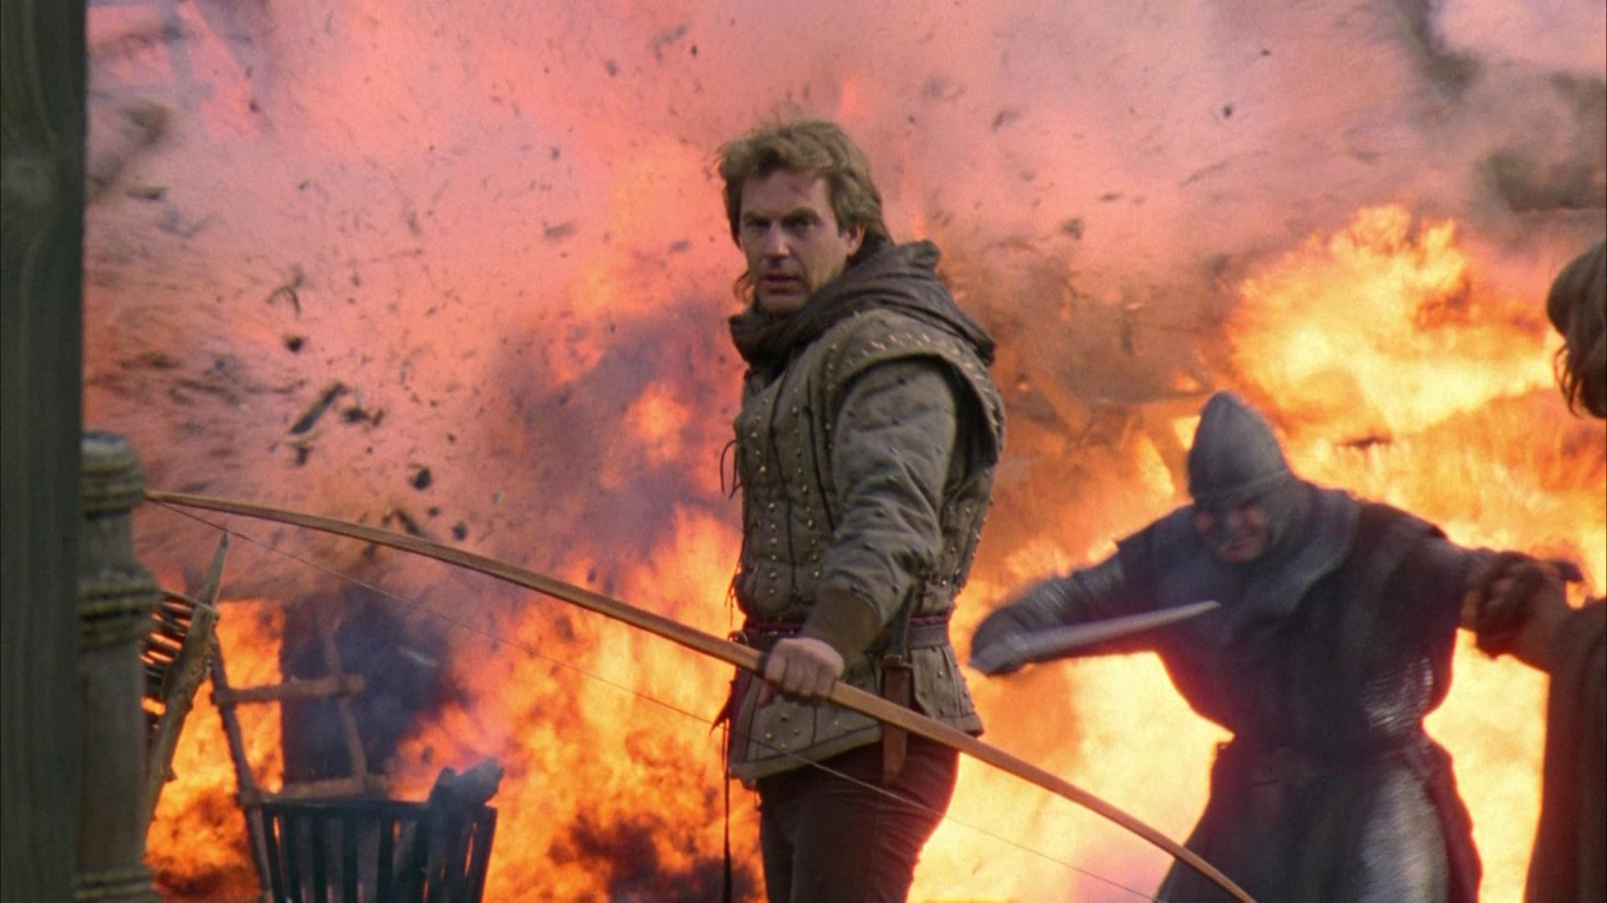

Slide 12
This is a remote place, and it’s already getting late.

Slide 13
The time is already past.

