Slide 2
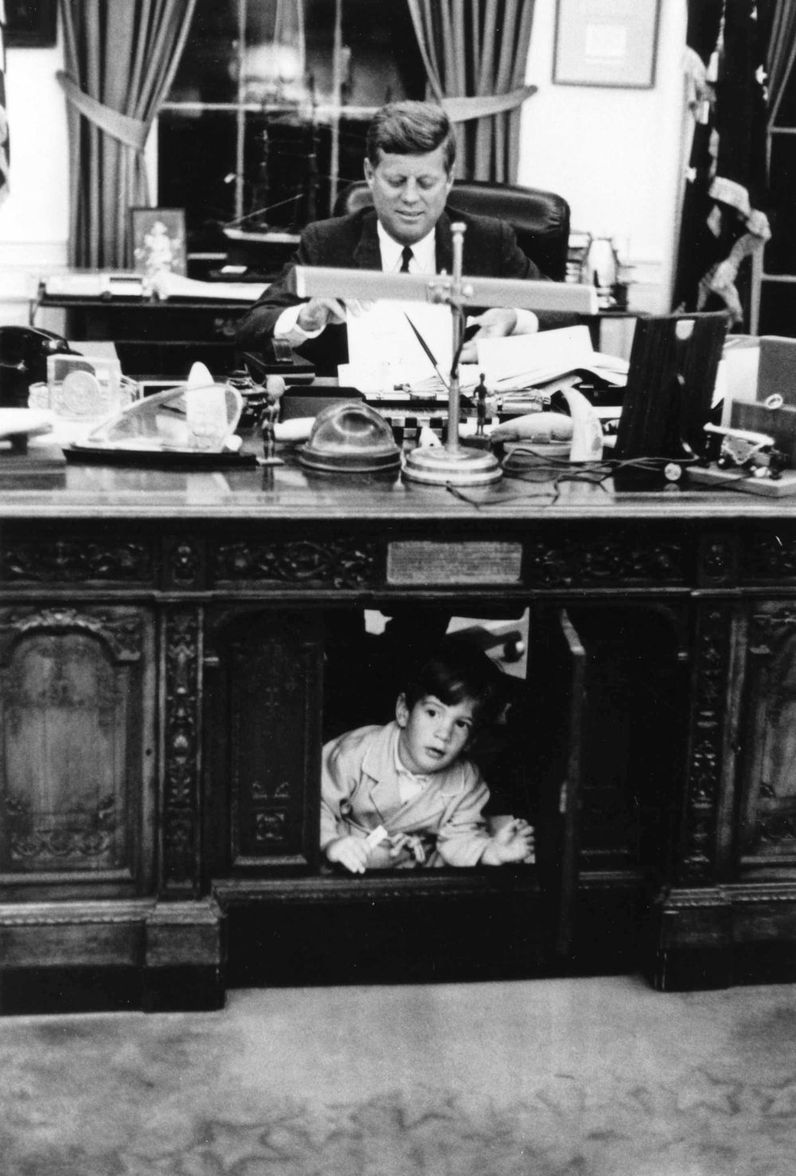

Slide 3
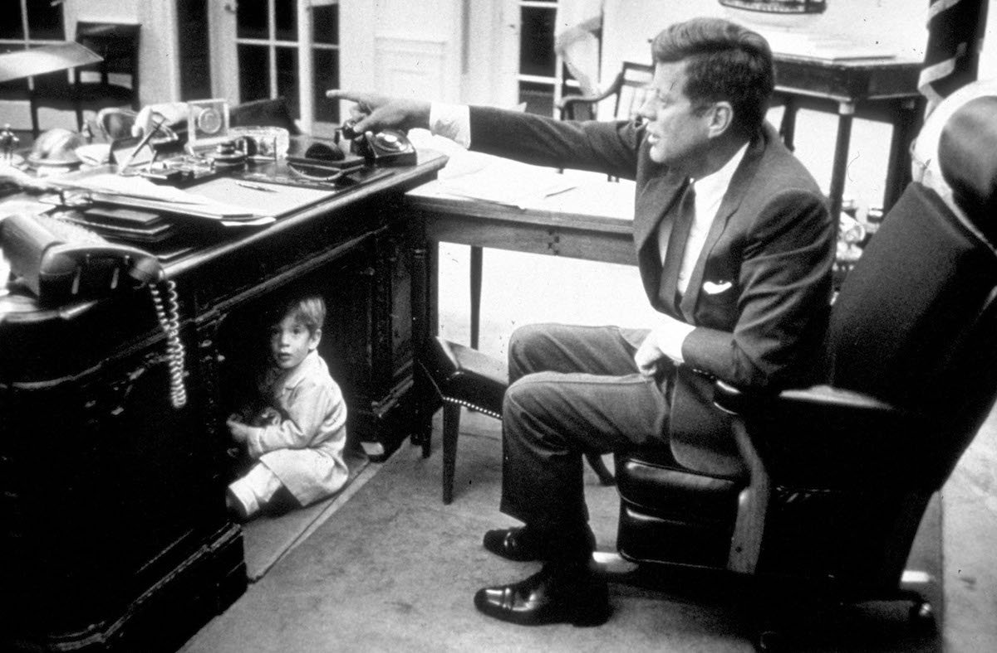

Slide 5
The Lord spoke to Moses after the death of the two sons of Aaron who died when they approached the Lord. The Lord said to Moses:

Slide 6
“Tell your brother Aaron that he is not to come whenever he chooses into the Most Holy Place behind the curtain in front of the atonement cover on the ark, or else he will die.

Slide 7
For I will appear in the cloud over the atonement cover...
This is to be a lasting ordinance for you: Atonement is to be made once a year for all the sins of the Israelites.

Slide 8
And it was done, as the Lord commanded Moses.
Leviticus 16:1-2, 34

Slide 10
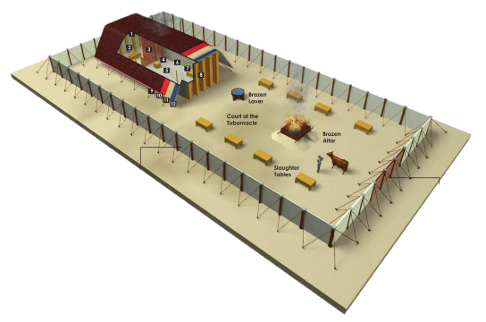

Slide 12
Only the High Priest entered the inner room, and that only once a year, and never without blood, which he offered for himself and for the sins the people had committed in ignorance.
Hebrews 9:7

Slide 14
Look, God’s dwelling place is now among the people, and He will dwell with them. They will be His people, and God Himself will be with them and be their God.
Revelation 21:3

Slide 16
I am the way and the truth and the life. No-one comes to the Father except through me. If you really know me, you will know my Father as well. From now on, you do know Him and have seen Him.
John 14:6-7

Slide 18
There have been many of these priests, since death prevented them from continuing in office; but because Jesus lives forever, He has a permanent priesthood.

Slide 19
Therefore He is able to save completely those who come to God through Him, because He always lives to intercede for them.
Hebrews 7:23-25

Slide 21
Two men went up to the temple to pray, one a Pharisee and the other a tax collector. The Pharisee stood by himself and prayed:

Slide 22
‘God, I thank you that I am not like other people- robbers, evildoers, adulterers- or even like this tax collector. I fast twice a week and give a tenth of all I get.

Slide 23
But the tax collector stood at a distance. He would not even look up to Heaven, but beat his breast and said, ‘God, have mercy on me, a sinner.’
Luke 18:10-12

