Slide 1
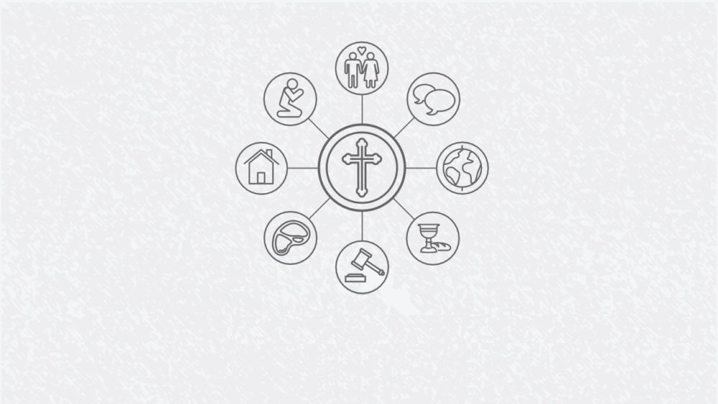
Life through Gospel lenses

Slide 2
This plan of God is not to choose some people, and then exclude and push away other people. The plan is to choose a people so that through these people God could reach all the people. Rev. Jon Middendorf

Slide 4

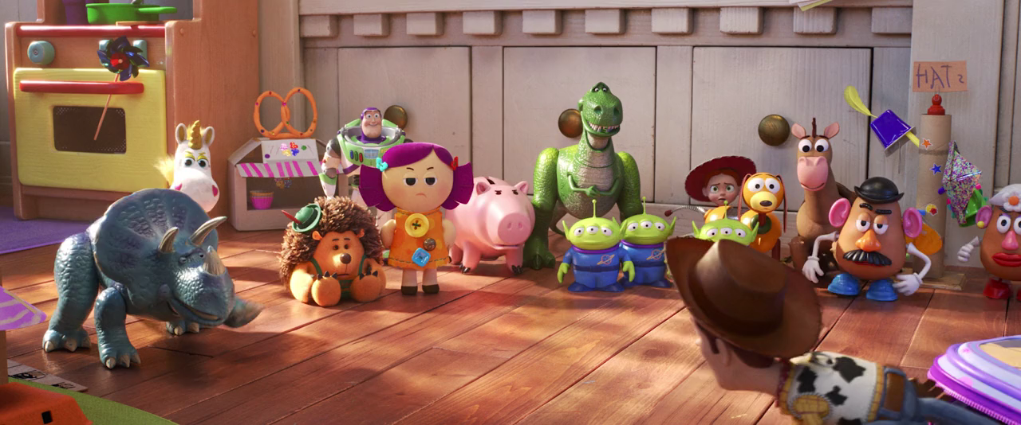

Slide 6
Then Peter began to speak: “I now realise how true it is that God does not show favouritism but accepts from every nation the one who fears him and does what is right.

Slide 7
You know the message God sent to the people of Israel, announcing the good news of peace through Jesus Christ, who is Lord of all.

Slide 8
You know what has happened throughout the province of Judea, beginning in Galilee after the baptism that John preached-

Slide 9
how God anointed Jesus of Nazareth with the Holy Spirit and power, and how he went around doing good and healing all who were under the power of the devil, because God was with him.

Slide 10
“We are witnesses of everything he did in the country of the Jews and in Jerusalem. They killed him by hanging him on a cross, but God raised him from the dead on the third day and caused him to be seen.

Slide 11
He was not seen by all the people, but by witnesses whom God had already chosen- by us who ate and drank with him after he rose from the dead.

Slide 12
He commanded us to preach to the people and to testify that he is the one whom God appointed as judge of the living and the dead.

Slide 13
All the prophets testify about him that everyone who believes in him receives forgiveness of sins through his name.”
Acts 10:34-43

Slide 15
What shall we say, then? Shall we go on sinning so that grace may increase? By no means! We are those who have died to sin; how can we live in it any longer?

Slide 16
Or don’t you know that all of us who were baptised into Christ Jesus were baptised into his death?

Slide 17
We were therefore buried with him through baptism into death in order that, just as Christ was raised from the dead through the glory of the Father, we too may live a new life.
Romans 6:1-4

Slide 19
Jesus did not identify the person with his sin, but rather saw in this sin something alien, something that really did not belong to him, something that merely chained and mastered him and from which he would set him free and bring him back to his real self.

Slide 20
Jesus was able to love men because He loved them through the layer of mud. Helmut Thielicke

Slide 22
You are well aware that it is against our law for a Jew to associate with or visit a Gentile. Acts 10:28

Slide 24
Life through Gospel lenses

