Slide 2
The desert and the parched land will be glad;
the wilderness will rejoice and blossom.
Like the crocus, it will burst into bloom;
it will rejoice greatly and shout for joy.

Slide 3
The glory of Lebanon will be given to it,
the splendour of Carmel and Sharon;
they will see the glory of the Lord,
the splendour of our God.

Slide 4
Strengthen the feeble hands,
steady the knees that give way;
say to those with fearful hearts,
“Be strong, do not fear;

Slide 5
your God will come,
he will come with vengeance;
with divine retribution
he will come to save you.”

Slide 6
Then will the eyes of the blind be opened
and the ears of the deaf unstopped.
Then will the lame leap like a deer,
and the mute tongue shout for joy.

Slide 7
Water will gush forth in the wilderness
and streams in the desert.
The burning sand will become a pool,
the thirsty ground bubbling springs.

Slide 8
In the haunts where jackals once lay,
grass and reeds and papyrus will grow.

Slide 9
And a highway will be there;
it will be called the Way of Holiness;
it will be for those who walk on that Way.

Slide 10
The unclean will not journey on it;
wicked fools will not go about on it.
No lion will be there,
nor any ravenous beast;
they will not be found there.

Slide 11
But only the redeemed will walk there,
and those the Lord has rescued will return.
They will enter Zion with singing;
everlasting joy will crown their heads.

Slide 12
Gladness and joy will overtake them,
and sorrow and sighing will flee away.
Isaiah 35:1-10

Slide 14
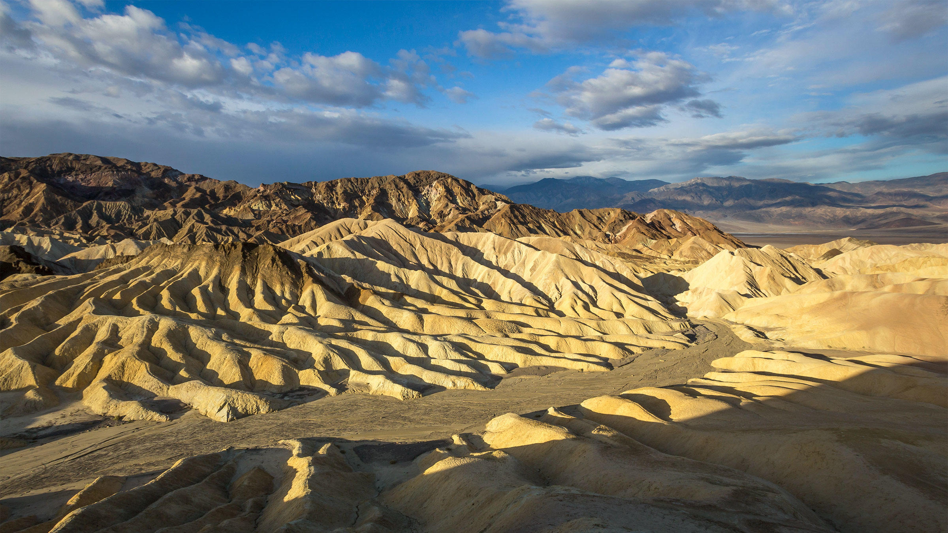

Slide 15
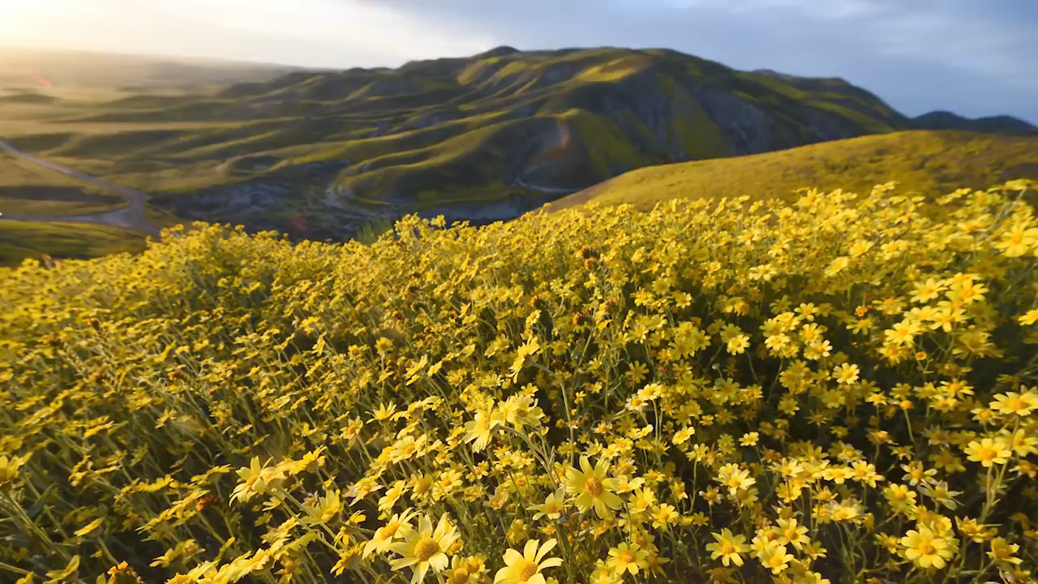

Slide 16
When the desert blooms, it blooms abundantly. Not half-heartedly. Not hidden in some lonesome valley. For a few brilliant weeks, the world is transformed into one living Van Gogh landscape.

Slide 17
When the wilderness blooms, when the desert is fertile, it’s as if nature itself sings a chorus of “Alleluia!”
Casey Thornburgh Sigmon

Slide 19
So, here it is: a word that couldn’t wait until it might make more sense.
Barbara Lundblad

Slide 21
All shall be well, and all shall be well, and all manner of thing shall be well.
Julian of Norwich

Slide 23
Refugees
In a sinking raft
Spy the lights of the lifeboat

Slide 25
This text helps us understand what it means to "be saved" in the Bible- not at all something that pertains only to individual souls,

Slide 26
but rather a transformation of humanity and creation that enables all to sing together in present and eternal joy.
Fred Gaiser

Slide 28
The scent of a flower we have not found, the echo of a tune we have not heard, news from a country we have never yet visited.
CS Lewis

Slide 30
The blind receive sight, the lame walk, those who have leprosy are cleansed, the deaf hear, the dead are raised, and the good news is proclaimed to the poor.
Matthew 11:5

Slide 32
