Slide 2
“[He] did more evil in the eyes of the LORD than any of those before him...[He] did more to arouse the anger of the LORD, the God of Israel, than did all the kings of Israel before him.”
1 Kings 16:30, 33

Slide 4
Now Ahab told Jezebel everything Elijah had done and how he had killed all the prophets with the sword. So Jezebel sent a messenger to Elijah to say, “May the gods deal with me, be it ever so severely, if by this time tomorrow I do not make your life like that of one of them.”

Slide 5
Elijah was afraid and ran for his life. When he came to Beersheba in Judah, he left his servant there, while he himself went a day’s journey into the wilderness. He came to a broom bush, sat down under it and prayed that he might die.

Slide 6
“I have had enough, Lord,” he said. “Take my life; I am no better than my ancestors.” Then he lay down under the bush and fell asleep. All at once an angel touched him and said, “Get up and eat.”

Slide 7
He looked around, and there by his head was some bread baked over hot coals, and a jar of water. He ate and drank and then lay down again. The angel of the Lord came back a second time and touched him and said, “Get up and eat, for the journey is too much for you.”

Slide 8
So he got up and ate and drank. Strengthened by that food, he traveled forty days and forty nights until he reached Horeb, the mountain of God. There he went into a cave and spent the night.

Slide 10
You’re blessed when you’re at the end of your rope. With less of you there is more of God and his rule.
You’re blessed when you feel you’ve lost what is most dear to you. Only then can you be embraced by the One most dear to you.

Slide 11
You’re blessed when you’ve worked up a good appetite for God. He’s food and drink in the best meal you’ll ever eat.
You’re blessed when you care. At the moment of being ‘care-full,’ you find yourselves cared for.

Slide 13
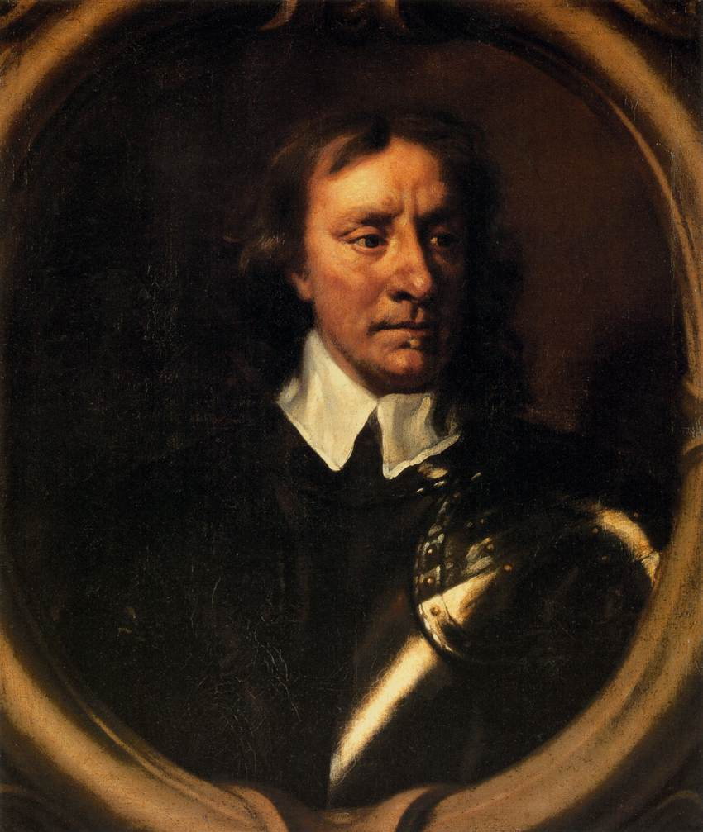

Slide 15
Was Yahweh a God for bad days as well as for good?
John Drane

