Slide 1
Let me tell you a story…

Slide 2
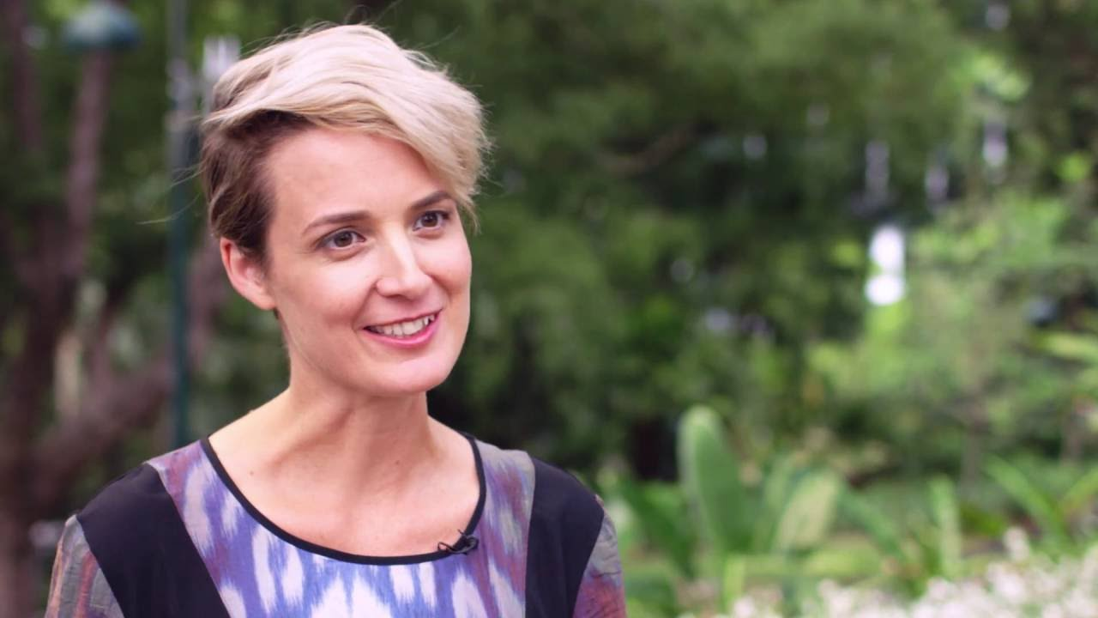

Slide 3
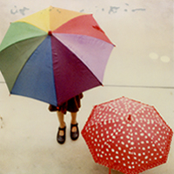

Slide 4
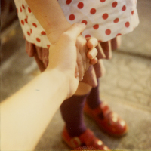

Slide 5
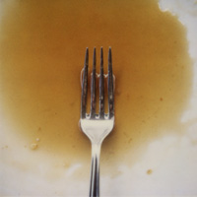

Slide 7
The springs of mercy are always full, the streams of mercy always flowing;

Slide 8
there is mercy enough in God, enough for all, enough for each, enough forever.
John Wesley

Slide 10
To some who were confident of their own righteousness and looked down on everyone else, Jesus told this parable:

Slide 11
“Two men went up to the temple to pray, one a Pharisee and the other a tax collector.

Slide 12
The Pharisee stood by himself and prayed: ‘God, I thank you that I am not like other people—robbers, evildoers, adulterers—or even like this tax collector.

Slide 13
I fast twice a week and give a tenth of all I get.’ “But the tax collector stood at a distance.

Slide 14
He would not even look up to heaven, but beat his breast and said, ‘God, have mercy on me, a sinner.’

Slide 15
“I tell you that this man, rather than the other, went home justified before God.

Slide 16
For all those who exalt themselves will be humbled, and those who humble themselves will be exalted.”
Luke 18:9-14

Slide 18
If someone else thinks they have reasons to put confidence in the flesh, I have more:

Slide 19
circumcised on the eighth day, of the people of Israel, of the tribe of Benjamin, a Hebrew of Hebrews; in regard to the law, a Pharisee;

Slide 20
as for zeal, persecuting the church; as for righteousness based on the law, faultless.
Philippians 3:4-6

Slide 22
He may direct the prayer to God, but it is actually addressed to himself and is entirely about himself.

Slide 23
His righteousness is no gift of grace, no miracle of mercy; rather, it is entirely his own accomplishment.

Slide 24
God, in fact, plays no active role in his prayer except, perhaps, to validate his own judgment of himself.
David Lose

Slide 26
People were also bringing babies to Jesus for him to place his hands on them. When the disciples saw this, they rebuked them.

Slide 27
But Jesus called the children to him and said, “Let the little children come to me, and do not hinder them, for the kingdom of God belongs to such as these.

Slide 28
Truly I tell you, anyone who will not receive the kingdom of God like a little child will never enter it.”
Luke 18:15-17

Slide 30
It’s rather outrageous that God shows mercy so easily to such a villain. The grace on display here is absurdly generous…

Slide 31
How shall we pray to a wildly merciful God? How shall we live, having learned of such boundless mercy? Matt Skinner

Slide 33
Where can I go from your Spirit?
Where can I flee from your presence?
If I go up to the heavens, you are there;
if I make my bed in the depths, you are there.

Slide 34
If I rise on the wings of the dawn,
if I settle on the far side of the sea,
even there your hand will guide me,
your right hand will hold me fast.

Slide 35
If I say, “Surely the darkness will hide me
and the light become night around me,”
even the darkness will not be dark to you;

Slide 36
the night will shine like the day,
for darkness is as light to you.
Psalm 139:7-12

Slide 37
Let me tell you a story…

