Slide 4
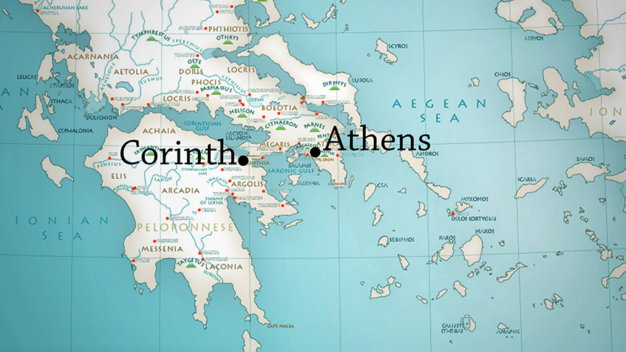

Slide 6
Now about food sacrificed to idols: We know that “We all possess knowledge.” But knowledge puffs up while love builds up. Those who think they know something do not yet know as they ought to know. But whoever loves God is known by God.

Slide 7
So then, about eating food sacrificed to idols: We know that “An idol is nothing at all in the world” and that “There is no God but one.” For even if there are so-called gods, whether in heaven or on earth (as indeed there are many “gods” and many “lords”),

Slide 8
yet for us there is but one God, the Father, from whom all things came and for whom we live; and there is but one Lord, Jesus Christ, through whom all things came and through whom we live. But not everyone possesses this knowledge.

Slide 9
Some people are still so accustomed to idols that when they eat sacrificial food they think of it as having been sacrificed to a god, and since their conscience is weak, it is defiled. But food does not bring us near to God; we are no worse if we do not eat, and no better if we do.

Slide 10
Be careful, however, that the exercise of your rights does not become a stumbling block to the weak. For if someone with a weak conscience sees you, with all your knowledge, eating in an idol’s temple, won’t that person be emboldened to eat what is sacrificed to idols?

Slide 11
So this weak brother or sister, for whom Christ died, is destroyed by your knowledge. When you sin against them in this way and wound their weak conscience, you sin against Christ.

Slide 12
Therefore, if what I eat causes my brother or sister to fall into sin, I will never eat meat again, so that I will not cause them to fall.
1 Corinthians 8:1-13

