Slide 1
Built to worship

Slide 2
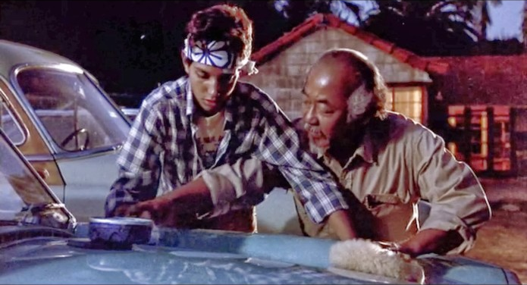

Slide 4
Doctrine is never taught in the Bible simply that it may be known; it is taught in order that it may be translated into practise.
FF Bruce

Slide 6
Therefore, I urge you, brothers and sisters, in view of God’s mercy, to offer your bodies as a living sacrifice, holy and pleasing to God—this is your true and proper worship.

Slide 7
Do not conform to the pattern of this world, but be transformed by the renewing of your mind. Then you will be able to test and approve what God’s will is—his good, pleasing and perfect will.
Romans 12:1-2

Slide 9
The way ‘good’ people explain away ‘bad’ behaviour.
Lindsay Dodgson

Slide 11
Oh, how great are God’s riches and wisdom and knowledge! How impossible it is for us to understand his decisions and his ways!

Slide 12
For who can know the Lord’s thoughts?
Who knows enough to give him advice?
And who has given him so much
that he needs to pay it back?

Slide 13
For everything comes from him and exists by his power and is intended for his glory. All glory to him forever! Amen.
Romans 11:33-36

Slide 15
He has ended the reign of death- 5:12-21
He has liberated us from sin- 6:1-23
He has rescued us from dysfunctional cycles- 7:7-25

Slide 16
He has given us His Spirit- 8:1-27
He is always at work for our good- 8:28-30
He is still at work in those who reject Him- 11:25-29

Slide 18
Now that we understand the gospel of God’s mercies…can we respond with proper worship that is manifest in loving relationships?
Elizabeth Shively

Slide 20
Therefore, I urge you, brothers and sisters, in view of God’s mercy, to offer your bodies as a living sacrifice, holy and pleasing to God—this is your true and proper worship.
Romans 12:1

Slide 22
Service to the Church- 12:3-8
Love in action- 12:9-21
Good citizens and neighbours- 13:1-7
Bearing with one another in love- 14:1-21

Slide 23
Carrying the Gospel- 15:14-21
Supporting each other- 15:23-32
Even when no-one knows our name- 16:1-16

Slide 25
Worship is now enfleshed and it moves beyond the sanctuary into the streets. Worship is now the kindness I extend to those in need.

Slide 26
Worship is now the time I invest in assisting those who are attempting to rise above the obvious barriers of our educational system.

Slide 27
Worship is now the resources I give to causes that improve and enhance the quality of life for fellow travellers.

Slide 28
Worship is now my life of service and sacrifice because I have a holistic understanding of worship.
John E Guns

Slide 29
Built to worship

