Slide 2
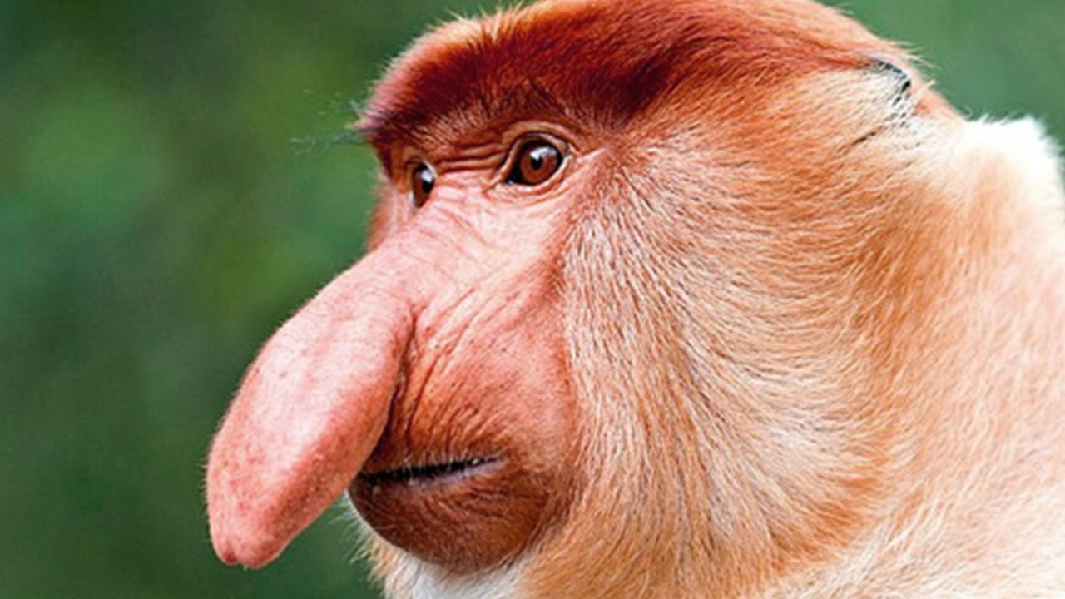
Proboscis Monkey

Slide 3
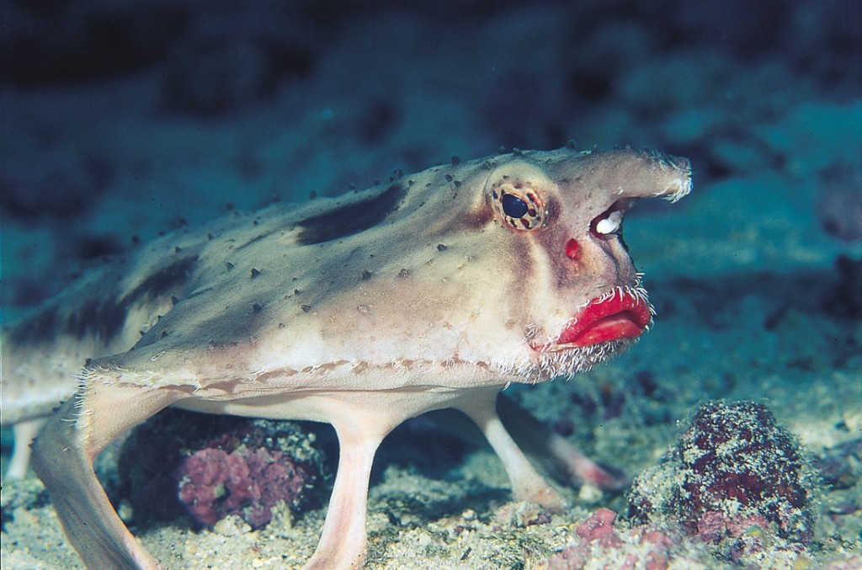
Red-Lipped Batfish

Slide 4
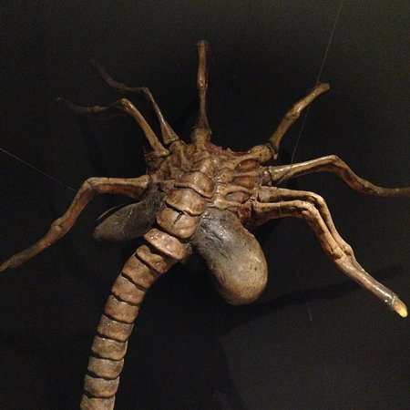
Facehugger

Slide 5
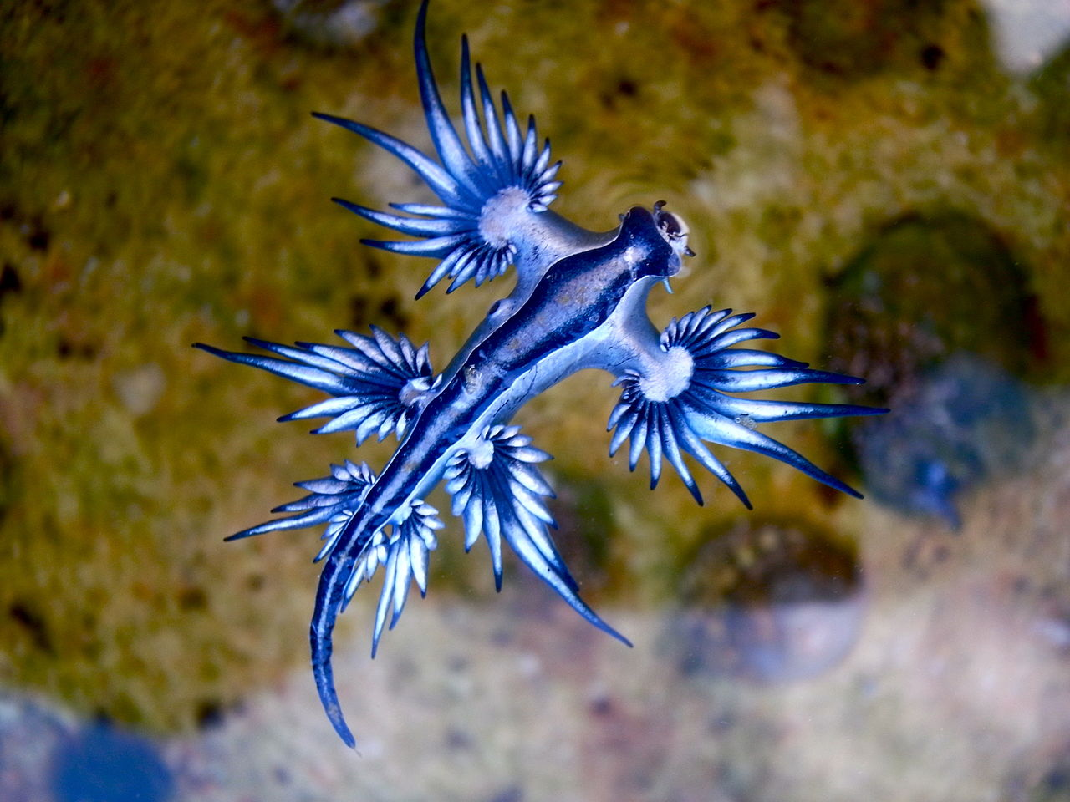
Glaucus Atlanticus

Slide 6
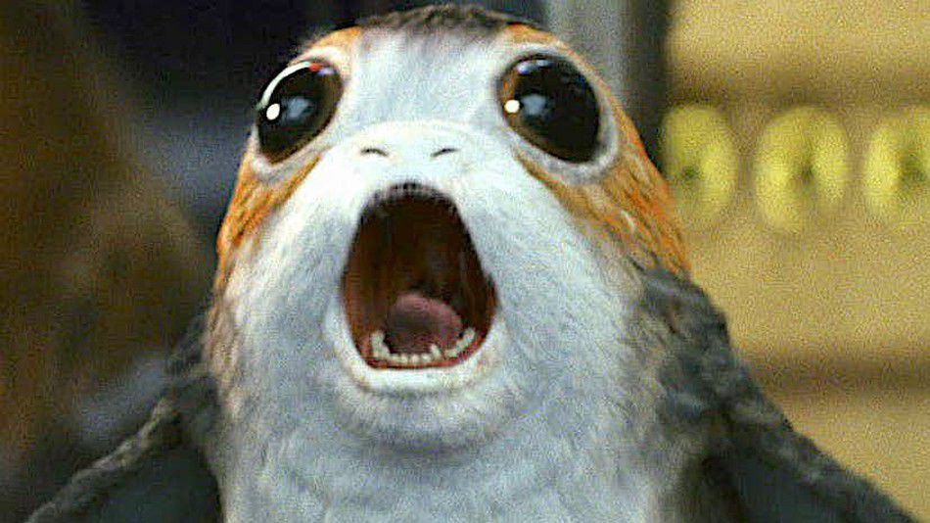
Porg

Slide 7
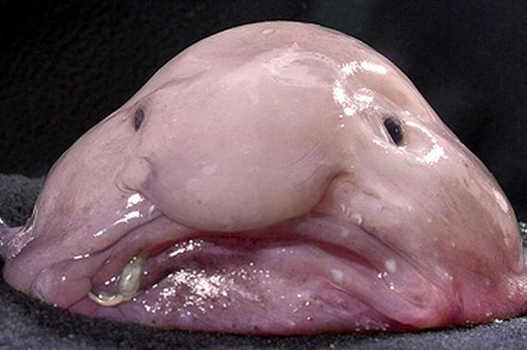
Blobfish

Slide 8
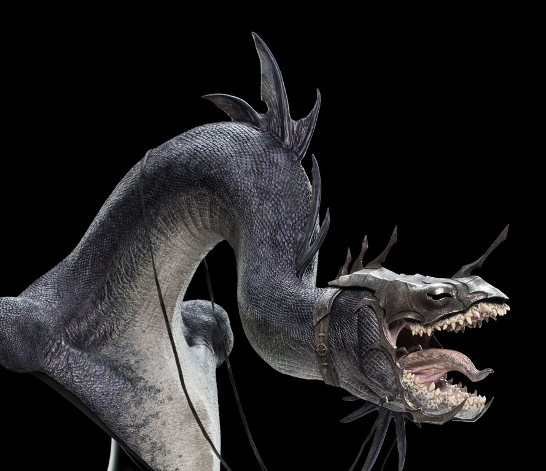
Fell Beast

Slide 9
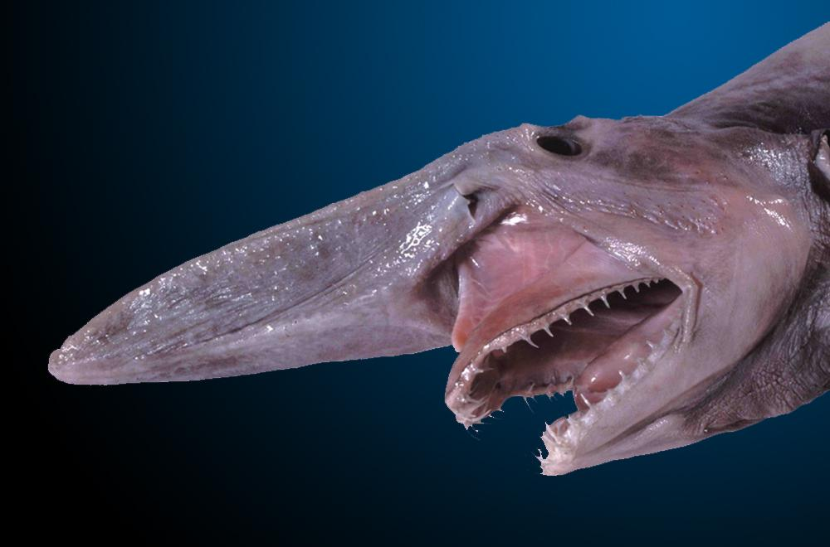
Goblin Shark

Slide 10
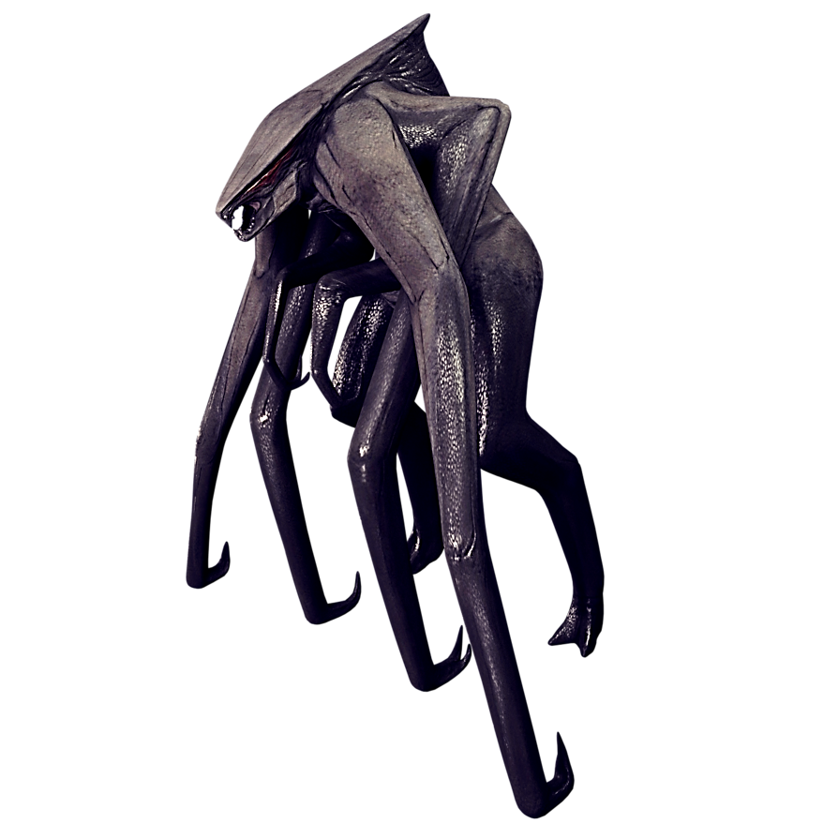
MUTO

Slide 11
Vulptex

Slide 12
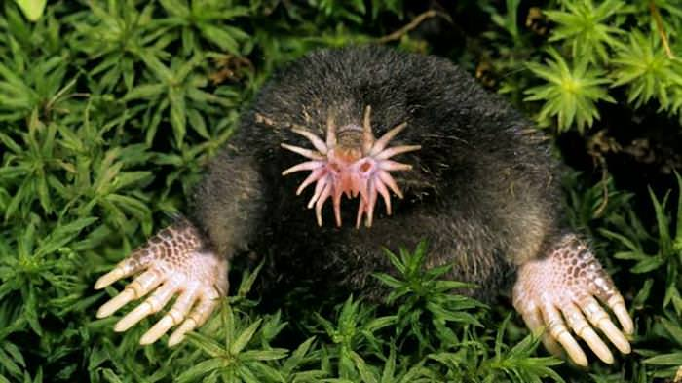
Star-nosed Mole

Slide 14
In the beginning, there was nothing. Nothing to hear. Nothing to feel. Nothing to see. Only emptiness. And darkness. And...nothing but nothing.

Slide 15
But God was there. And God had a wonderful Plan. ‘I’ll take this emptiness,’ God said, ‘and I’ll fill it up! Out of the darkness, I’m going to make light! And out of the nothing, I’m going to make everything!’

Slide 17
First, God. God is the subject of life. God is foundational for living. If we don’t have a sense of the primacy of God, we will never get it right, get life right, get our lives right.

Slide 18
Not God at the margins; not God as an option; not God on the weekends. God at the centre and circumference; God first and last; God, God, God.
Eugene Peterson

Slide 20
In the beginning, God created the heavens and the earth. Now the earth was formless and empty, darkness was over the surface of the deep, and the Spirit of God was hovering over the waters.

Slide 22
Blood Red Mirror

Slide 23
Green White

Slide 24
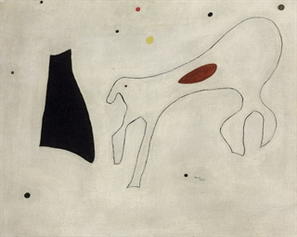
Le Chien

Slide 25
White Painting [Three Panel]

Slide 27
The heavens declare the glory of God; the skies proclaim the work of His hands.
Psalm 19:1

Slide 28
God’s glory is on tour in the skies, God-craft on exhibit across the horizon.

Slide 30
They are not the thing itself; they are only the scent of a flower we have not found, the echo of a tune we have not heard, news from a country we have never yet visited.
CS Lewis

Slide 34
Telos

Slide 36
Flesh gives birth to flesh, but the Spirit gives birth to spirit.
John 3:6

Slide 38
If I find in myself desires which nothing in this world can satisfy, the only logical explanation is that I was made for another world.
CS Lewis

