Slide 2
Let me tell you a story…

Slide 3
[The Kingdom] is a treasure so inestimably precious that the one who obtains it is willing to surrender for it whatever would interfere with having it.
William Hendriksen

Slide 5
“The kingdom of heaven is like treasure hidden in a field. When a man found it, he hid it again, and then in his joy went and sold all he had and bought that field.

Slide 6
“Again, the kingdom of heaven is like a merchant looking for fine pearls.

Slide 7
When he found one of great value, he went away and sold everything he had and bought it.”
Matthew 13:44-46

Slide 10
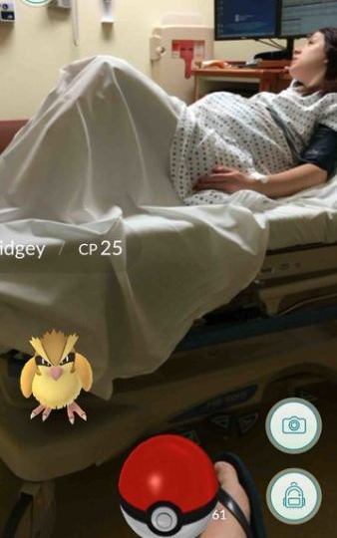

Slide 12
Persuaded that the true nature of things is not obvious, Jesus sets out, in word and deed, to fracture the hypnotic hold of life-as-it-has-always-been.
Dale Alisson

Slide 14
The kingdom of Heaven is not simply joy; it is a joy that is worth all that you have.
Jennifer T Kaalund

Slide 16
To participate in and be possessed by the empire of Heaven is worth everything.
Warren Carter

Slide 17
Let me tell you a story…

