Slide 1
Life through Gospel lenses

Slide 2
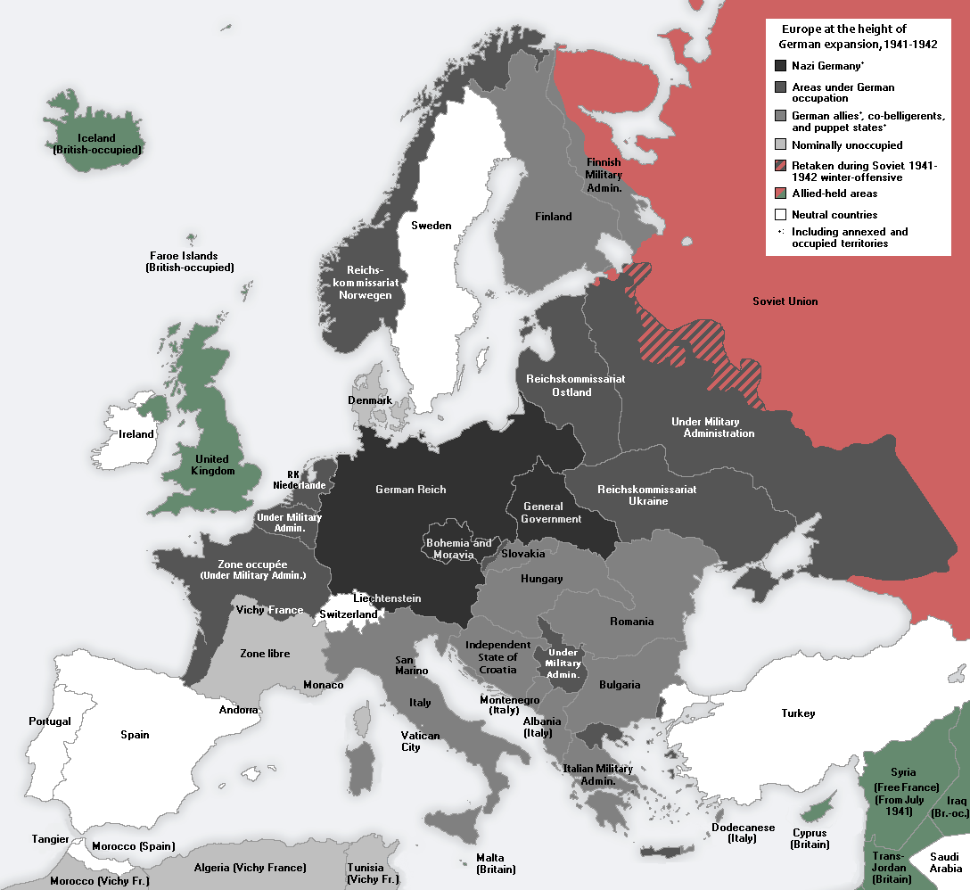

Slide 4
Jesus’ beatitudes are nonsensical on the terms projected by the powerful, the rich, the comfortable; if we are honest, they are nonsensical to most of us.

Slide 5
How can weakness be powerful? How can peacemakers thrive in a world tinged with violence? How can persecution be a site of blessed transformation?
Eric Barreto

Slide 9
Now when Jesus saw the crowds, he went up on a mountainside and sat down. His disciples came to him, and he began to teach them. He said:

Slide 10
“Blessed are the poor in spirit,
for theirs is the kingdom of heaven.
Blessed are those who mourn,
for they will be comforted.

Slide 11
Blessed are the meek,
for they will inherit the earth.
Blessed are those who hunger and thirst for righteousness,
for they will be filled.

Slide 12
Blessed are the merciful,
for they will be shown mercy.
Blessed are the pure in heart,
for they will see God.

Slide 13
Blessed are the peacemakers,
for they will be called children of God.
Blessed are those who are persecuted because of righteousness,
for theirs is the kingdom of heaven.

Slide 14
“Blessed are you when people insult you, persecute you and falsely say all kinds of evil against you because of me.

Slide 15
Rejoice and be glad, because great is your reward in heaven, for in the same way they persecuted the prophets who were before you.
Matthew 5:1-12

Slide 17
A lie doesn’t become truth, wrong doesn’t become right, and evil doesn’t become good just because it’s accepted by a majority. Rick Warren

Slide 18
Truth is not what you want it to be; it is what it is. And you must bend to its power or live a lie.
Miyamoto Musashi

Slide 20
You have heard that it was said…But I tell you.

Slide 22
Millennials aren’t looking for a hipper Christianity…we’re looking for a truer Christianity, a more authentic Christianity.

Slide 23
Like every generation before ours and every generation after, we’re looking for Jesus- the same Jesus who can be found in the strange places He’s always been going:

Slide 24
In bread, in wine, in baptism, in the Word, in suffering, in community, and among the least of these.
Rachel Held Evans

Slide 28
In the Resurrection we are granted all the resources we need to live today as if we were already living in God’s future.
Jon Middendorf

Slide 30
Life through Gospel lenses

