Slide 2
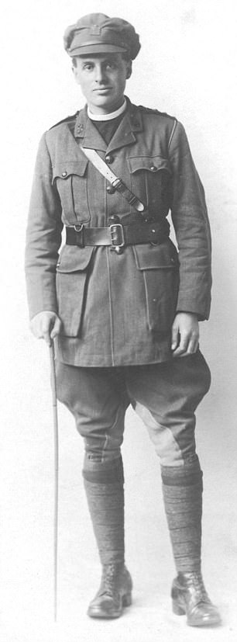

Slide 3
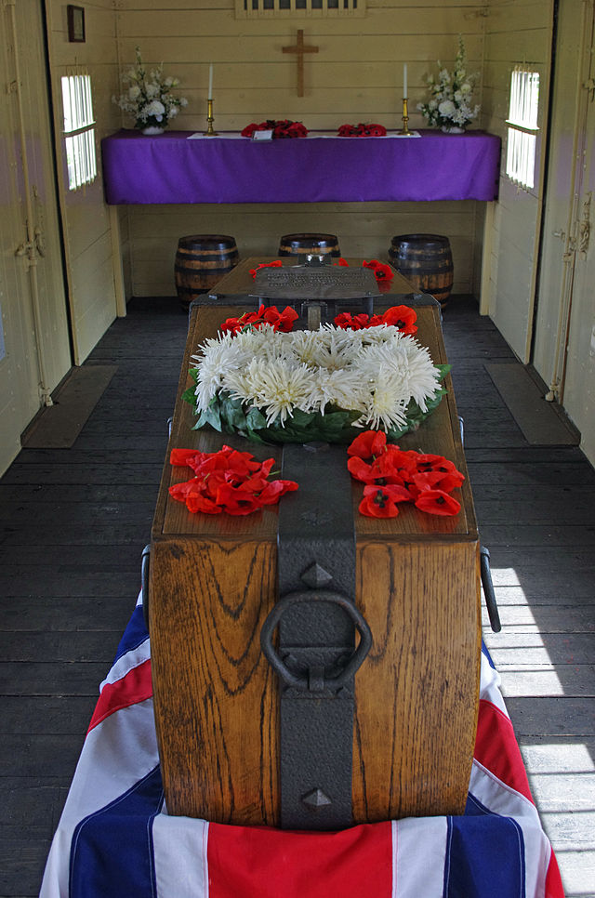

Slide 4
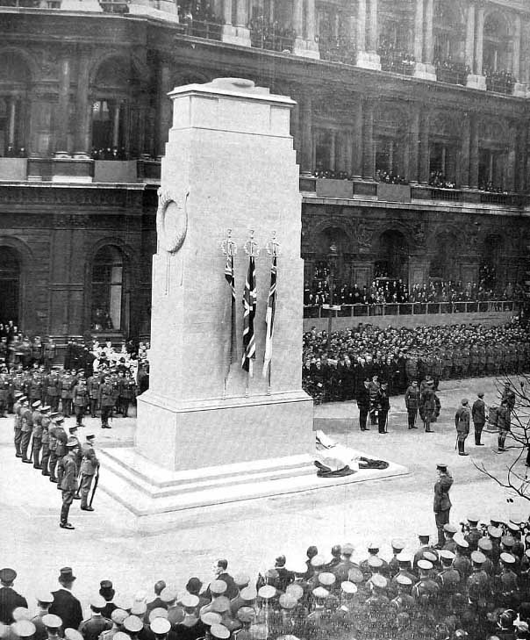

Slide 5
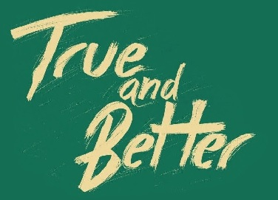

Slide 6
Now Naaman was commander of the army of the king of Aram. He was a great man in the sight of his master and highly regarded, because through him the Lord had given victory to Aram.

Slide 7
He was a valiant soldier, but he had leprosy. Now bands of raiders from Aram had gone out and had taken captive a young girl from Israel, and she served Naaman’s wife.

Slide 8
She said to her mistress, “If only my master would see the prophet who is in Samaria! He would cure him of his leprosy.” Naaman went to his master and told him what the girl from Israel had said.

Slide 9
“By all means, go,” the king of Aram replied. “I will send a letter to the king of Israel.” So Naaman left, taking with him ten talents of silver, six thousand shekels of gold and ten sets of clothing.

Slide 10
The letter that he took to the king of Israel read: “With this letter I am sending my servant Naaman to you so that you may cure him of his leprosy.”

Slide 11
As soon as the king of Israel read the letter, he tore his robes and said, “Am I God? Can I kill and bring back to life? Why does this fellow send someone to me to be cured of his leprosy?

Slide 12
See how he is trying to pick a quarrel with me!” When Elisha the man of God heard that the king of Israel had torn his robes, he sent him this message:

Slide 13
“Why have you torn your robes? Have the man come to me and he will know that there is a prophet in Israel.”
2 Kings 5:1-8

Slide 15
He has a name, she does not. He was a great warrior, she was a captive. He lived a life that demanded respect, she was a servant.

Slide 16
Yet despite being on foreign soil, and despite being a captive of war, she had the one thing that could rid Naaman of the condition that plagued him.
WD Tucker

Slide 18
The plan of God is not to choose some people, and then exclude and push away other people. The plan is to choose a people so that through those people God could reach all the people.
Jon Middendorf

Slide 20
The Servant grew up before God- a scrawny seedling, a scrubby plant in a parched field. There was nothing attractive about Him, nothing to cause us to take a second look.

Slide 21
He was looked down on and passed over, a man who suffered, who knew pain firsthand. One look at Him and people turned away. We looked down on Him, thought He was scum.
Isaiah 53:1-3

Slide 23
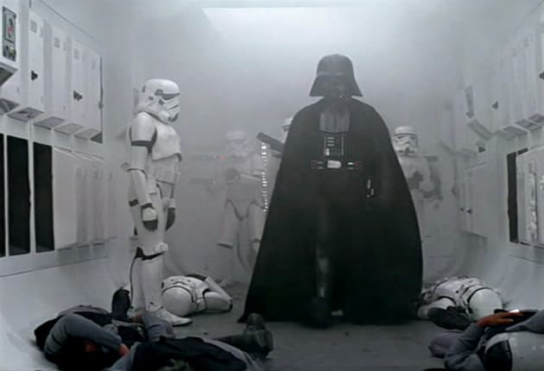

Slide 24
