Slide 1
Community
Bible
Experience

Slide 3
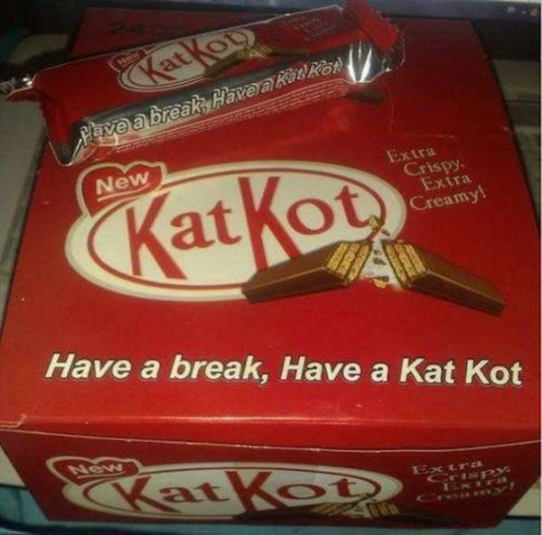

Slide 5
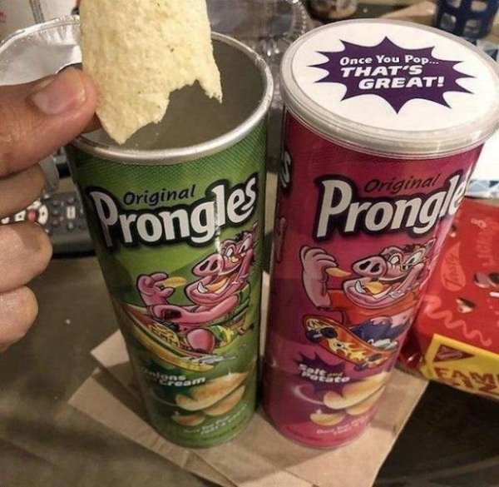

Slide 6
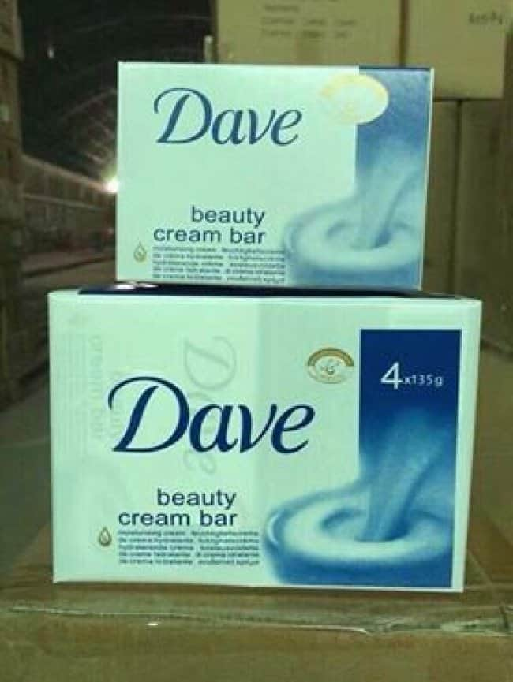

Slide 9
After Jesus had finished instructing his twelve disciples, he went on from there to teach and preach in the towns of Galilee.

Slide 10
When John, who was in prison, heard about the deeds of the Messiah, he sent his disciples to ask him, “Are you the one who is to come, or should we expect someone else?”

Slide 11
Jesus replied, “Go back and report to John what you hear and see:

Slide 12
The blind receive sight, the lame walk, those who have leprosy are cleansed, the deaf hear, the dead are raised, and the good news is proclaimed to the poor.

Slide 13
Blessed is anyone who does not stumble on account of me.”

Slide 14
As John’s disciples were leaving, Jesus began to speak to the crowd about John: “What did you go out into the wilderness to see? A reed swayed by the wind?

Slide 15
If not, what did you go out to see? A man dressed in fine clothes? No, those who wear fine clothes are in kings’ palaces. Then what did you go out to see? A prophet?

Slide 16
Yes, I tell you, and more than a prophet. This is the one about whom it is written:
“‘I will send my messenger ahead of you,
who will prepare your way before you.’

Slide 17
Truly I tell you, among those born of women there has not risen anyone greater than John the Baptist; yet whoever is least in the kingdom of heaven is greater than he. Matthew 11:1-11

Slide 19
who through faith conquered kingdoms, administered justice, and gained what was promised;

Slide 20
who shut the mouths of lions, quenched the fury of the flames, and escaped the edge of the sword;

Slide 21
whose weakness was turned to strength; and who became powerful in battle and routed foreign armies. Women received back their dead, raised to life again.

Slide 22
There were others who were tortured, refusing to be released so that they might gain an even better resurrection. Some faced jeers and flogging, and even chains and imprisonment.

Slide 23
They were put to death by stoning; they were sawed in two; they were killed by the sword.

Slide 24
They went about in sheepskins and goatskins, destitute, persecuted and mistreated— the world was not worthy of them.
Hebrews 11:33-38

Slide 26
After me comes one who is more powerful than I, whose sandals I am not worthy to carry. He will baptize you with the Holy Spirit and fire.

Slide 27
His winnowing fork is in his hand, and he will clear his threshing floor, gathering his wheat into the barn and burning up the chaff with unquenchable fire. Matthew 3:11-12

Slide 29
Whatever our misgivings, whatever our disappointments, God is not disappointed in us and comes to us anyway, eager to join us in our weakness,

Slide 30
to hold onto us in our insecurity, and to comfort us in our fear.

Slide 31
For God in Jesus came not for the strong and the proud but the weak and vulnerable. God in Jesus, in other words, came for us.
David Lose

Slide 33
The resurrection and the judgment will demonstrate before all worlds who won and who lost. We can wait.
AW Tozer

