Slide 2
When evening came, Jesus arrived with the Twelve. While they were reclining at the table eating, he said, “Truly I tell you, one of you will betray me—one who is eating with me.”

Slide 3
They were saddened, and one by one they said to him, “Surely you don’t mean me?”
“It is one of the Twelve,” he replied, “one who dips bread into the bowl with me. The Son of Man will go just as it is written about him.

Slide 4
But woe to that man who betrays the Son of Man! It would be better for him if he had not been born.”

Slide 5
While they were eating, Jesus took bread, and when he had given thanks, he broke it and gave it to his disciples, saying, “Take it; this is my body.”

Slide 6
Then he took a cup, and when he had given thanks, he gave it to them, and they all drank from it.

Slide 7
“This is my blood of the covenant, which is poured out for many,” he said to them. “Truly I tell you, I will not drink again from the fruit of the vine until that day when I drink it new in the kingdom of God.”
Mark 14:17-26

Slide 9
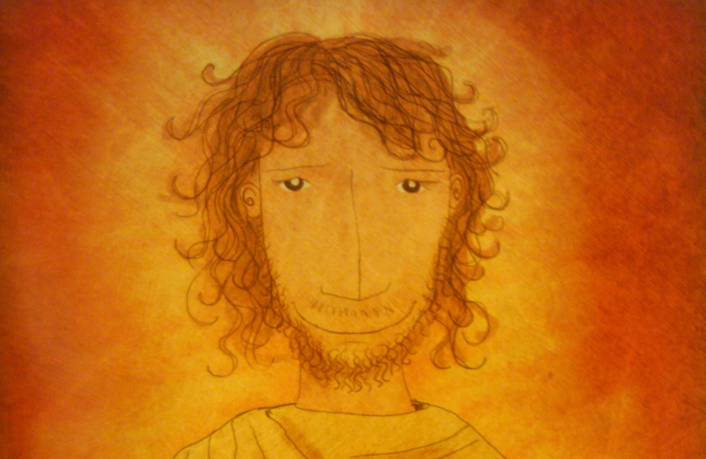

Slide 11
This is a new exodus, the fulfillment of Israel’s hopes and dreams. It inaugurates a new relationship between God and His people.
Kent Brower

