Slide 2
If the why of something is really important, if you believe in it so much that you’ll pursue it come Hell or high water, the how may not look pretty- but you’ll figure it out. You will make it happen because you believe in it.

Slide 4
I pray also for those who will believe in me through their message, that all of them may be one, Father, just as you are in me and I am in you. May they also be in us so that the world may believe that you have sent me.
John 17:20-21

Slide 6
As a prisoner for the Lord, then, I urge you to live a life worthy of the calling you have received. Be completely humble and gentle; be patient, bearing with one another in love.

Slide 7
Make every effort to keep the unity of the Spirit through the bond of peace. There is one body and one Spirit, just as you were called to one hope when you were called;

Slide 8
One Lord, one faith, one baptism; one God and Father of all, who is over all and through all and in all.
Ephesians 4:1-6

Slide 10
[Christ] Himself is our peace, who has made the two groups one and has destroyed the barrier, the dividing wall of hostility.
Ephesians 2:14

Slide 12
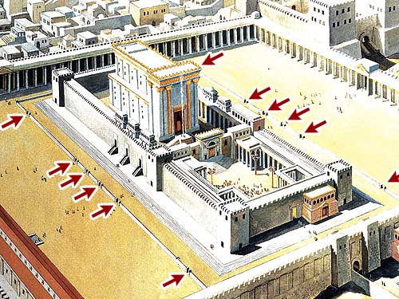

Slide 13
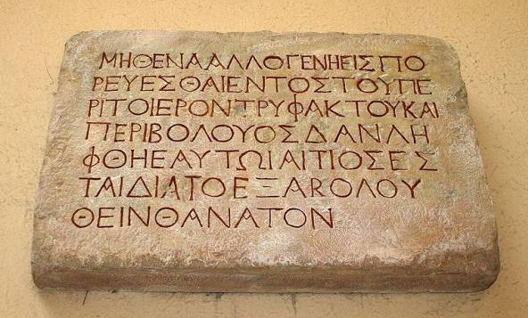

Slide 15
Truth is not what you want it to be. It is what it is, and you must bend to its power or live a lie.
Miyamoto Musashi

Slide 17
I know what most easily destroys churches. It is not crack cocaine. It is not government oppression. It is not even lack of funds. Rather, it is gossip and slander that grieves the Holy Spirit.
Jim Cymbala

Slide 19
[The Attorney General] as a long-term United Methodist in a tremendously powerful, public position is particularly accountable to us, his Church. He is ours, and we are his.

Slide 21
I looked, and there before me was a great multitude that no-one could count, from every nation, tribe, people and language, standing before the Throne and before the Lamb.

Slide 22
They were wearing white robes and were holding palm branches in their hands. And they cried out in a loud voice, ‘Salvation belongs to our God, who sits on the Throne, and to the Lamb.’
Rev 7:9-10

Slide 24
As a prisoner for the Lord, then, I urge you to live a life worthy of the calling you have received.
Ephesians 4:1

Slide 26
Human beings cannot themselves create it; it is given to them, but their responsibility is to keep it, to guard it in the face of many attempts from within and without the Church to take it away.
F. Foulkes

