Slide 1
Life through Gospel lenses

Slide 2
40 million users
75.9 million users

Slide 3
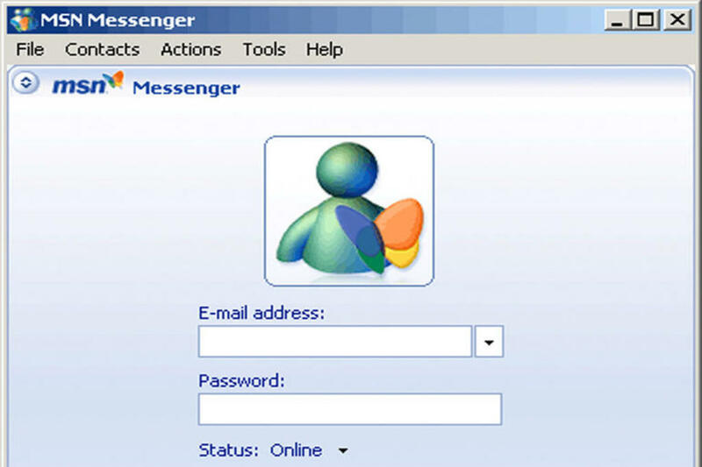
321 million users
330 million users

Slide 4
630 million users
1 billion users

Slide 5
2.5 billion users

Slide 10
“You are the salt of the earth. But if the salt loses its saltiness, how can it be made salty again? It is no longer good for anything, except to be thrown out and trampled underfoot.

Slide 11
“You are the light of the world. A town built on a hill cannot be hidden. Neither do people light a lamp and put it under a bowl. Instead they put it on its stand, and it gives light to everyone in the house.

Slide 12
In the same way, let your light shine before others, that they may see your good deeds and glorify your Father in heaven.
Matthew 5:13-16

Slide 14
God said, Let there be… and it was so.

Slide 16
The history of the Church has never been about great men and women of God; it’s always been about the great God of men and women.
Mike Pilavachi

Slide 18
It is not the Church of God that has a mission in the world, but the God of mission who has Church in the world.
Tim Dearborn

Slide 20
I am the light of the world.
John 8:12, 9:5

Slide 22
As the Father has sent me, I am sending you. John 20:21

Slide 24
We are connected as we’ve never been connected before, and we seem to have damaged ourselves in the process.

Slide 25
An online connection can be deeply felt, but you only need to deal with the part of the person you see in your game world or social network.

Slide 26
One might say that absorbed in those they have ‘friended,’ [people] lose interest in friendship.
Sherry Turkle

Slide 28
The healthy Church is a foretaste of the coming paradise where Jesus, our King, unites a people of differences.

Slide 29
Our distinctions don’t disappear, but a greater reason for unity appears. This family is connected by far better blood: His.
Greg Morse

Slide 31
I looked, and there before me was a great multitude that no one could count, from every nation, tribe, people and language, standing before the throne and before the Lamb.

Slide 32
They were wearing white robes and were holding palm branches in their hands. And they cried out in a loud voice:

Slide 33
“Salvation belongs to our God,
who sits on the throne,
and to the Lamb.”
Revelation 7:9-10

Slide 34
Life through Gospel lenses

