Slide 2
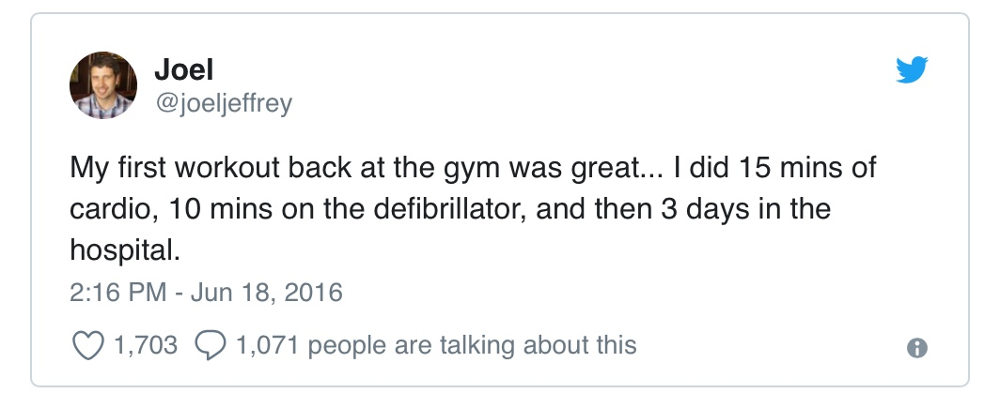

Slide 3
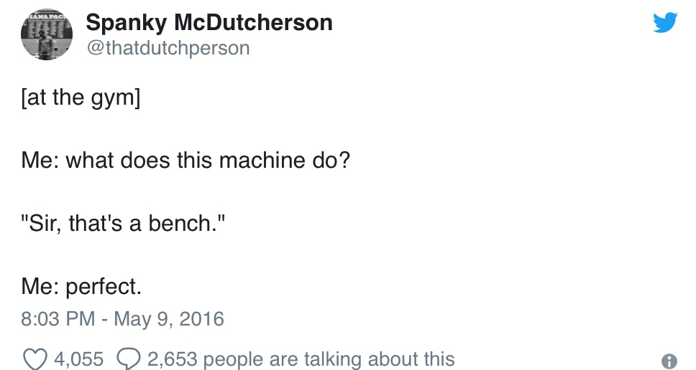

Slide 4
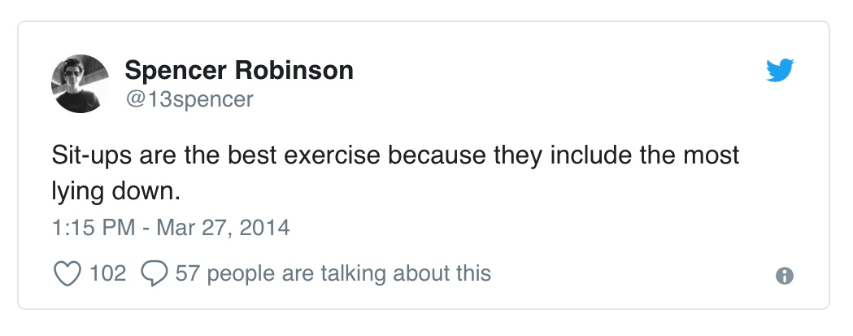

Slide 5
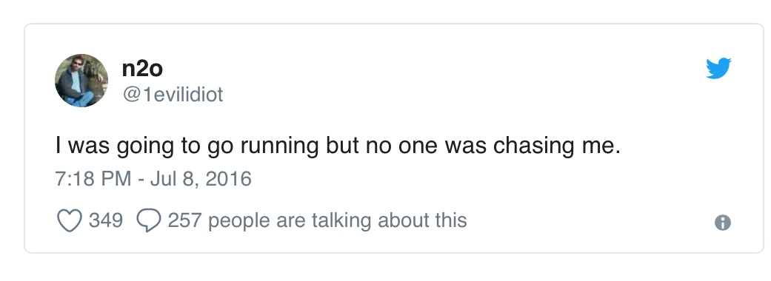

Slide 6
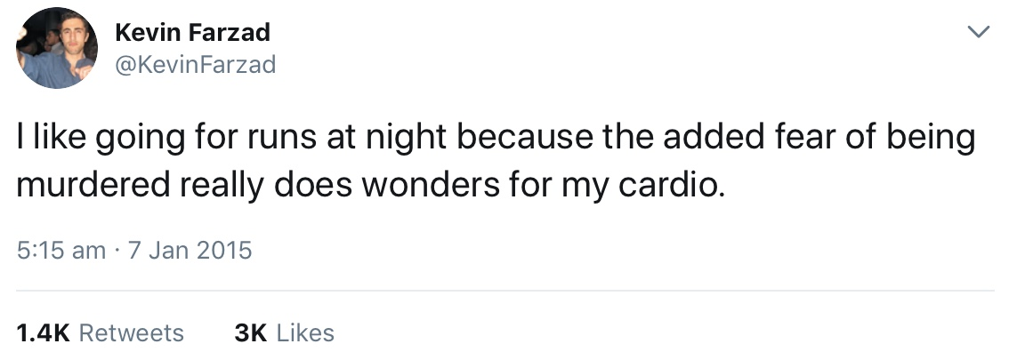

Slide 8
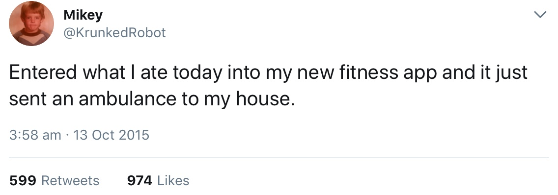

Slide 9
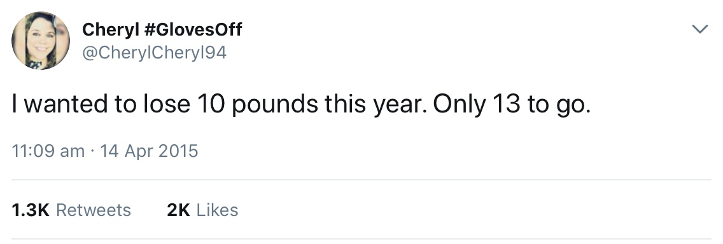

Slide 12
“I have the right to do anything,” you say—but not everything is beneficial. “I have the right to do anything”—but I will not be mastered by anything.

Slide 13
You say, “Food for the stomach and the stomach for food, and God will destroy them both.” The body, however, is not meant for sexual immorality but for the Lord, and the Lord for the body.

Slide 14
By his power God raised the Lord from the dead, and he will raise us also. Do you not know that your bodies are members of Christ himself? Shall I then take the members of Christ and unite them with a prostitute? Never!

Slide 15
Do you not know that he who unites himself with a prostitute is one with her in body? For it is said, “The two will become one flesh.” But whoever is united with the Lord is one with him in spirit.

Slide 16
Flee from sexual immorality. All other sins a person commits are outside the body, but whoever sins sexually, sins against their own body.

Slide 17
Do you not know that your bodies are temples of the Holy Spirit, who is in you, whom you have received from God? You are not your own; you were bought at a price. Therefore honour God with your bodies.
1 Cor 6:12-20

Slide 19
You are the meeting place of Heaven and Earth; the arena of encounter with God; the sacred space wherein His presence dwells...Every heart that bows the knee to Christ becomes a tabernacle in the world.
Gerard Kelly

Slide 21
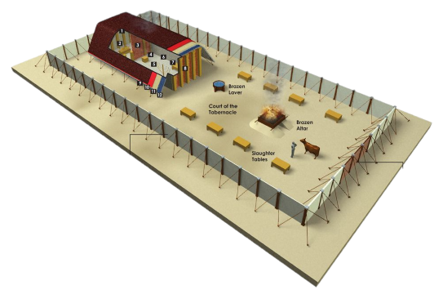

Slide 22
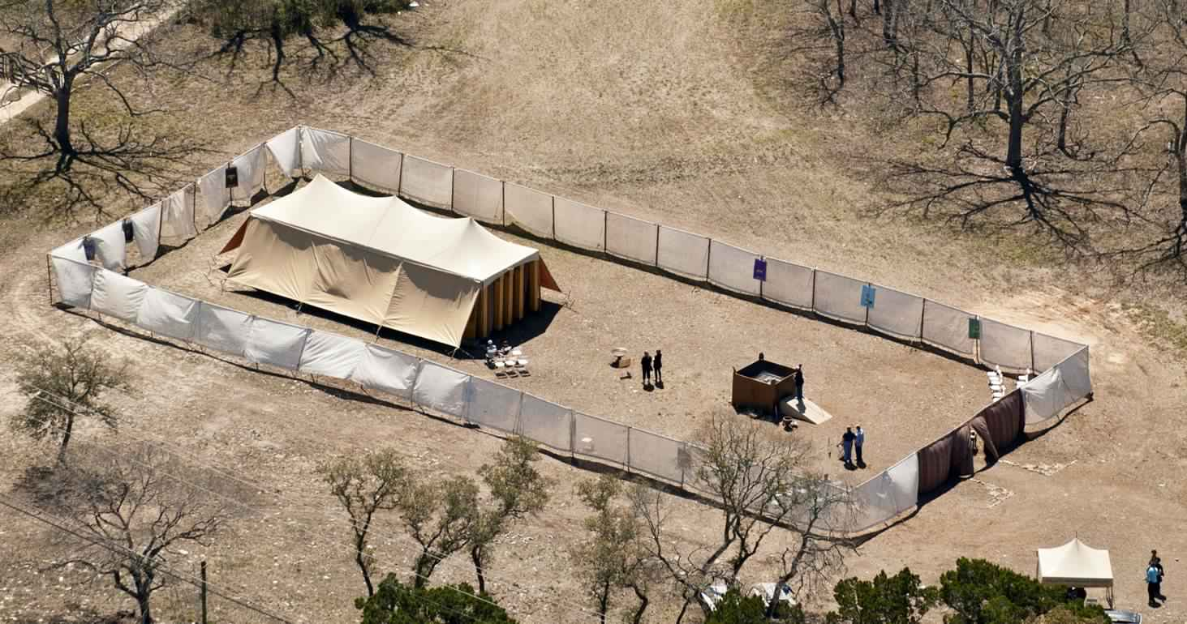

Slide 24
Then have them make a sanctuary for me, and I will dwell among them.
Exodus 25:8

Slide 26
After the king was settled in his palace and the LORD had given him rest from all his enemies around him, he said to Nathan the prophet, ‘Here I am, living in a house of cedar, while the ark of God remains in a tent.’
2 Samuel 7:1-2

Slide 28
The Word became flesh and made his dwelling among us.
John 1:14

Slide 30
It matters not how strait the gate.
How charged with punishments the scroll.
I am the master of my fate,
I am the captain of my soul.
WE Henley

Slide 32
The greatest single cause of atheism in the world today is Christians, who acknowledge Jesus with their lips and walk out the door and deny Him by their lifestyle.

Slide 33
That is what an unbelieving world simply finds unbelievable.
Brennan Manning

