Slide 1
Let me tell you a story…

Slide 2
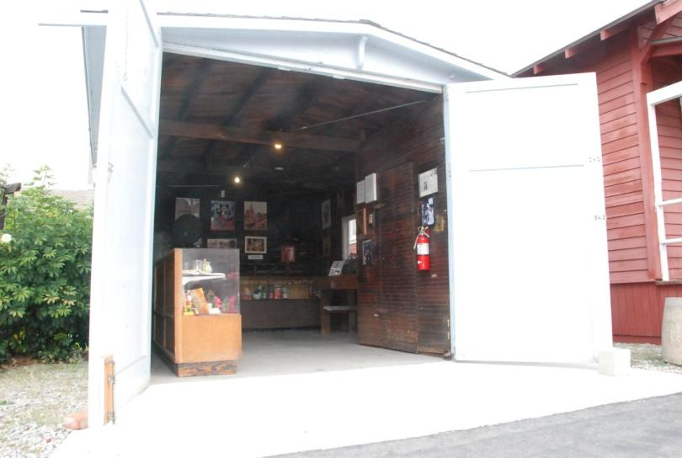

Slide 3
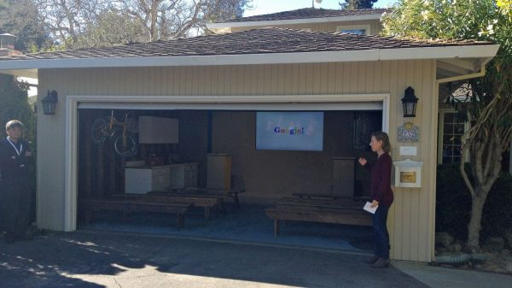

Slide 4
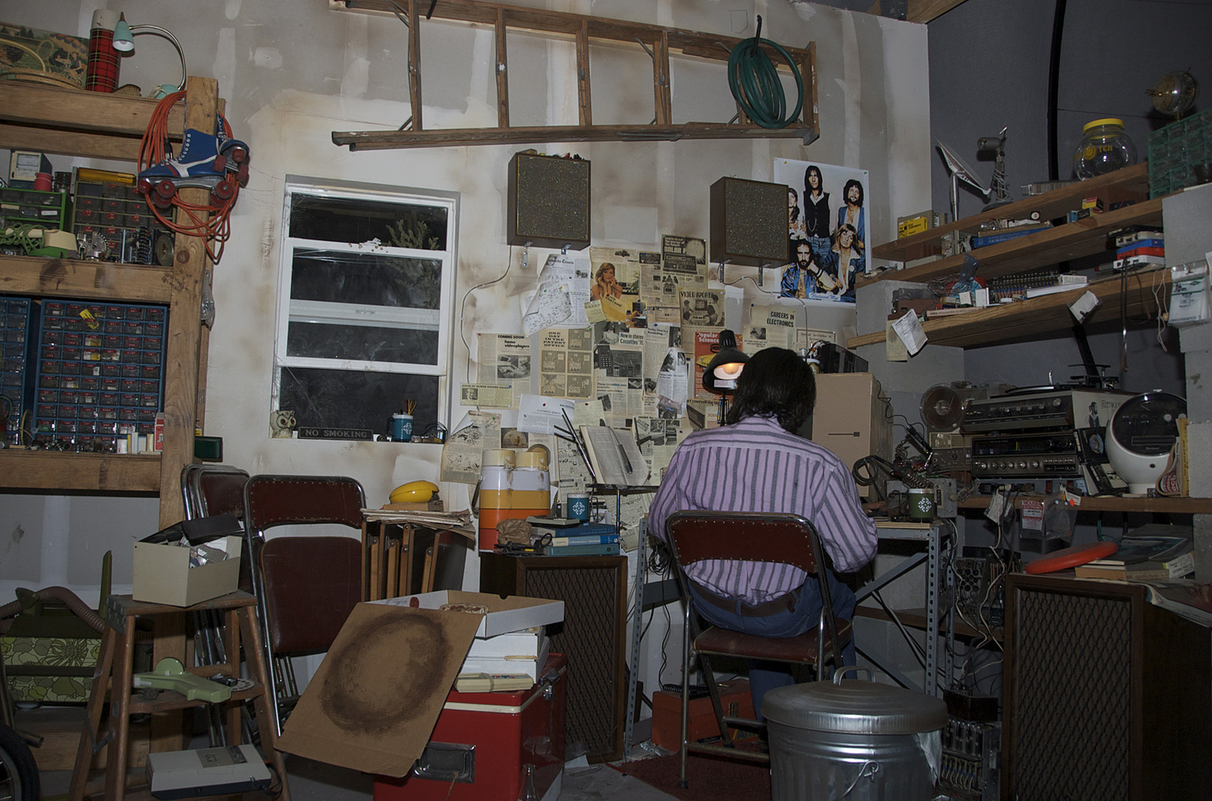

Slide 5
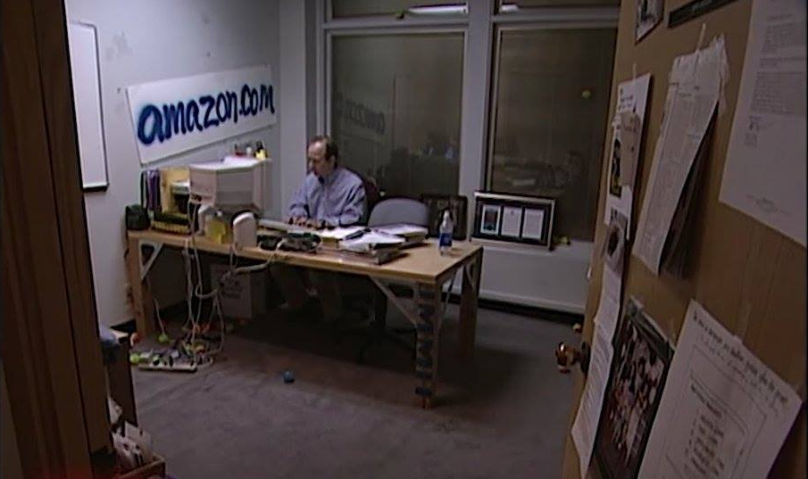

Slide 6
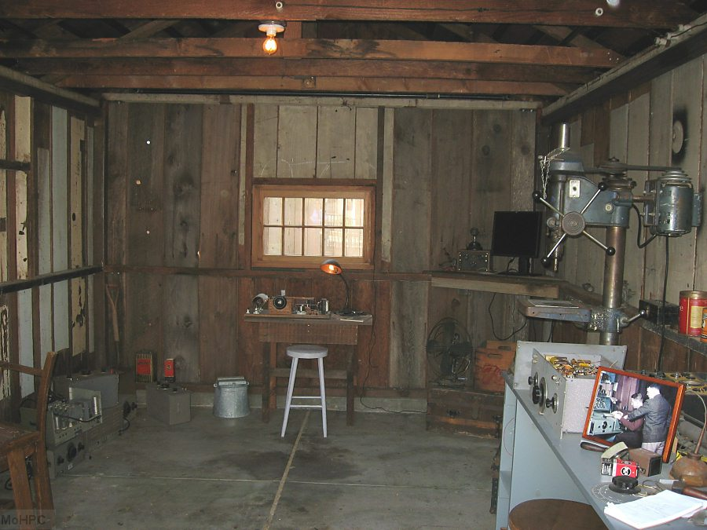

Slide 8
Again [Jesus] said, “What shall we say the kingdom of God is like, or what parable shall we use to describe it? It is like a mustard seed, which is the smallest of all seeds on earth.

Slide 9
Yet when planted, it grows and becomes the largest of all garden plants, with such big branches that the birds can perch in its shade.”

Slide 10
With many similar parables Jesus spoke the word to them, as much as they could understand. He did not say anything to them without using a parable.

Slide 11
But when he was alone with his own disciples, he explained everything.
Mark 4:30-34

Slide 13
The glory of this present house will be greater than the glory of the former house,’ says the Lord Almighty.

Slide 14
‘And in this place I will grant peace,’ declares the Lord Almighty.”
Haggai 2:9

Slide 16
For the message of the cross is foolishness to those who are perishing…a stumbling block to Jews and foolishness to Gentiles.
1 Corinthians 1:18, 23

Slide 18
But to us who are being saved it is the power of God…to those whom God has called, both Jews and Greeks, Christ [is] the power of God and the wisdom of God.

Slide 19
For the foolishness of God is wiser than human wisdom, and the weakness of God is stronger than human strength.
1 Corinthians 1:18, 24-25

Slide 21
Mustard... is extremely beneficial for the health. It grows entirely wild, though it is improved by being transplanted.

Slide 22
But on the other hand when it has once been sown it is scarcely possible to get the place free of it, as the seed when it falls germinates at once.
Pliny the Elder

Slide 24
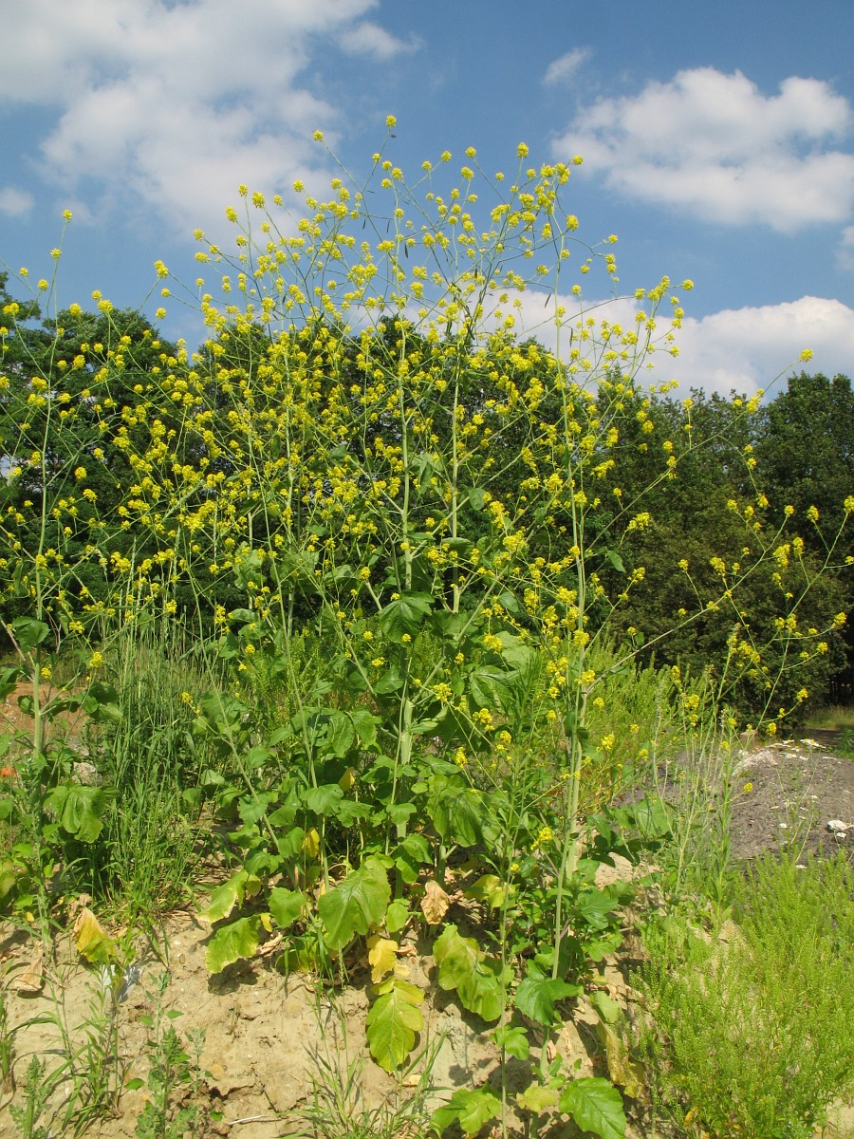

Slide 26
The reign of God apparently isn’t much of a cash crop. Yet it grows. It is not easily eradicated. Good luck keeping it out of your well-manicured garden or your farmland.

Slide 27
Better be careful what you pray for when you say, “Your Kingdom come...”
Matt Skinner

Slide 28
Let me tell you a story…

