Slide 1

Life through Gospel lenses

Slide 2
We all, who with unveiled faces contemplate the Lord’s glory, are being transformed into his image with ever-increasing glory, which comes from the Lord, who is the Spirit. 2 Corinthians 3:18

Slide 4

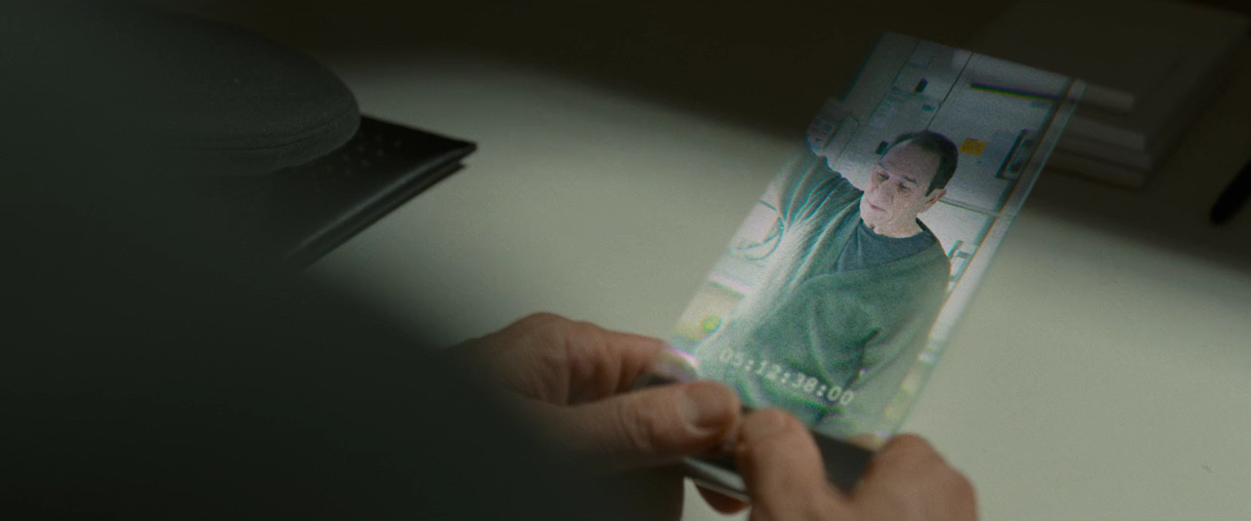

Slide 5
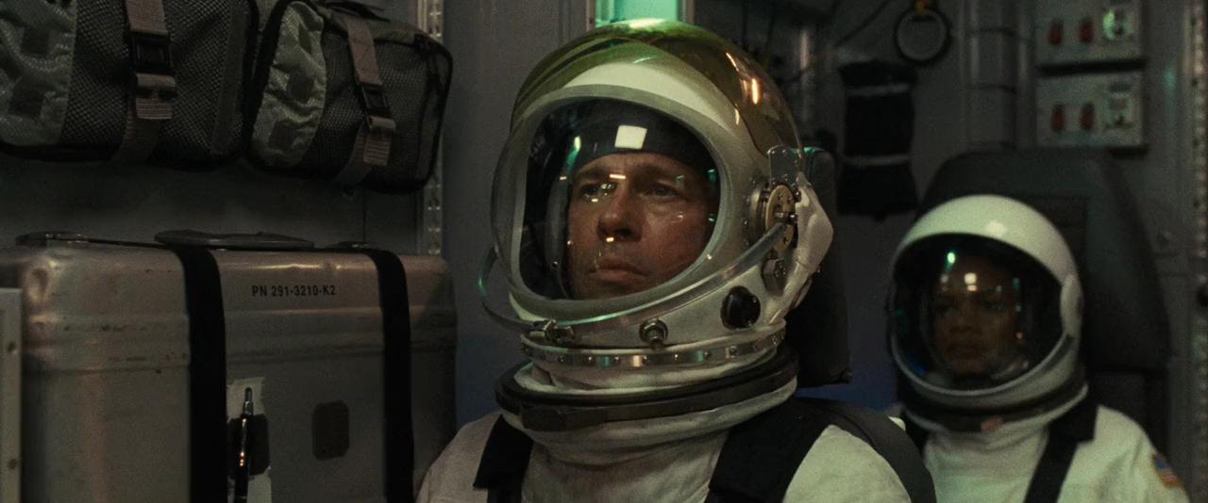

Slide 6
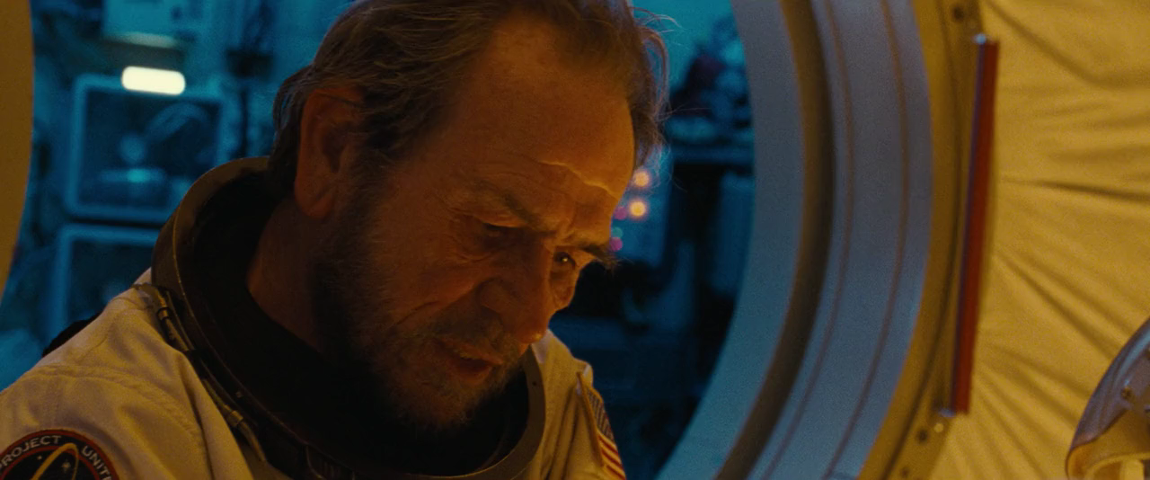

Slide 8
For we did not follow cleverly devised stories when we told you about the coming of our Lord Jesus Christ in power, but we were eyewitnesses of his majesty.

Slide 9
He received honour and glory from God the Father when the voice came to him from the Majestic Glory, saying, “This is my Son, whom I love; with him I am well pleased.”

Slide 10
We ourselves heard this voice that came from heaven when we were with him on the sacred mountain.

Slide 11
We also have the prophetic message as something completely reliable, and you will do well to pay attention to it, as to a light shining in a dark place, until the day dawns and the morning star rises in your hearts.

Slide 12
Above all, you must understand that no prophecy of Scripture came about by the prophet’s own interpretation of things.

Slide 13
For prophecy never had its origin in the human will, but prophets, though human, spoke from God as they were carried along by the Holy Spirit.
2 Peter 1:16-21

Slide 15
You formed us for yourself, O Lord, and our hearts are restless ‘til they rest in you.
St Augustine

Slide 17
That which was from the beginning, which we have heard, which we have seen with our eyes, which we have looked at and our hands have touched—this we proclaim concerning the Word of life.

Slide 18
The life appeared; we have seen it and testify to it, and we proclaim to you the eternal life, which was with the Father and has appeared to us.
1 John 1:1-2

Slide 20
To those who through the righteousness of our God and Saviour Jesus Christ have received a faith as precious as ours. 2 Peter 1:1

Slide 22
There is one body and one Spirit, just as you were called to one hope when you were called; one Lord, one faith, one baptism; one God and Father of all, who is over all and through all and in all. Ephesians 4:4-5

Slide 24
His divine power has given us everything we need for a godly life through our knowledge of him who called us by his own glory and goodness.

Slide 25
Through these he has given us his very great and precious promises, so that through them you may participate in the divine nature, having escaped the corruption in the world caused by evil desires.
2 Peter 1:3-4

Slide 27
If their ‘private revelations’ agree with Scripture, they are needless; and if they disagree, they are false. JI Packer

Slide 29
In the past God spoke to our ancestors through the prophets at many times and in various ways, but in these last days he has spoken to us by his Son, whom he appointed heir of all things, and through whom also he made the universe.

Slide 30
The Son is the radiance of God’s glory and the exact representation of his being, sustaining all things by his powerful word.
Hebrews 1:1-3

Slide 32
He who did not spare his own Son, but gave him up for us all—how will he not also, along with him, graciously give us all things?
Romans 8:32

Slide 33
Life through Gospel lenses

