Slide 2
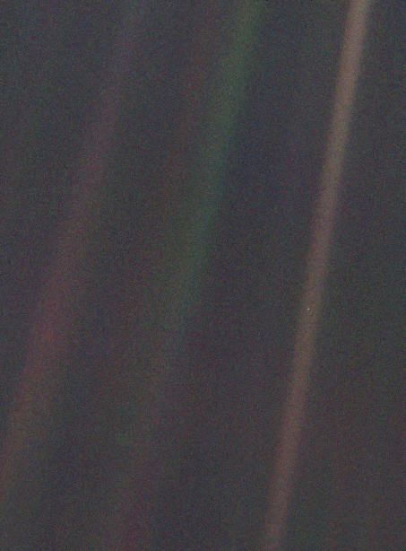

Slide 3
If you look at it, you see a dot. That’s here. That’s home. That’s us. On it, everyone you ever heard of, every human being who has ever lived, lived out their lives...

Slide 4
every saint and sinner in the history of our species, lived there on a mote of dust, suspended in a sunbeam...Our planet is a lonely speck in the great enveloping cosmic dark.

Slide 5
In our obscurity- in all this vastness- there is no hint that help will come from elsewhere to save us from ourselves.
Carl Sagan

Slide 7
The Lord had said to Abram, “Go from your country, your people and your father’s household to the land I will show you.

Slide 8
“I will make you into a great nation, and I will bless you; I will make your name great, and you will be a blessing.

Slide 9
I will bless those who bless you, and whoever curses you I will curse; and all peoples on earth will be blessed through you.”
So Abram went, as the Lord had told him.
Genesis 12:1-4

Slide 11
A journey that leaves behind an old life and looks forward to a future not yet seen.
Dennis Olsen

