Slide 1
Built to worship

Slide 2
Then the Pharisees went out and laid plans to trap him in his words. They sent their disciples to him along with the Herodians. “Teacher,” they said, “we know that you are a man of integrity and that you teach the way of God in accordance with the truth.

Slide 3
You aren’t swayed by others, because you pay no attention to who they are. Tell us then, what is your opinion? Is it right to pay the imperial tax to Caesar or not?”

Slide 4
But Jesus, knowing their evil intent, said, “You hypocrites, why are you trying to trap me? Show me the coin used for paying the tax.” They brought him a denarius, and he asked them, “Whose image is this? And whose inscription?”

Slide 5
“Caesar’s,” they replied.
Then he said to them, “So give back to Caesar what is Caesar’s, and to God what is God’s.”

Slide 6
When they heard this, they were amazed. So they left him and went away.
Matthew 22:15-22

Slide 8
Taxation is no better than downright slavery. Judas the Galilean

Slide 10
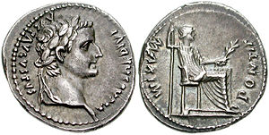
Tiberius Caesar, august son of the divine Augustus
High Priest

Slide 12
The Son is the image of the invisible God.
Colossians 1:15

Slide 14
We have no king but Caesar.
John 19:15

Slide 16
We may divide our budget, but we must never divide our allegiance.
Lance Pape

Slide 18
Anyone who loves their father or mother more than me is not worthy of me; anyone who loves their son or daughter more than me is not worthy of me.

Slide 19
Whoever does not take up their cross and follow me is not worthy of me. Matthew 10:37-38

Slide 21
The baptised have pledged their allegiance to the Prince of Peace. Baptism means we have already transferred our citizenship to the Kingdom of Heaven. Brian Zahnd

Slide 23
Then God said, ‘Let us make mankind in our image, in our likeness. Genesis 1:26

Slide 25
Rome has some authority in some matters, but God has final authority in all matters. Timothy Geddert

Slide 27
As the hound follows the hare, never ceasing in its running, ever drawing nearer in the chase, with unhurrying and unperturbed pace, so does God follow the fleeing soul by His Divine grace.

Slide 28
And though in sin or in human love, away from God it seeks to hide itself, Divine grace follows after, unwearyingly follows ever after.
JFX O’Conor

Slide 30
Sin is not just the doing of bad things, but the making of good things into ultimate things. Tim Keller

Slide 32
I will give them an undivided heart and put a new spirit in them; I will remove their heart of stone and give them a heart of flesh.

Slide 33
They will follow my decrees and be careful to keep my laws. They will be my people, and I will be their God.
Ezekiel 11:19-20

Slide 35
I am saying this for your own good, not to restrict you, but that you may live in a right way in undivided devotion to the Lord. 1 Corinthians 7:35

Slide 37
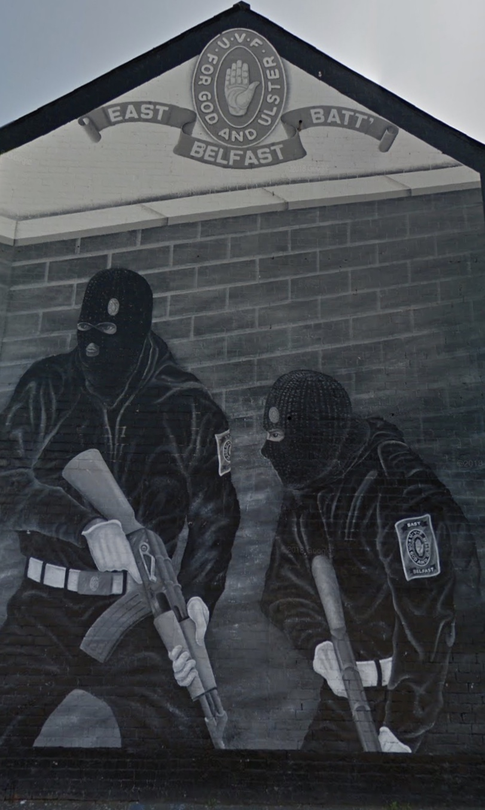

Slide 38
Built to worship

