Slide 2
I will tell of the kindnesses of the Lord,
the deeds for which he is to be praised,
according to all the Lord has done for us—

Slide 3
yes, the many good things
he has done for Israel,
according to his compassion and many kindnesses.

Slide 4
He said, “Surely they are my people,
children who will be true to me”;
and so he became their Saviour.

Slide 5
In all their distress he too was distressed,
and the angel of his presence saved them.

Slide 6
In his love and mercy he redeemed them;
he lifted them up and carried them
all the days of old.
Isaiah 63:7-9

Slide 8
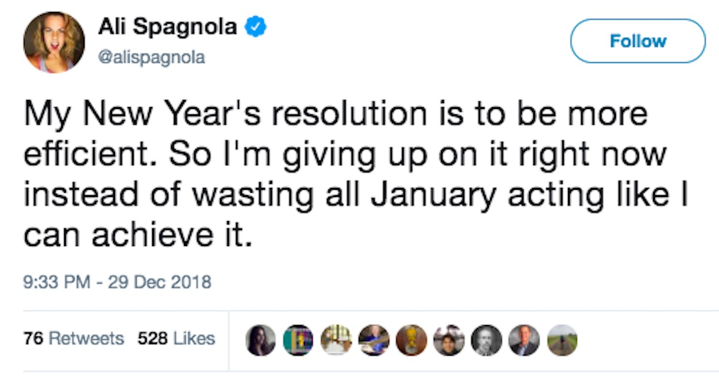

Slide 9
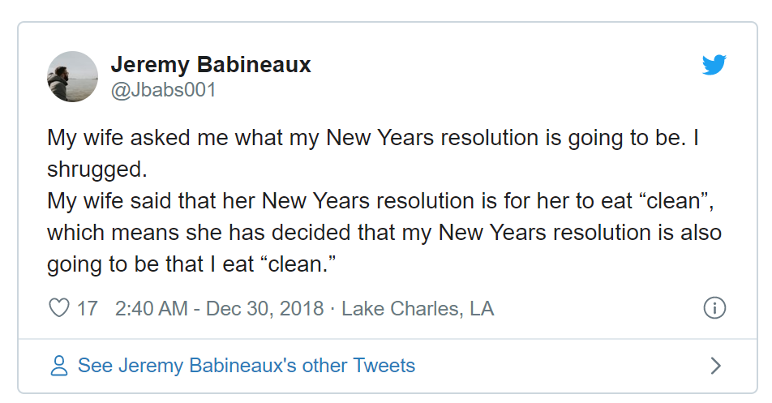

Slide 10
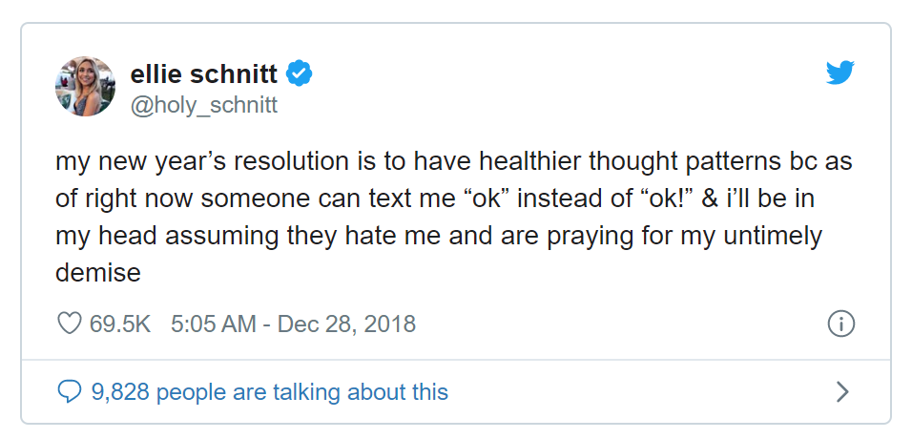

Slide 11
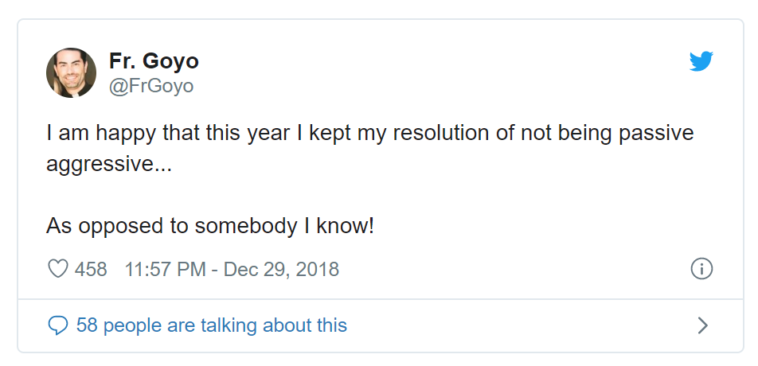

Slide 12
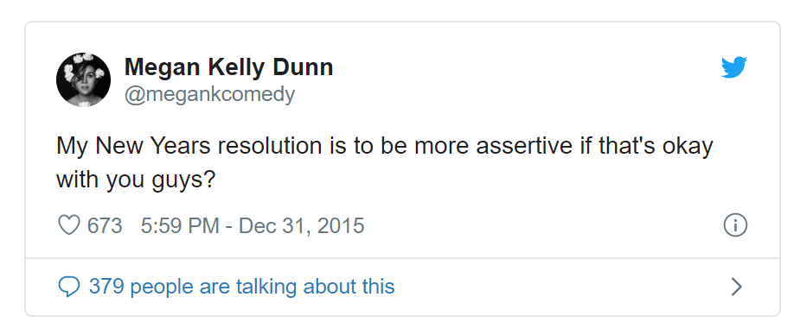

Slide 13
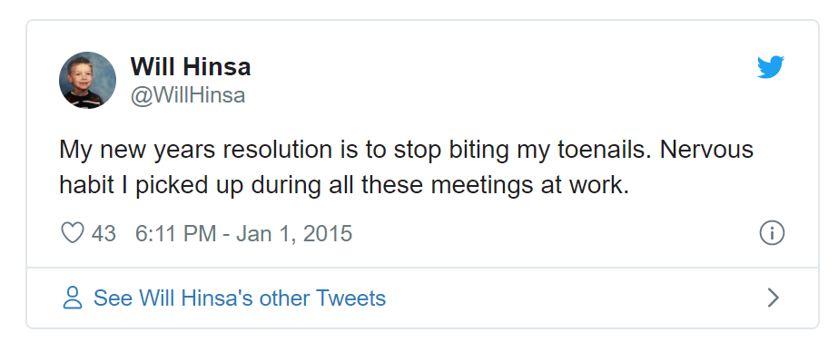

Slide 15
I’ll make a list of God’s gracious dealings,
all the things God has done that need praising,
All the generous bounties of God,
his great goodness to the family of Israel—

Slide 16
Compassion lavished,
love extravagant.
Isaiah 63:7

Slide 18
Give us today our daily bread. Matthew 6:11

Slide 20
I have indeed seen the misery of my people in Egypt. I have heard them crying out…and I am concerned about their suffering. So I have come down to rescue them.
Exodus 3:7-8

