Slide 1
Community
Bible
Experience

Slide 2
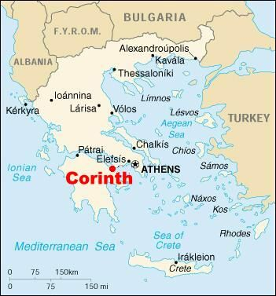

Slide 4
“I will destroy the wisdom of the wise”
1 Corinthians 1:19

Slide 5
“The foolishness of God is wiser than human wisdom”
1 Corinth 1:25

Slide 7
“…people who are still worldly - mere infants in Christ”
1 Corinth 3:1

Slide 9
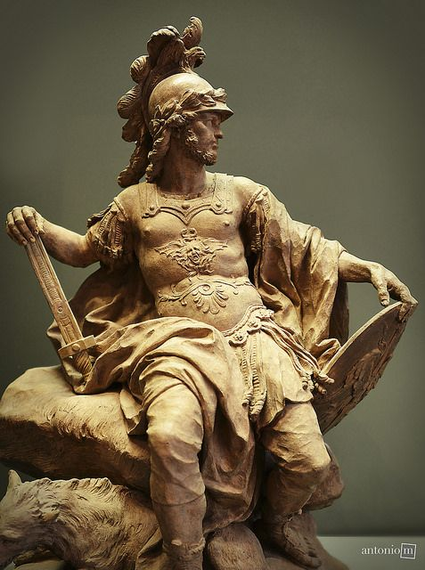

Slide 11
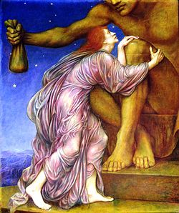

Slide 13
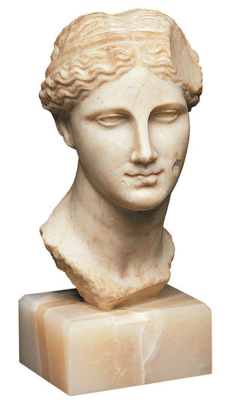

Slide 15
“above all…the church must be for the world what Jesus was for Israel, it is vital that we in the church should come where there is real pain and dehumanization caused by the worship of Aphrodite…”

Slide 16
“…and be prepared to stand alongside those who are hurt, approaching them where they are, not there we want them to be.”

Slide 17
“This will undoubtedly mean that Christians will find themselves, as Jesus found himself, at risk morally and physically. But let there be no mistake”

Slide 18
“Jesus did not shout platitudes at Israel from a safe distance. He identified with her plight, even though it cost him his life. The church must find appropriate ways of doing the same thing in the modern world.”
(Tom Wright)

Slide 20
“But their idols are silver and gold, made by human hands. They have mouths, but cannot speak, eyes, but cannot see. They have ears, but cannot hear, noses, but cannot smell.”

Slide 21
“They have hands, but cannot feel, feet, but cannot walk, nor can they utter a sound with their throats. Those who make them will be like them, and so will all who trust in them.”
Psalm 115:4-8

Slide 23
“Everything that collective human rebellion could become; everything that the radical wickedness of the world could produce;”

Slide 24
“everything that evil powers beyond the range of human comprehension could accomplish; all of that was heaped on to Jesus.”

Slide 25
“And the cross itself, symbol as it is of the worst that paganism can and did do, became also the symbol of the divine victory over that paganism.”
(Tom Wright)

Slide 27
“The other gods were strong; but Thou wast weak;”
“They rode, but Thou didst stumble to a throne;

Slide 28
But to our wounds only God’s wounds can speak,
And not a god has wounds, but Thou alone.”
Edward Shillito –
Jesus of the Scars

