Slide 1
In Between

Slide 2
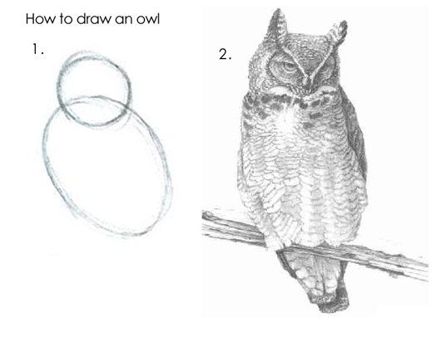

Slide 3
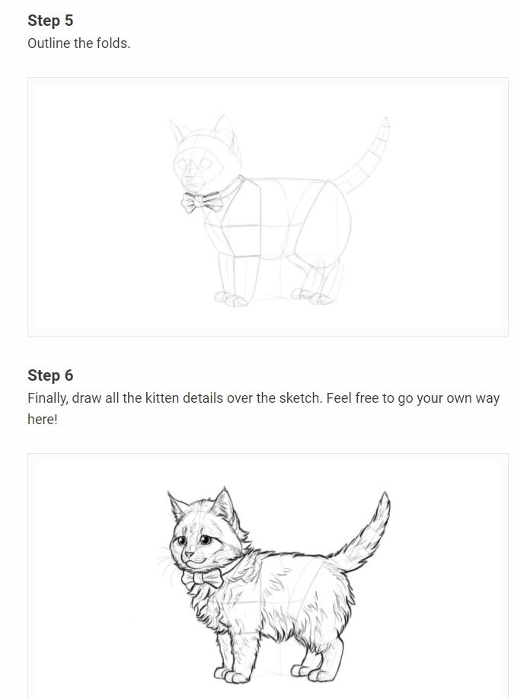

Slide 4
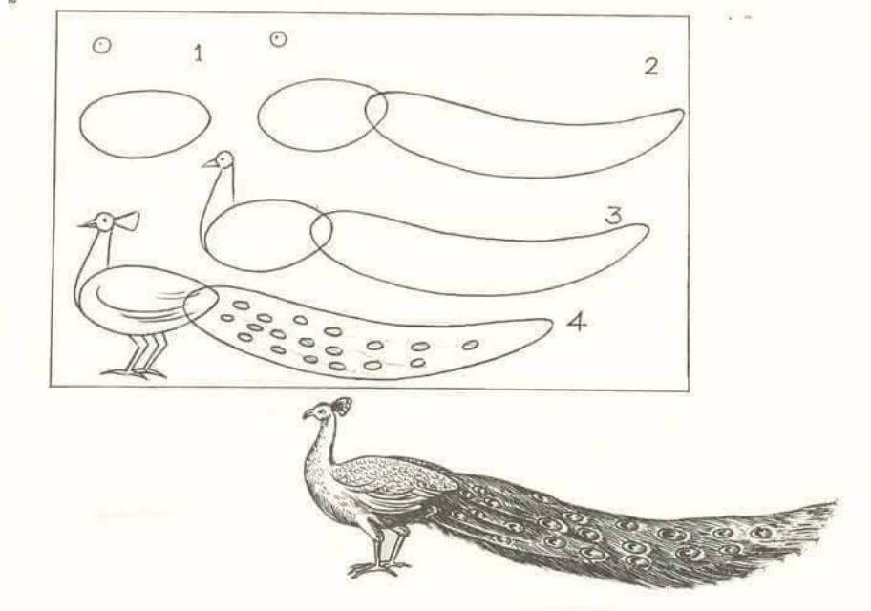

Slide 5
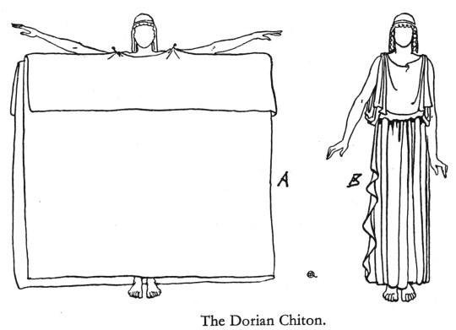

Slide 8
In my former book, Theophilus, I wrote about all that Jesus began to do and to teach until the day he was taken up to heaven, after giving instructions through the Holy Spirit to the apostles he had chosen. After his suffering, he presented himself to them and gave many convincing proofs that he was alive.

Slide 9
He appeared to them over a period of forty days and spoke about the kingdom of God. On one occasion, while he was eating with them, he gave them this command:

Slide 10
“Do not leave Jerusalem, but wait for the gift my Father promised, which you have heard me speak about. For John baptized with water, but in a few days you will be baptized with the Holy Spirit.”
Acts 1:1-5

Slide 12
Very truly I tell you, whoever believes in me will do the works I have been doing, and they will do even greater things than these, because I am going to the Father.
John 14:12

Slide 14
“Come, follow me,” Jesus said, “and I will send you out to fish for people.” At once they left their nets and followed him.
Matthew 4:19-20

Slide 16
So Christ himself gave the apostles, the prophets, the evangelists, the pastors and teachers, to equip his people for works of service, so that the body of Christ may be built up.
Ephesians 4:11-12

Slide 18
The Continuing Words and Deeds of Jesus by His Spirit through His Apostles.
John Stott

Slide 20
For two whole years Paul stayed there in his own rented house and welcomed all who came to see him. He proclaimed the kingdom of God and taught about the Lord Jesus Christ—with all boldness and without hindrance!
Acts 28:30-31

