Slide 2
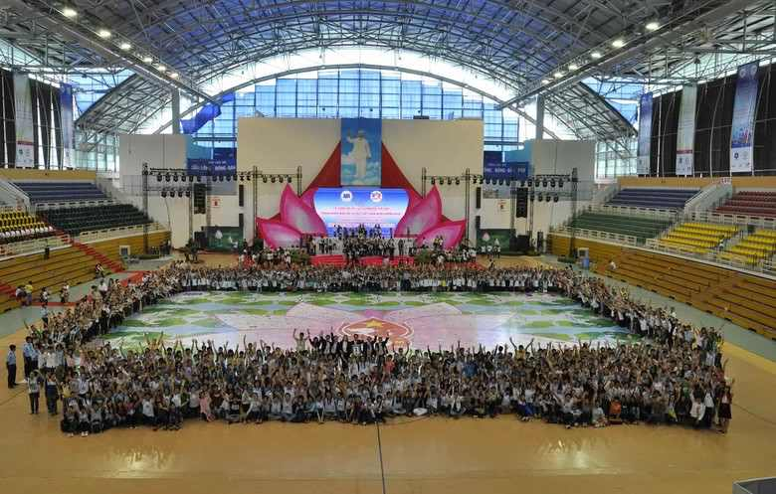

Slide 5
“Very truly I tell you Pharisees, anyone who does not enter the sheep pen by the gate, but climbs in by some other way, is a thief and a robber.

Slide 6
The one who enters by the gate is the shepherd of the sheep. The gatekeeper opens the gate for him, and the sheep listen to his voice. He calls his own sheep by name and leads them out.

Slide 7
When he has brought out all his own, he goes on ahead of them, and his sheep follow him because they know his voice.

Slide 8
But they will never follow a stranger; in fact, they will run away from him because they do not recognize a stranger’s voice.”

Slide 9
Jesus used this figure of speech, but the Pharisees did not understand what he was telling them. Therefore Jesus said again, “Very truly I tell you, I am the gate for the sheep.

Slide 10
All who have come before me are thieves and robbers, but the sheep have not listened to them. I am the gate; whoever enters through me will be saved.

Slide 11
They will come in and go out, and find pasture. The thief comes only to steal and kill and destroy; I have come that they may have life, and have it to the full.

Slide 13
Helping people find life in all its fullness.

Slide 14
In Llay, for Llay
Locally focused, globally minded
Growing deeper and wider
Not all Kingdom work leads to salvation

