Slide 2
Then Jesus came from Galilee to the Jordan to be baptised by John. But John tried to deter him, saying, “I need to be baptised by you, and do you come to me?”

Slide 3
Jesus replied, “Let it be so now; it is proper for us to do this to fulfil all righteousness.” Then John consented.

Slide 4
As soon as Jesus was baptised, he went up out of the water.

Slide 5
At that moment heaven was opened, and he saw the Spirit of God descending like a dove and alighting on him.

Slide 6
And a voice from heaven said, “This is my son, whom I love; with him I am well pleased.”
Matthew 3:13-17

Slide 8
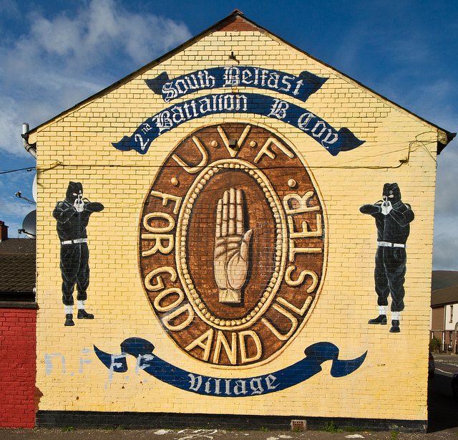

Slide 9
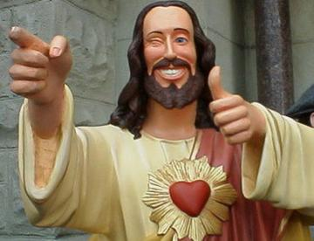

Slide 10
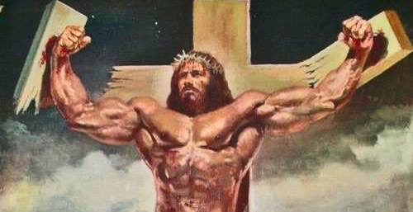

Slide 11
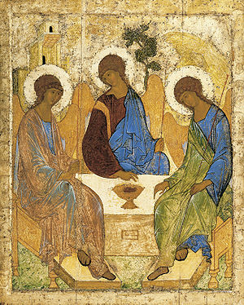

Slide 13
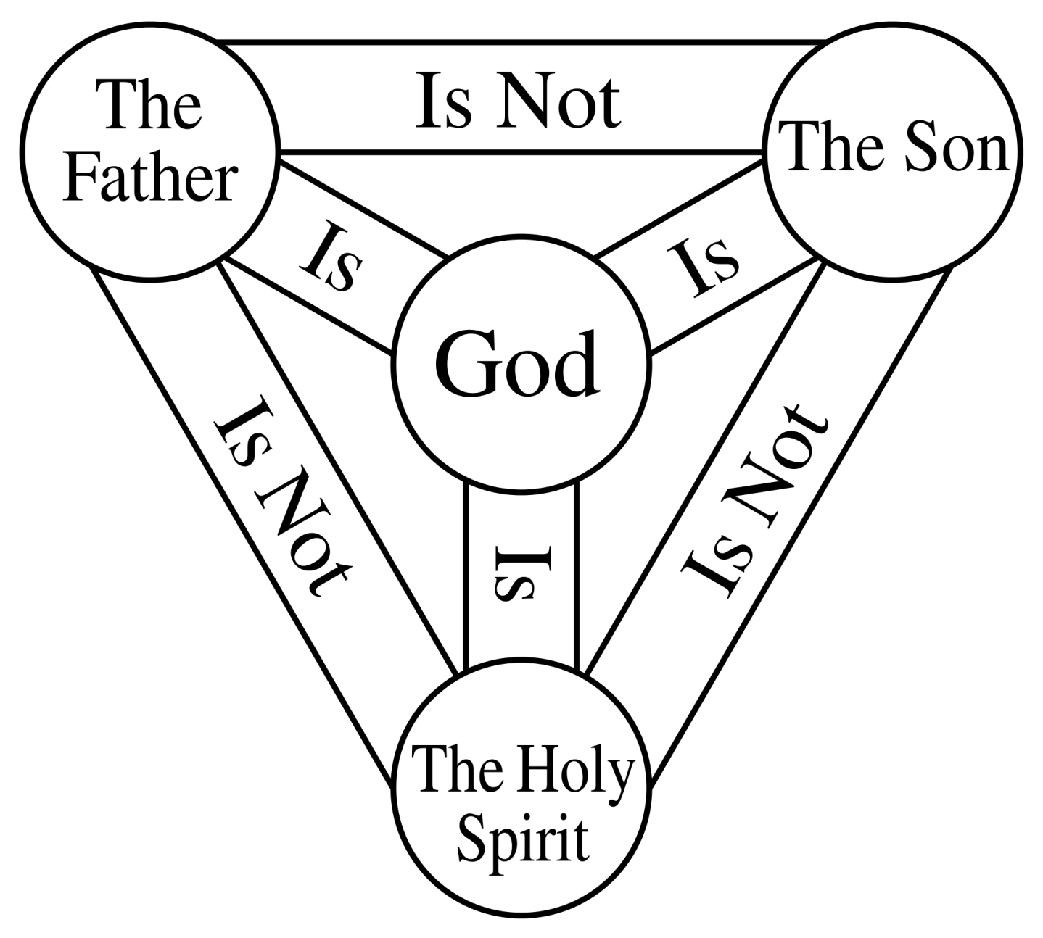

Slide 15
God’s work, putting all things right all these centuries, is coming together right now in this baptism.
Matthew 3:15

