Slide 2
‘The days are coming,’ declares the Lord, ‘when I will fulfill the good promise I made to the people of Israel and Judah.

Slide 3
‘In those days and at that time I will make a righteous Branch sprout from David’s line;

Slide 4
he will do what is just and right in the land. In those days Judah will be saved and Jerusalem will live in safety.

Slide 5
This is the name by which it will be called: The Lord Our Righteous Saviour.’
Jeremiah 33:14-16

Slide 7
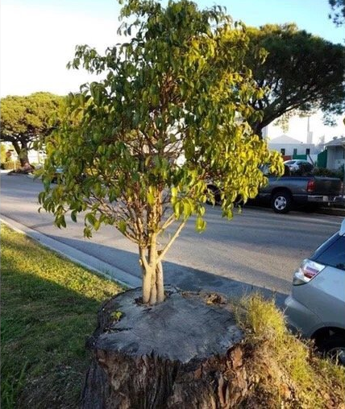

Slide 8
In the midst of darkness, light is about to break in. In the midst of despair, hope erupts. After long waiting, a Branch will sprout...

Slide 9
This word of tenacious hope is spoken to counteract all of the life-sapping, despair-inducing evidence to the contrary. Kathryn Schifferdecker

Slide 11
In Advent, we live in the unsettling tension between what is and what will be.
Anne Stewart

