Slide 2
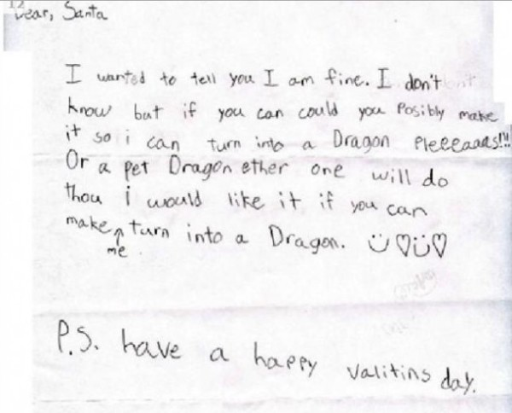

Slide 3
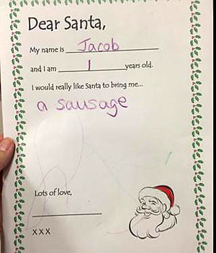

Slide 4
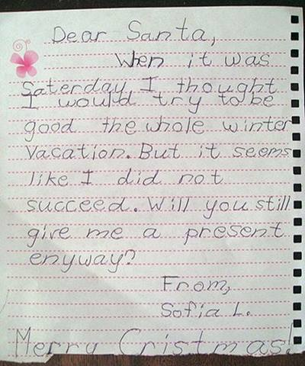

Slide 5
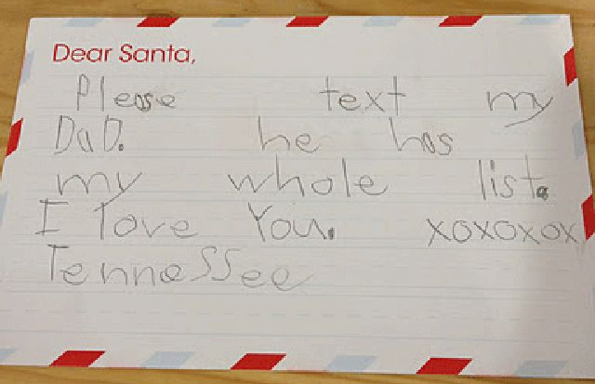

Slide 6
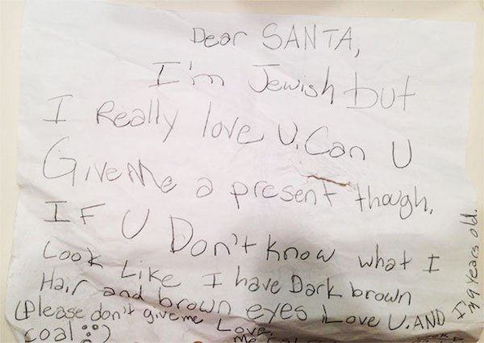

Slide 7
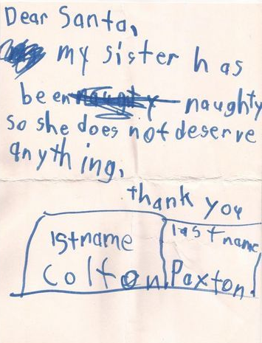

Slide 9
And there were shepherds living out in the fields nearby, keeping watch over their flocks at night.

Slide 10
An angel of the Lord appeared to them, and the glory of the Lord shone around them, and they were terrified.

Slide 11
But the angel said to them, “Do not be afraid. I bring you good news that will cause great joy for all the people.

Slide 12
Today in the town of David a Saviour has been born to you; he is the Messiah, the Lord. This will be a sign to you:

Slide 13
You will find a baby wrapped in cloths and lying in a manger.”

Slide 14
Suddenly a great company of the heavenly host appeared with the angel, praising God and saying,

Slide 15
“Glory to God in the highest heaven, and on earth peace to those on whom his favour rests.”

Slide 16
When the angels had left them and gone into heaven, the shepherds said to one another,

Slide 17
“Let’s go to Bethlehem and see this thing that has happened, which the Lord has told us about.”
Luke 2:8-15

Slide 19
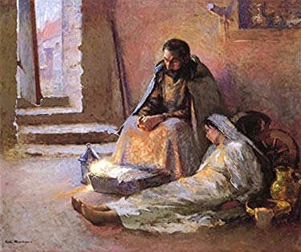

Slide 21
“Glory to God in the highest heaven, and on earth peace to those on whom his favour rests.”
Luke 2:13-14

Slide 23
...the isolated, the disenfranchised and the forgotten.
CA Satterlee

Slide 25
Each one hopes that if he feeds the crocodile enough, the crocodile will eat him last. All of them hope that the storm will pass before their turn comes to be devoured.

Slide 26
But I fear greatly that the storm will not pass. It will rage and it will roar ever more loudly, ever more widely.
Winston Churchill

Slide 28
If it is possible, as far as it depends on you, live at peace with everyone.
Romans 12:18

