Slide 2
What’s the use of a book, thought Alice, without pictures or conversations?

Slide 3
Alice’s Adventures in Wonderland- Lewis Caroll

Slide 4
It was the best of times, it was the worst of times.

Slide 5
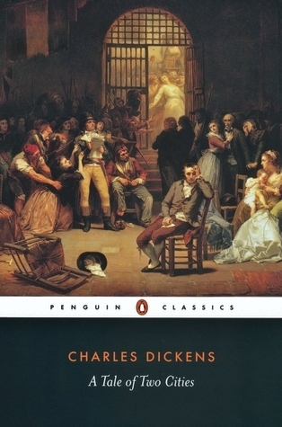
A Tale of Two Cities- Charles Dickens

Slide 6
Mr and Mrs Dursley, of number four, Privet Drive, were proud to say that they were very normal, thank you very much.

Slide 7
Harry Potter and the Philosopher’s Stone- JK Rowling

Slide 8
It is a truth, universally acknowleged, that a single man in possession of a good fortune, must be in want of a wife.

Slide 9
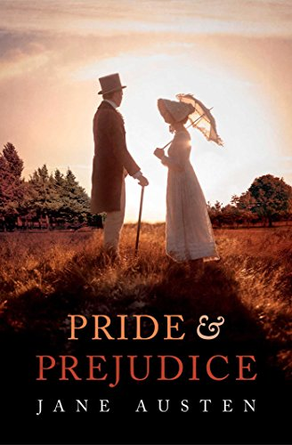
Pride and Prejudice- Jane Austin

Slide 10
In a hole in the ground there lived a Hobbit.

Slide 11
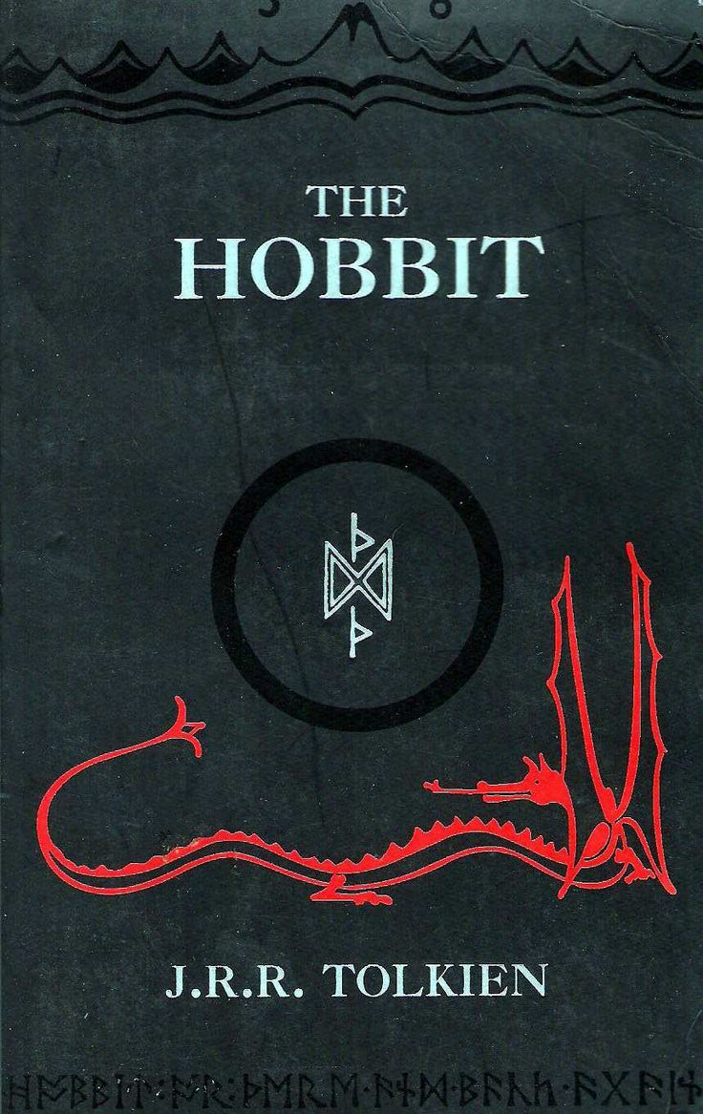
The Hobbit- JRR Tolkien

Slide 12
Call me Ishmael.

Slide 13
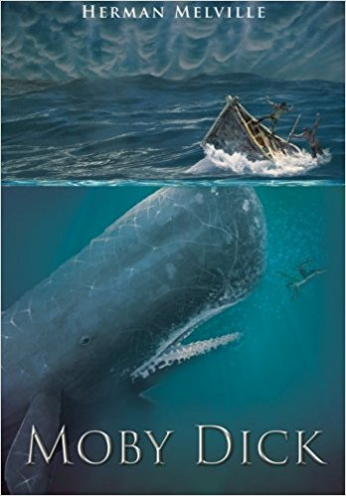
Moby Dick- Herman Melville

Slide 14
All children, except one, grow up.

Slide 15
Peter Pan- JM Barrie

Slide 16
Once there were four children, whose names were Peter, Susan, Edmund, and Lucy.

Slide 17
The Lion, the Witch and the Wardrobe- CS Lewis

Slide 18
Marley was dead, to begin with.

Slide 19
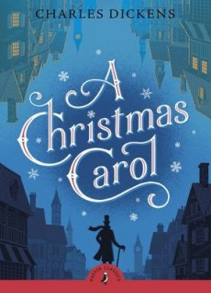
A Christmas Carol- Charles Dickens

Slide 21
It cannot be that the people should grow in grace unless they give themselves to reading. A reading people will always be a knowing people.
John Wesley

Slide 23
Everything that goes into a life of pleasing God has been miraculously given to us by getting to know, personally and intimately, the One who invited us to God.
2 Peter 1:3

Slide 25
So I will always remind you of these things, even though you know them and are firmly established in the truth you now have.

Slide 26
I think it is right to refresh your memory as long as I live in the tent of this body, because I know that I will soon put it aside, as our Lord Jesus Christ has made clear to me.

Slide 27
And I will make every effort to see that after my departure you will always be able to remember these things.

Slide 28
For we did not follow cleverly devised stories when we told you about the coming of our Lord Jesus Christ in power, but we were eyewitnesses of his majesty.

Slide 29
He received honour and glory from God the Father when the voice came to him from the Majestic Glory, saying, “This is my Son, whom I love; with him I am well pleased.”

Slide 30
We ourselves heard this voice that came from heaven when we were with him on the sacred mountain.

Slide 31
We also have the prophetic message as something completely reliable, and you will do well to pay attention to it, as to a light shining in a dark place, until the day dawns and the morning star rises in your hearts.

Slide 32
Above all, you must understand that no prophecy of Scripture came about by the prophet’s own interpretation of things.

Slide 33
For prophecy never had its origin in the human will, but prophets, though human, spoke from God as they were carried along by the Holy Spirit.
2 Peter 1:12-21

Slide 35
These words I speak to you are not incidental additions to your life, homeowner improvements to your standard of living. They are foundational words, words to build a life on.

Slide 36
If you work these words into your life, you are like a smart carpenter who built his house on solid rock. Rain poured down, the river flooded, a tornado hit- but nothing moved that house. It was fixed to the rock.

Slide 38
The way of life God has revealed in Christ...provides the only light there is in a dark world, and [we] must heed that light diligently until the dawn of Christ’s final coming.
DW Kendall

Slide 40
When he, the Spirit of truth comes, he will guide you into all the truth. He will not speak on his own; he will speak only what he hears, and he will tell you what is yet to come.

Slide 41
He will glorify me because it is from me that he will receive what he will make known to you.
John 16:13-14

Slide 43
In the past God spoke to our ancestors through the prophets at many times and in various ways, but in these last days he has spoken to us by his Son, whom he appointed heir of all things, and through whom also he made the universe.
Hebrews 1:1-2

