Slide 2
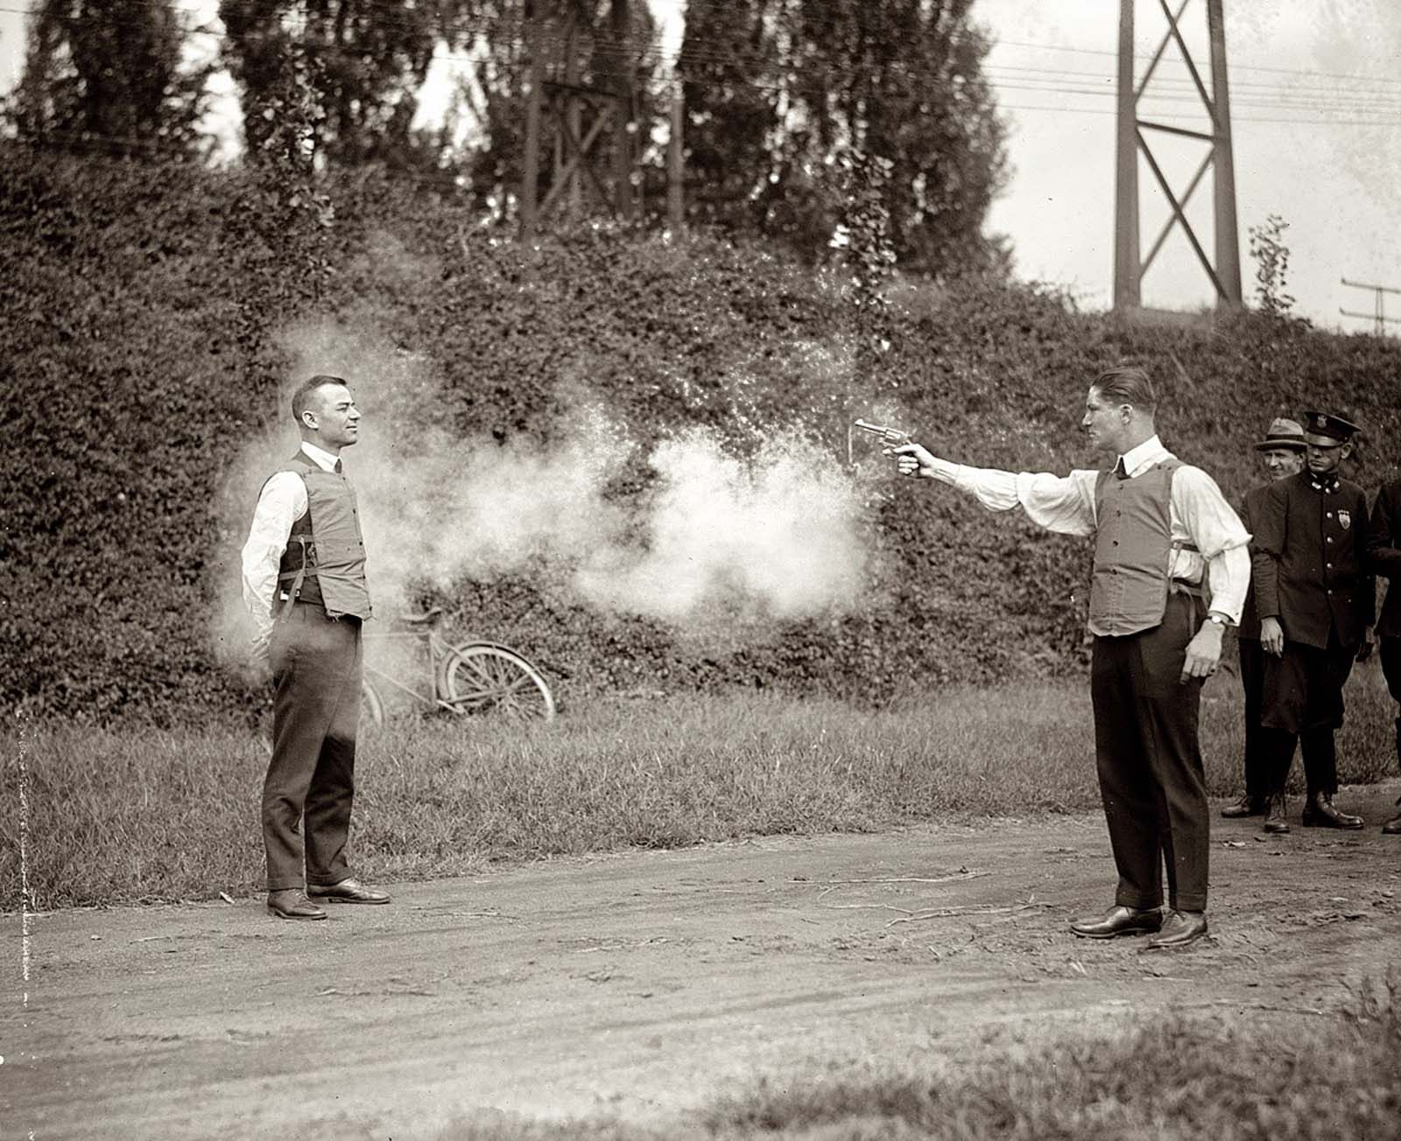

Slide 6
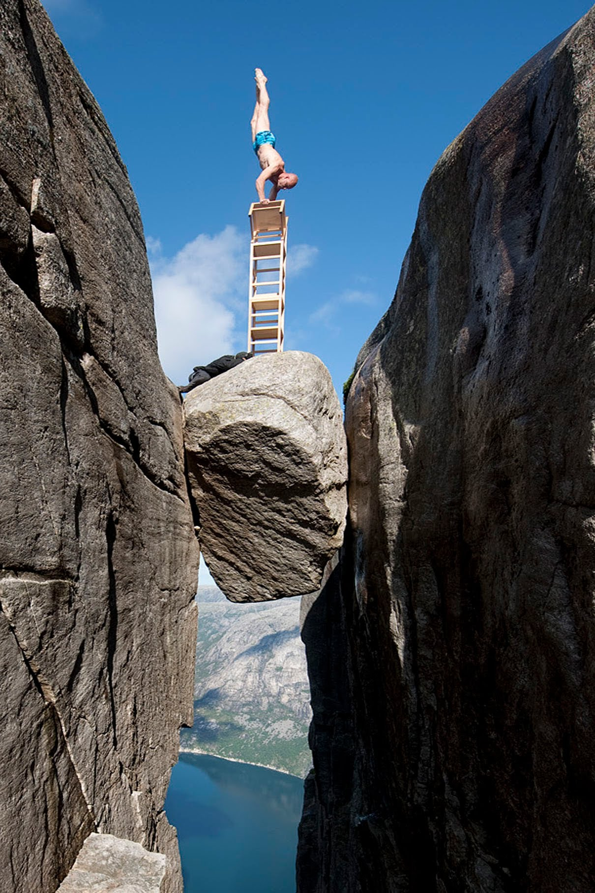

Slide 7
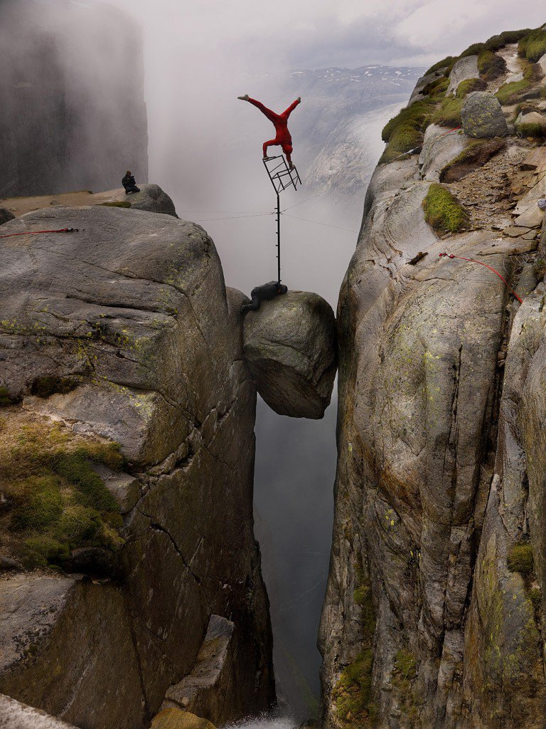

Slide 8
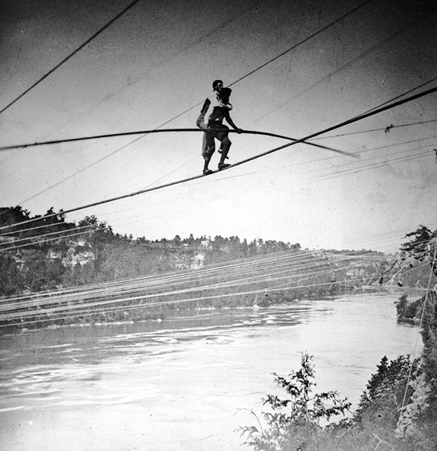

Slide 9
Look up, Harry- you are no longer Colcord, you are Blondin. Until I clear this place be a part of me, mind, body, and soul. If I sway, sway with me.

Slide 10
Do not attempt to do any balancing yourself. If you do we will both go to our death.
Charles Blondin

Slide 12
The Lord said to Moses, “Speak to the entire assembly of Israel and say to them, ‘Be holy because I, the Lord your God, am holy.’”
Leviticus 19:1-2

Slide 14
When you reap the harvest of your land, do not reap to the very edges of your field or gather the gleanings of your harvest.

Slide 15
Do not go over your vineyard a second time or pick up the grapes that have fallen. Leave them for the poor and the foreigner. I am the Lord your God.
Leviticus 19:9-10

Slide 16
Now Naomi had a relative on her husband’s side, a man of standing from the clan of Elimelek, whose name was Boaz.

Slide 17
And Ruth the Moabite said to Naomi, “Let me go to the fields and pick up the leftover grain behind anyone in whose eyes I find favour.”

Slide 18
Naomi said to her, “Go ahead, my daughter.” So she went out, entered a field and began to glean behind the harvesters.

Slide 19
As it turned out, she was working in a field belonging to Boaz, who was from the clan of Elimelek. Just then Boaz arrived from Bethlehem and greeted the harvesters, “The Lord be with you!”

Slide 20
“The Lord bless you!” they answered. Boaz asked the overseer of his harvesters, “Who does that young woman belong to?”

Slide 21
The overseer replied, “She is the Moabite who came back from Moab with Naomi. She said, ‘Please let me glean and gather among the sheaves behind the harvesters.’

Slide 22
She came into the field and has remained here from morning till now, except for a short rest in the shelter.”

Slide 23
So Boaz said to Ruth, “My daughter, listen to me. Don’t go and glean in another field and don’t go away from here.

Slide 24
Stay here with the women who work for me. Watch the field where the men are harvesting, and follow along after the women. I have told the men not to lay a hand on you.

Slide 25
And whenever you are thirsty, go and get a drink from the water jars the men have filled.”
Ruth 2:1-9

