Slide 1
Built to worship

Slide 2
What’s the most unpopular benign opinion you hold?

Slide 3
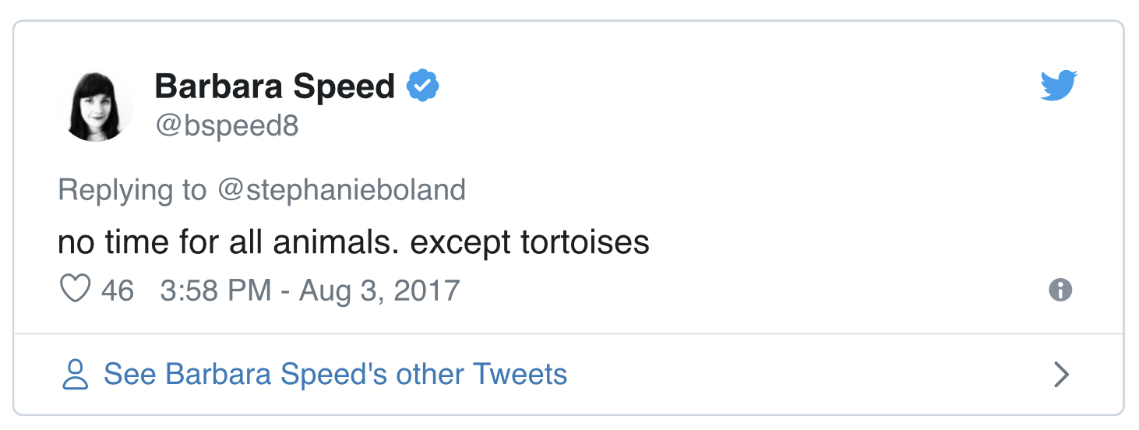

Slide 4
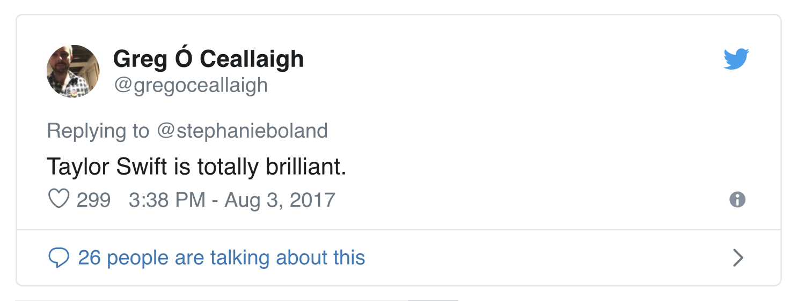

Slide 5
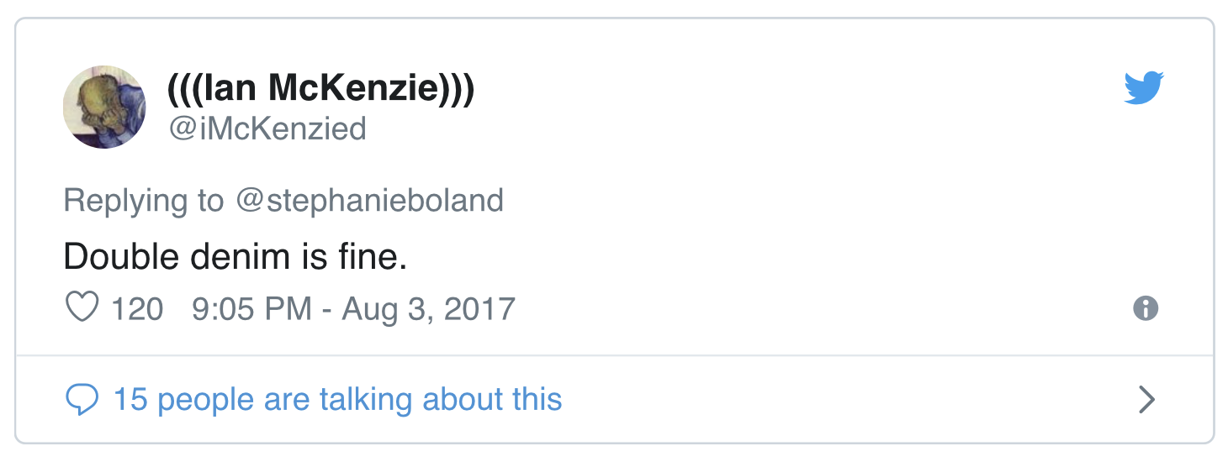

Slide 6
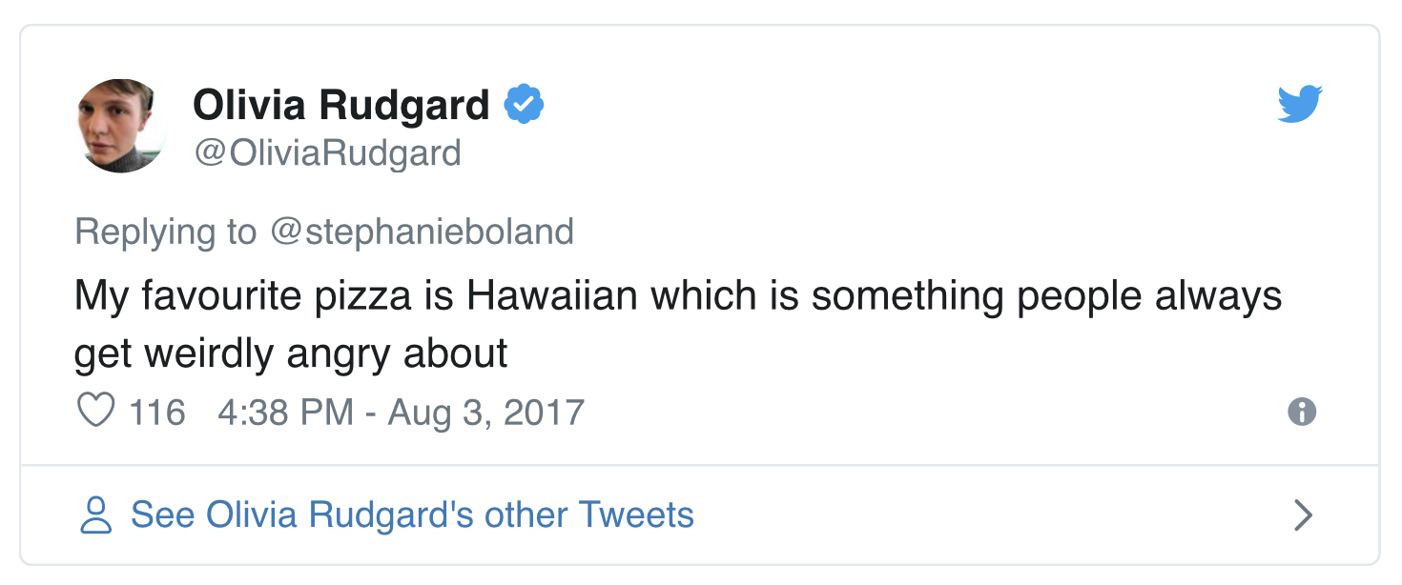

Slide 7
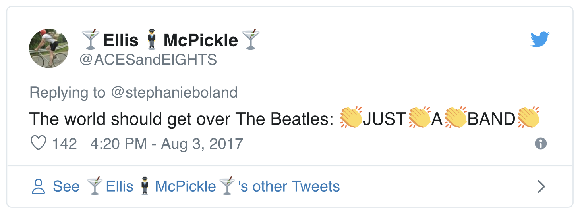

Slide 8
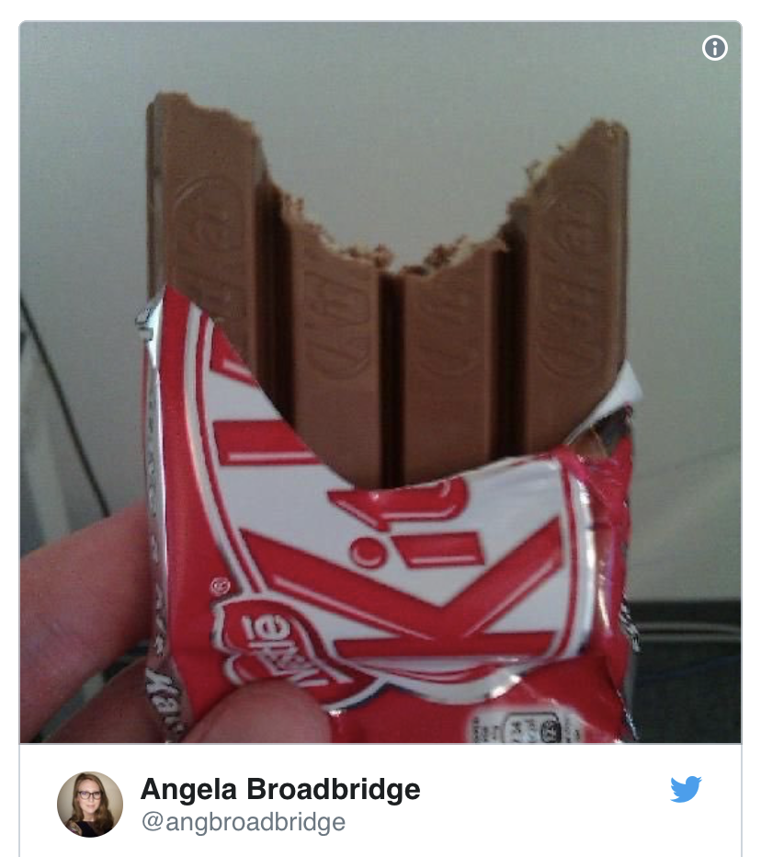

Slide 9
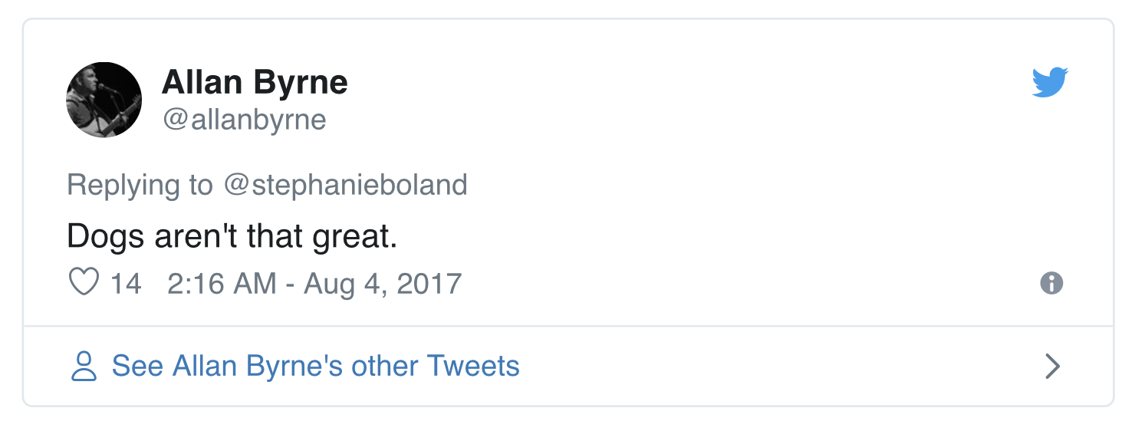

Slide 11
Now John’s disciples and the Pharisees were fasting. Some people came and asked Jesus, “How is it that John’s disciples and the disciples of the Pharisees are fasting, but yours are not?”

Slide 12
Jesus answered, “How can the guests of the bridegroom fast while he is with them? They cannot, so long as they have him with them.

Slide 13
But the time will come when the bridegroom will be taken from them, and on that day they will fast.

Slide 14
“No one sews a patch of unshrunk cloth on an old garment. Otherwise, the new piece will pull away from the old, making the tear worse. And no one pours new wine into old wineskins.

Slide 15
Otherwise, the wine will burst the skins, and both the wine and the wineskins will be ruined. No, they pour new wine into new wineskins.”
Mark 2:18-22

Slide 17
Do not think that I have come to abolish the Law or the Prophets; I have not come to abolish them but to fulfil them.
Matthew 5:17

Slide 19
Every teacher of the law who has become a disciple in the kingdom of heaven is like the owner of a house who brings out of his storeroom new treasures as well as old.
Matthew 13:52

Slide 21
The plan of God is not to choose some people, and then exclude and push away other people…the plan is to choose a people so that through those people God could reach all the people. Jon Middendorf

Slide 23
An island of holiness in a sea of pollution. Kent Brower

Slide 25
No-one after drinking old wine wants the new, for they say, ‘The old is better.’ Luke 5:39

Slide 27
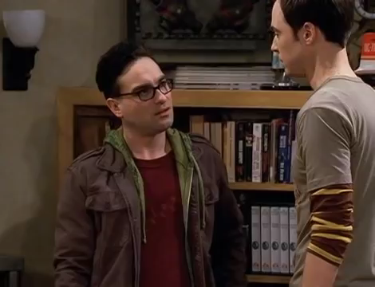

Slide 29
You formed us for yourself, oh Lord, and our hearts are restless ‘til they rest in you. Augustine

Slide 31
Do you find yourself in need of grace? Take some. Reuben Welch

Slide 33
This boundary-smashing Jesus is our only hope of deliverance from all that holds us captive.
Elisabeth Johnson

Slide 34
Built to worship

