Slide 4
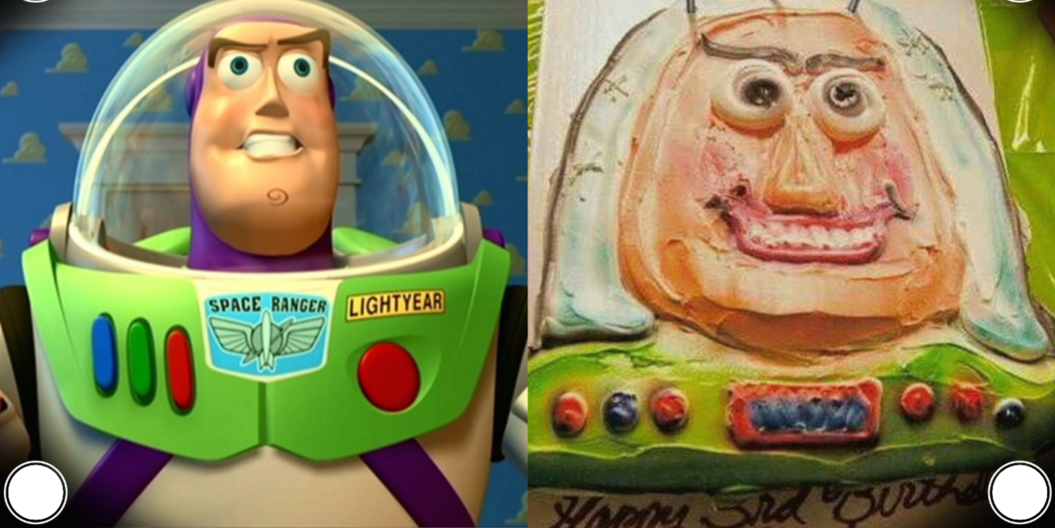

Slide 5
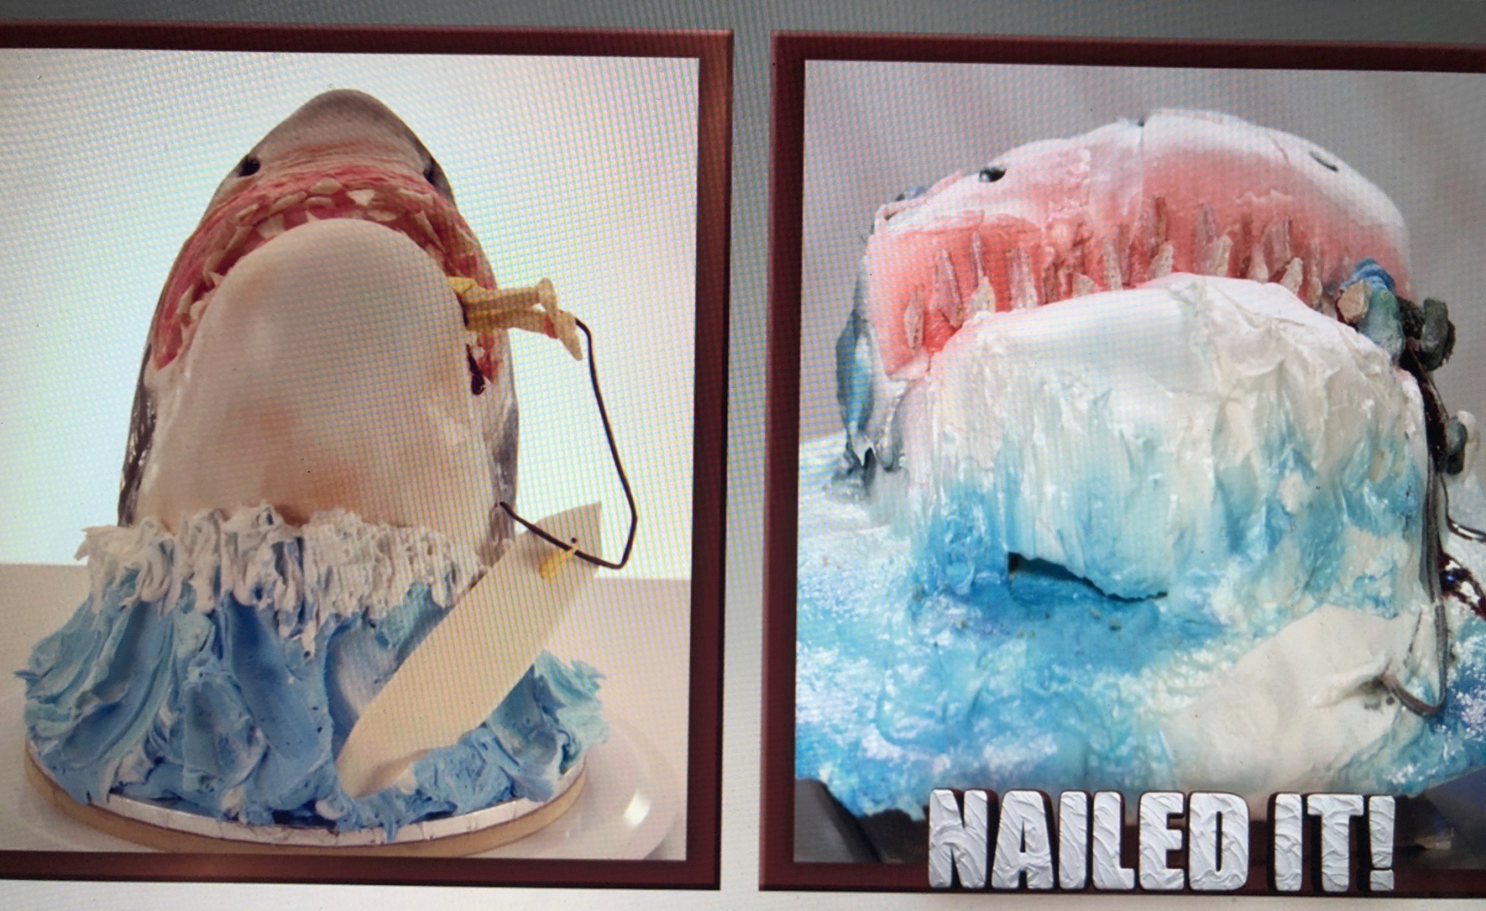

Slide 6
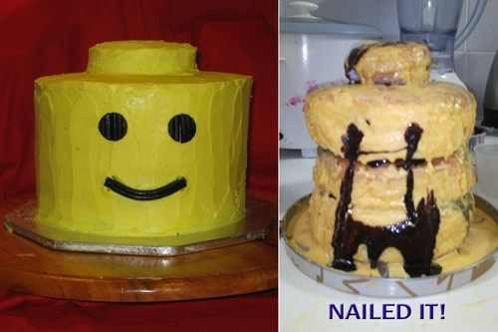

Slide 7
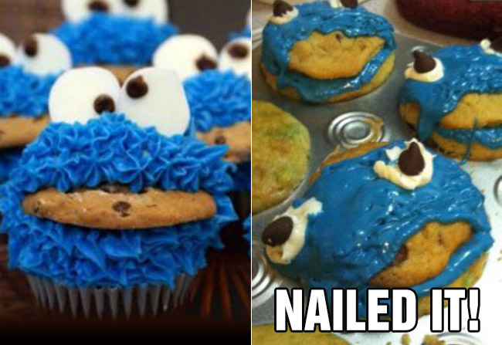

Slide 8
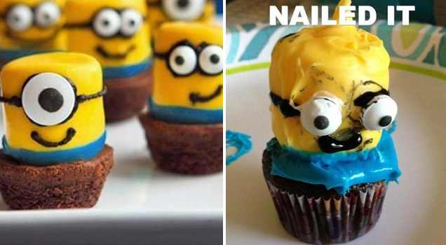

Slide 10
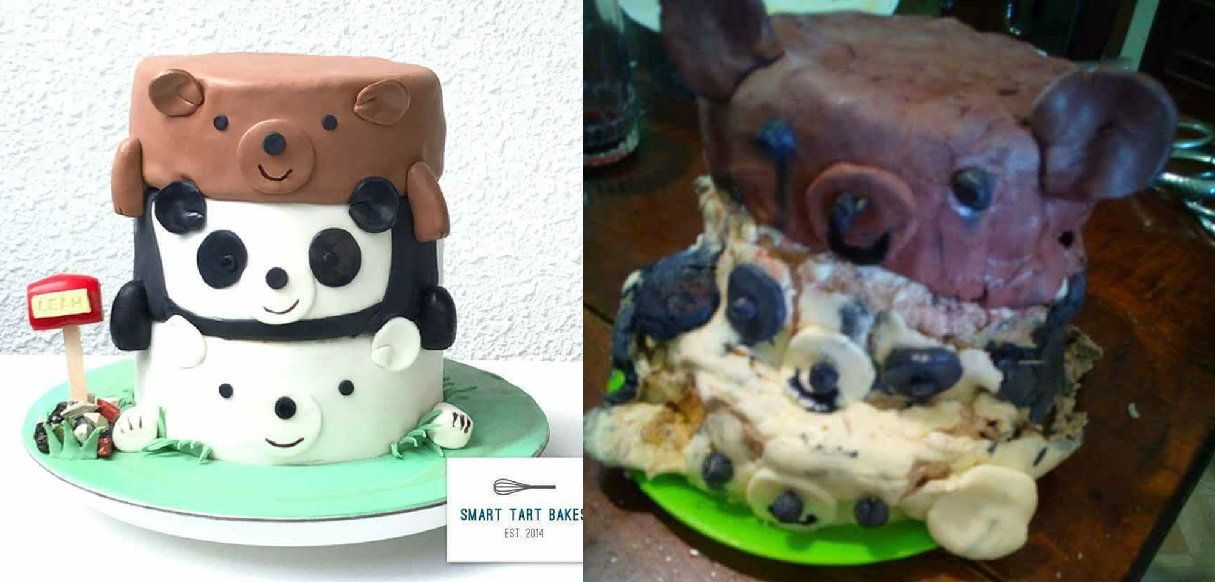

Slide 11
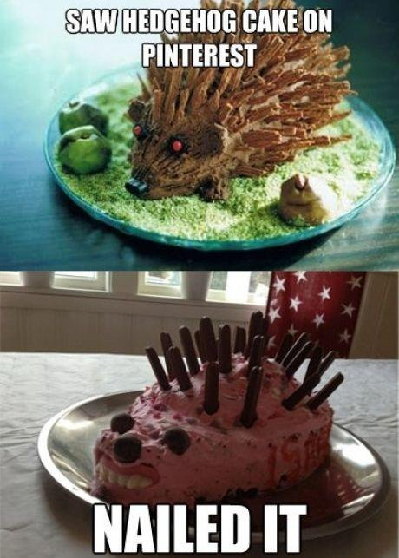

Slide 13
After Jacob had stayed with him for a whole month, Laban said to him, “Just because you are a relative of mine, should you work for me for nothing? Tell me what your wages should be.”

Slide 14
Now Laban had two daughters; the name of the older was Leah, and the name of the younger was Rachel. Leah had weak eyes, but Rachel had a lovely figure and was beautiful.

Slide 15
Jacob was in love with Rachel and said, “I’ll work for you seven years in return for your younger daughter Rachel.”

Slide 16
Laban said, “It’s better that I give her to you than to some other man. Stay here with me.” So Jacob served seven years to get Rachel, but they seemed like only a few days to him because of his love for her.

Slide 17
Then Jacob said to Laban, “Give me my wife. My time is completed, and I want to make love to her.” So Laban brought together all the people of the place and gave a feast.

Slide 18
But when evening came, he took his daughter Leah and brought her to Jacob, and Jacob made love to her. And Laban gave his servant Zilpah to his daughter as her attendant.

Slide 19
When morning came, there was Leah! So Jacob said to Laban, “What is this you have done to me? I served you for Rachel, didn’t I? Why have you deceived me?”

Slide 20
Laban replied, “It is not our custom here to give the younger daughter in marriage before the older one.

Slide 21
Finish this daughter’s bridal week; then we will give you the younger one also, in return for another seven years of work.”

Slide 22
And Jacob did so. He finished the week with Leah, and then Laban gave him his daughter Rachel to be his wife. Laban gave his servant Bilhah to his daughter Rachel as her attendant.

Slide 23
Jacob made love to Rachel also, and his love for Rachel was greater than his love for Leah. And he worked for Laban another seven years.
Genesis 29:14-30

Slide 25
When morning came, there was Leah!
Genesis 29:25

Slide 27
May the Lord make the woman who is coming into your home like Rachel and Leah, who together built up the family of Israel.
Ruth 4:11

