Slide 1
Blessed are those who find wisdom, those who gain understanding.
Proverbs 3:13

Slide 2
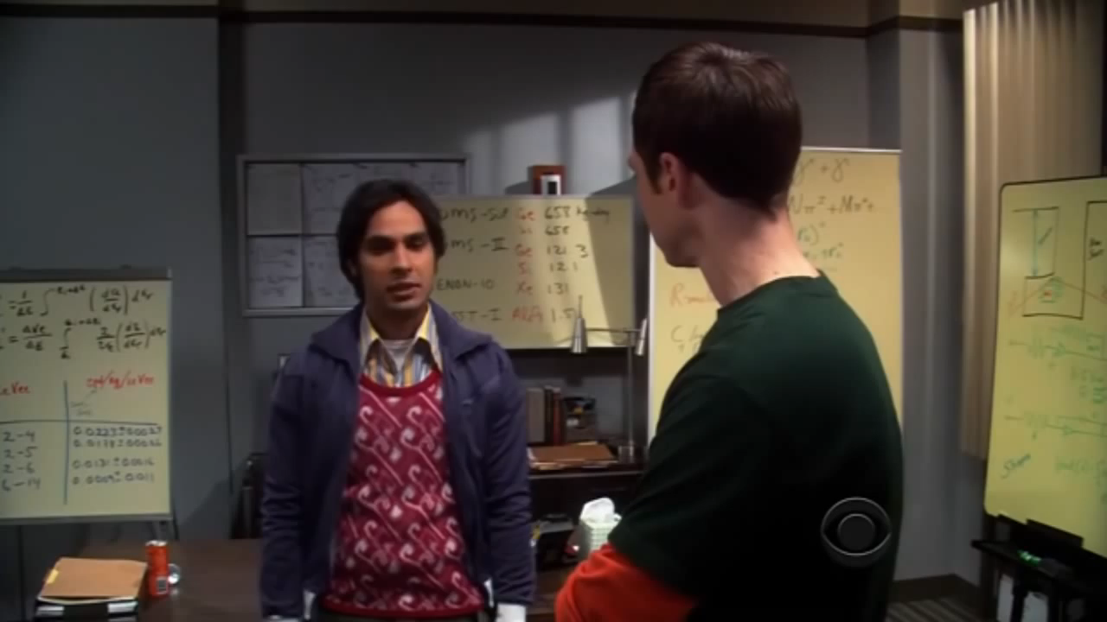

Slide 4


Slide 6
Wisdom has built her house...she has set her table. So pull up a seat and sit down. Eat and drink your fill. And be satisfied.
Will Gafney

